Slide 1
Train Fire Analysis GB Safety Data
Clifton Masdea - Risk & Safety Intelligence Analyst, RSSB
11 May 2023

Slide 2
Introduction: Train Fire Analysis
SMIS Data Analysis
Trend in train fires
European Data Analysis
Total European train fires
Summary
Arson/vandalism
Technical fires
Train fires by country
Injuries due to train fires
NFCC Project to develop a common definition of risk for railway incidents
RSSB meeting with Assistant Chief Fire Officer in Devon and Somerset on providing data to support NFCC project defining risk for railway incidents

Slide 3
SMIS Data Analysis

Slide 4
How has the data been selected?
Train fire events:
Annual count January 2006 – December 2022
All other data January 2022 – December 2022
Passenger and non passenger trains
Reportable events
Reportable | Not Reportable | Not applicable
Any fire internally or externally on a train or vehicle causing damage. If the fire brigade was called to extinguish the fire on any other vehicle (except passenger trains). If there was smoke which led to an evacuation of a passenger train If severe arcing or fusing caused damage. | If there is only smoke and no flames or evidence of fire damage. It is possible to have smoke without fire, e.g. traction motor overheating. If fire extinguishers were only used on smoke. | In depots, yards and sidings. Lineside fires.

Slide 5
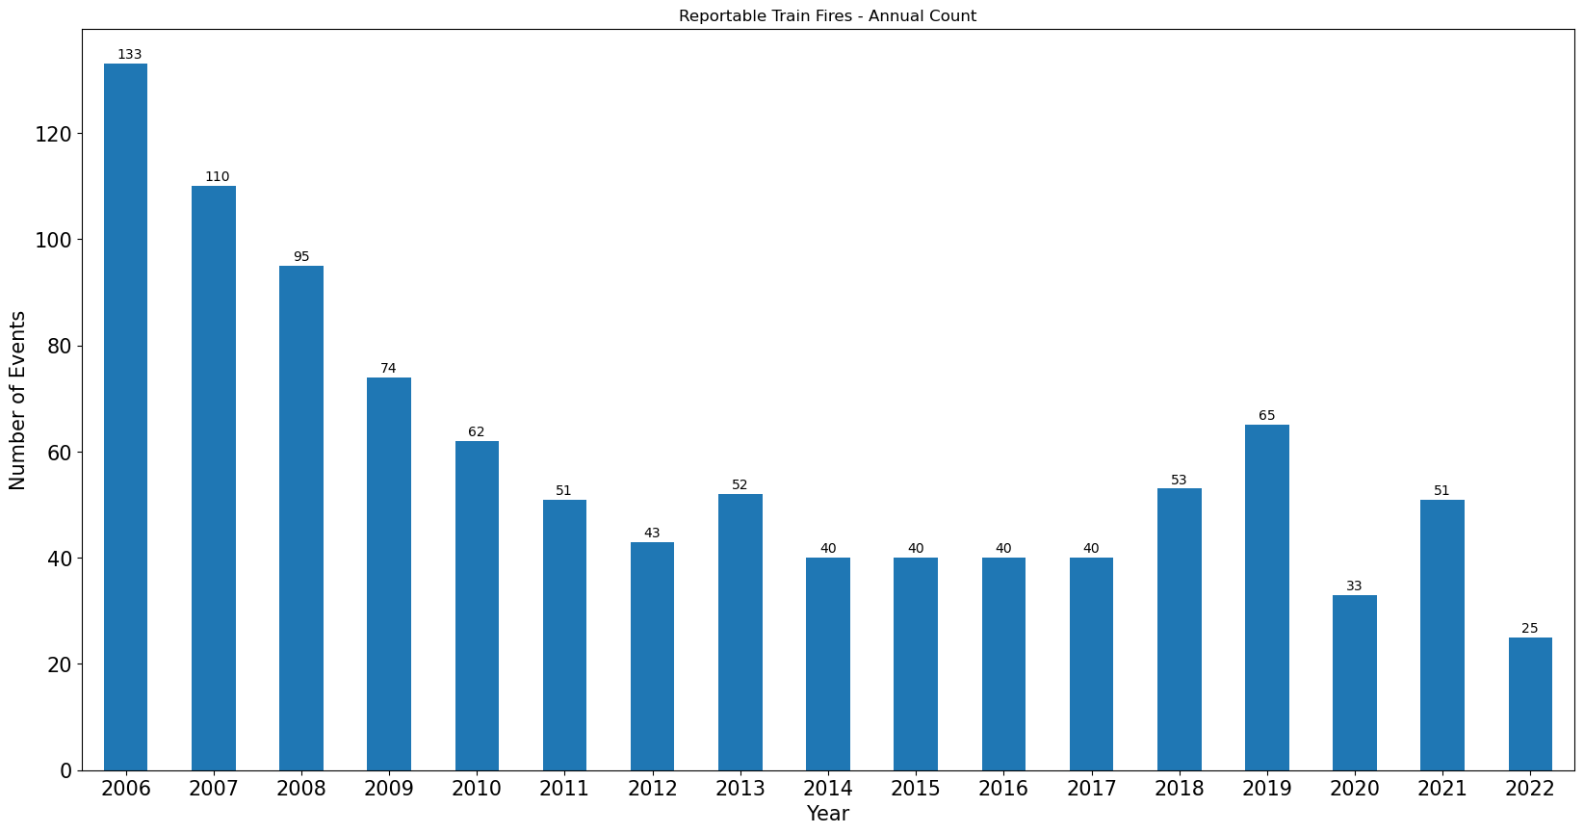
Reportable Train Fires – Annual Count (2006 – 2022)

Slide 6
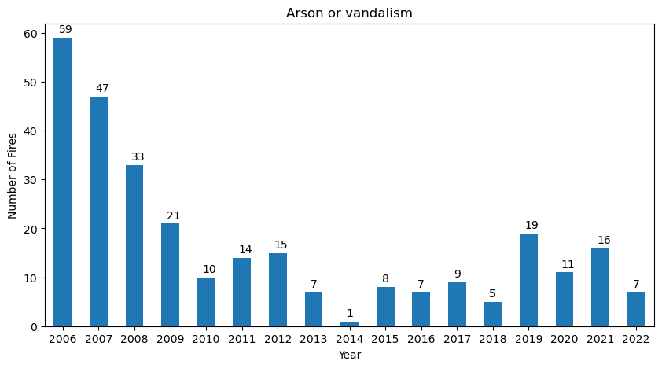
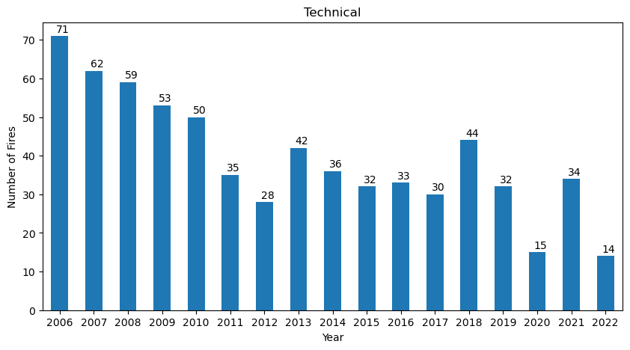
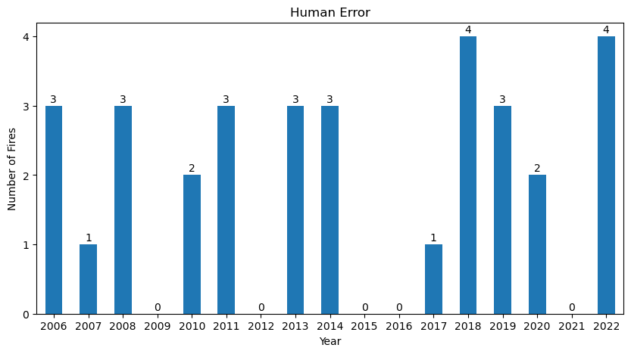
Reportable Train Fires – by case group (2006-2022)

Slide 7
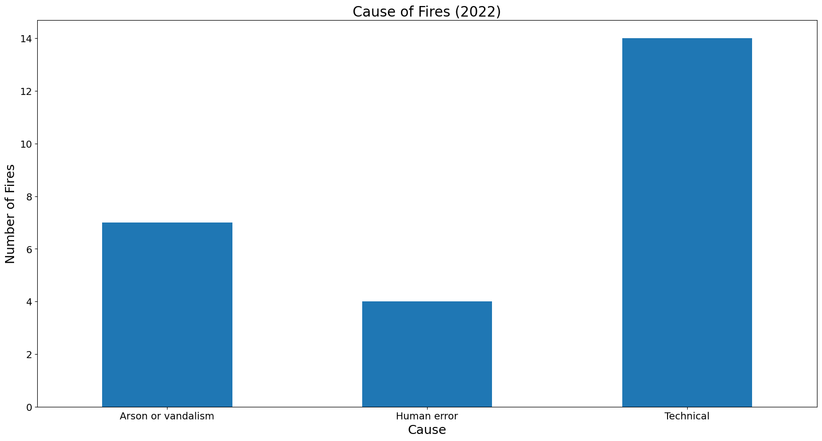
Reportable Train Fires by Cause (2022)

Slide 8
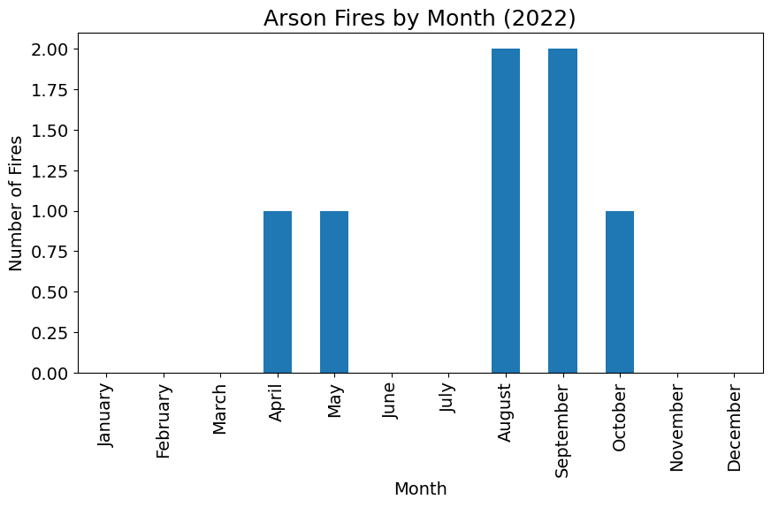
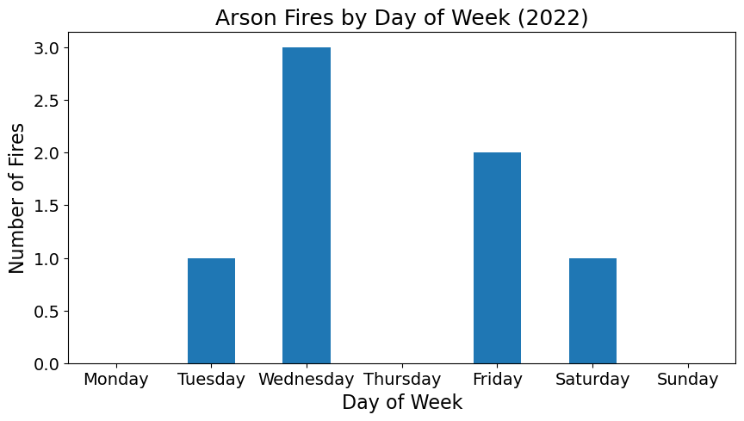
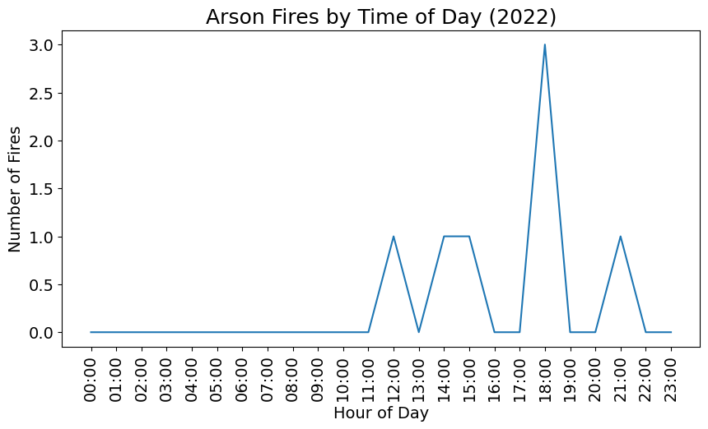
Arson/Vandalism Fires – Details: Time of Events (2022)

Slide 9
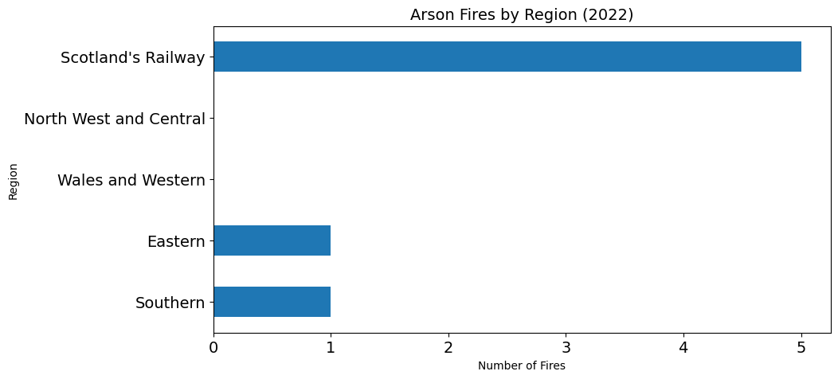
Arson/Vandalism Fires – Details: Locations (2022)

Slide 10
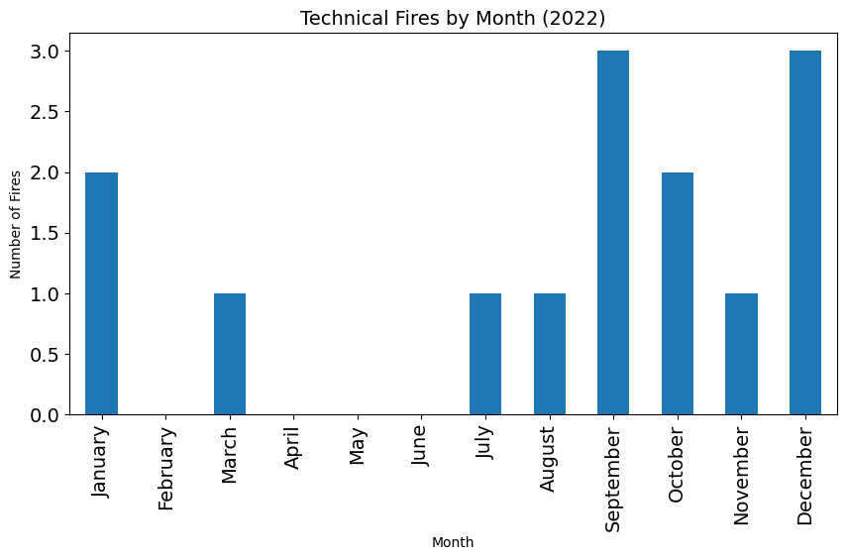
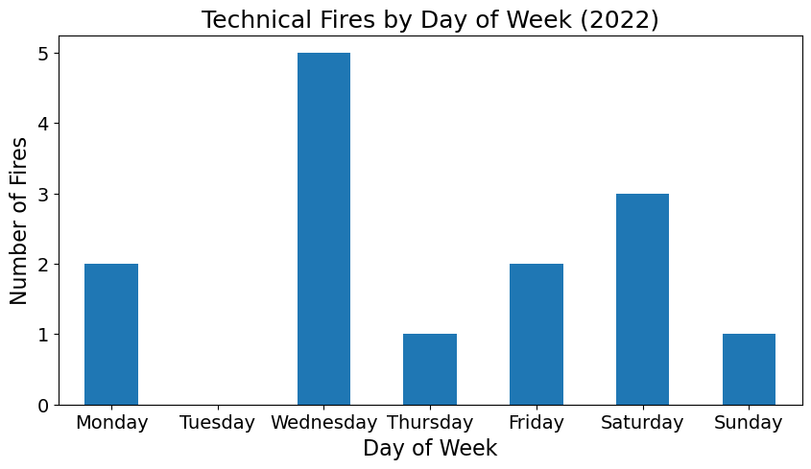
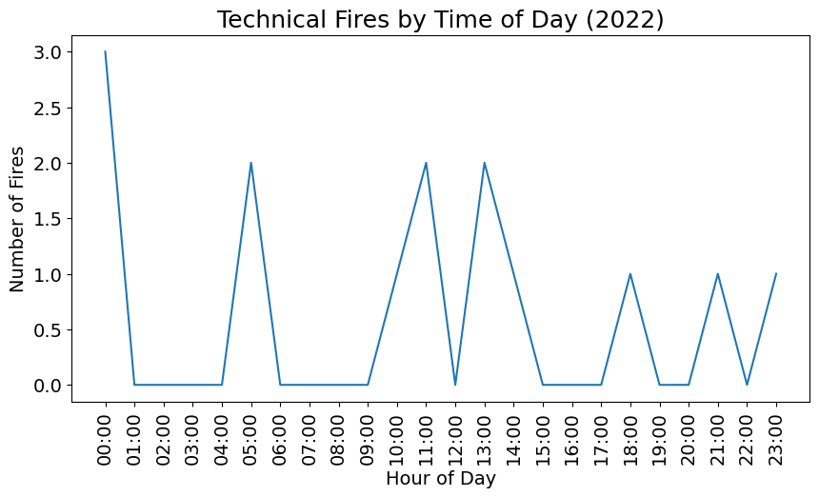
Technical Fires: Details – Time of Events (2022)

Slide 11
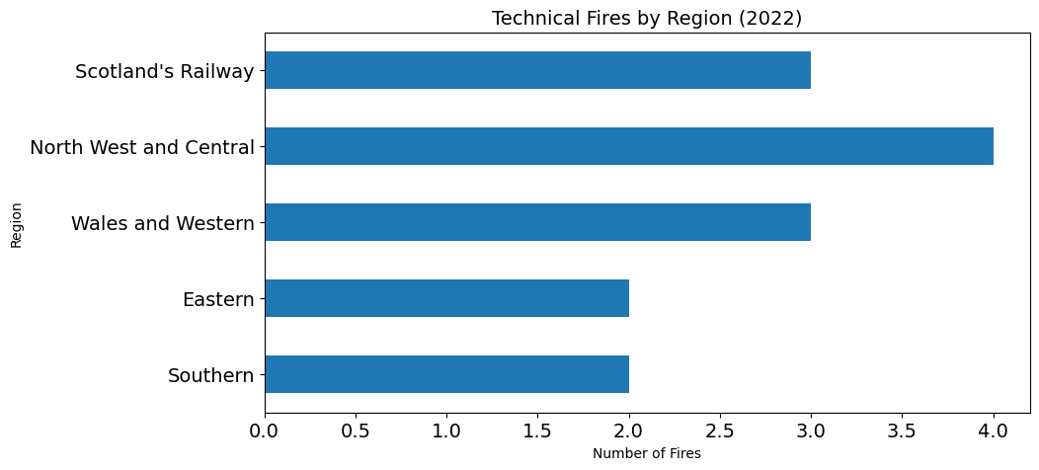
Technical Fires – Details: Locations (2022)

Slide 12
Additional Information
There was almost an an equal number of exterior and interior fires recorded:
Exterior – 13
Interior – 11
Unknown – 1
Action taken:
Burned out with no intervention – 3 events.
Fire service called – 6 events.
Workforce intervened – 10 events.

Slide 13
European CSI Data

Slide 14
Data Source
The following sets of data have been taken from the European Union Agency for Railways website.
It includes data from 27 European states.
Not all countries have latest mileage data, in this case an average percentage change since the last reported value has been used to estimate what the latest milage would be.
The latest data available is for 2021.
The following information can be publicly accessed:
Total number of fires in rolling stock
Number of fires in rolling stock relative to train kilometres
Number of persons killed due to fires in rolling stock
Number of persons seriously injured due to fires in rolling stock.

Slide 15
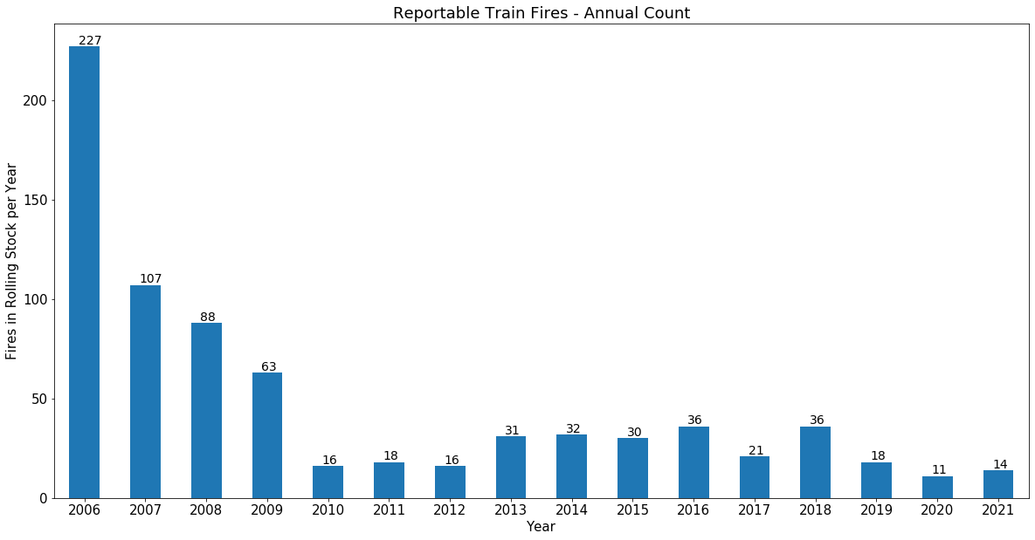
Number of Fires in Rolling tock Reported in CSI’s – all EU
Notes:
UK no longer reports to CSI

Slide 16
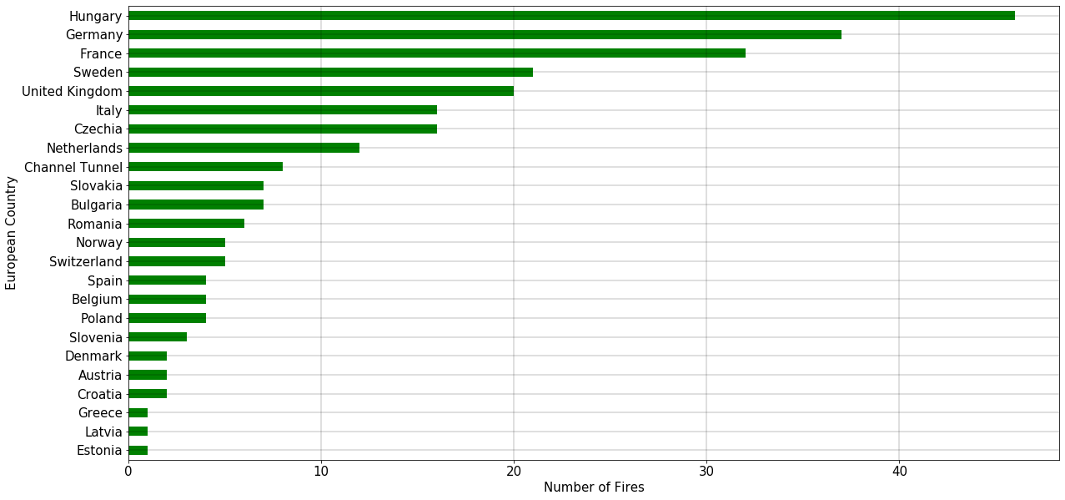
Count of fires in rolling stock reported in CSIs (2010-2021)

Slide 17
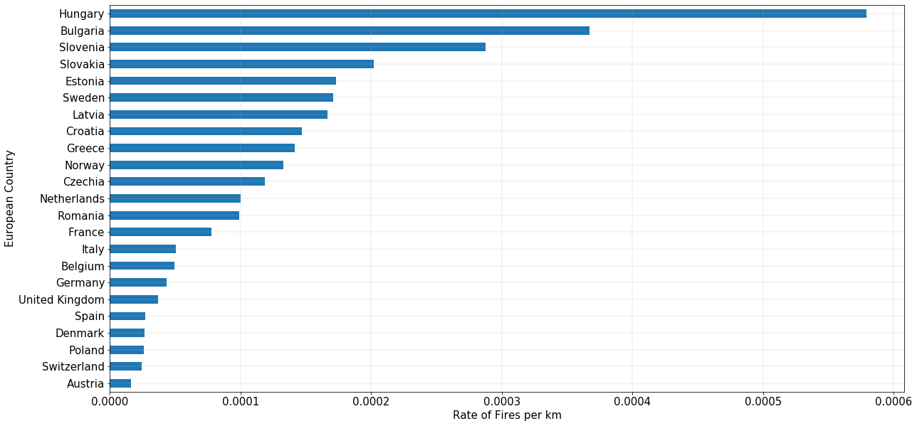
Rate of fires in rolling stock reported in CSIs (2010 – 2021)
Notes:
Some countries have larger train networks which is why there was a decrease in many (France for example)

Slide 18
Number of people killed or injured due to fire on rolling stock reported in CSIs over the last 6 years
 | 2016 | 2017 | 2018 | 2019 | 2020 | 2021
Passengers killed | 0 | 0 | 0 | 0 | 1 | 0
Passengers injured | 1 | 0 | 1 | 0 | 0 | 0
Workforce killed | 0 | 0 | 0 | 0 | 0 | 0
Workforce injured | 1 | 0 | 3 | 0 | 0 | 0
Other persons killed | 0 | 0 | 0 | 0 | 0 | 0
Other persons injured | 0 | 0 | 0 | 0 | 0 | 0
Total people killed | 0 | 0 | 0 | 0 | 1 | 0
Total people injured | 2 | 0 | 4 | 0 | 0 | 0

Slide 19
NFCC Project to develop a common definition of risk for railway incidents

Slide 20
Data to Support the NFCC definition of risk for Railway incidents
RSSB have been contacted by the Assistant Chief Fire Officer in Devon and Somerset as part of his role as the National Fire Chief Council (NFCC) lead for rail.
The NFCC have a project to develop common definition of risk across the UK linked to the incident types that they currently attend, as currently, all fire and rescue services have their own definitions.
The project has made good progress with Road Accidents with data being provided by organisations such as the DFT, however, they had struggled to find similar data for rail, until they were put in touch with RSSB via the Rail Delivery Group.
RSSB have been asked to provide national data from both SMIS and the Safety Risk Model (SRM) to help create a standardised definition of risk for railway related incidents and providing a better understanding of the frequency and risk of these events to help improve their national response to rail related incidents.
As well as Fire and Explosion events, some of the other types of incidents that they respond to on the Railway include:
Train collisions & Derailments
Trains striking animals & Road vehicles
Environmental contamination events
Personal accidents occurring in places where people cannot easily be reached
Lift failures
Infrastructure failures etc.

Slide 21
Summary

