Slide 1




Rule Book changes published in September 2023 –
Interactive Briefing Slide Deck
Please view in slideshow mode for the links to work.
The presentation is interactive. You decide how to navigate through it, (use the arrow buttons) but you can always return to the main menu by clicking on the home icon.
Some slides contain links to additional online content. These are indicated with this icon; click on the icon and it will take you to the content.
You can close the presentation at any time by clicking on the exit icon.

Slide 2


The following Rule Book Modules, Handbooks and Forms have been revised in the September 2023 Standards catalogue
GERT8000-HB10
Handbook 10
GERT8000-HB13
Handbook 13
GERT8000-HB19
Handbook 19
GERT8000-HB20
Handbook 20 (withdrawn)
GERT8000-HB21
Handbook 21 (withdrawn)
GERT8000-OTM
GERT8000-S5
GERT8000-S7
GERT8000-SS1
GERT8000-SS2
GERT8000-TW1
GERT8000-TW4
GERT8000- TW5
GERT8000-TS1
GERT8000-TS2
GERT8000- TS11
GERT8000-M1
GERT8000-M2
Rule Book histories
and briefing notes
Rule Book Forms
Glossary

Slide 3




Changes to Standards – September 2023
GERT8000-HB10 Issue 5 – Handbook 10 Duties of the COSS or SWL and person in charge when
using a hand trolley
Following an accident in which a train struck an unlit trolley left on the line, a recommendation was made that a trolley must always carry a red light, and that the use of a red flag, which might be less effective, is no longer allowed.
Safe work leader (SWL) is no longer a recognised competency and all references have been removed. It will always be a COSS who carries out the relevant rules.
To remove gender-specific language from the Rule Book, the term ‘manned’
level crossings has been replaced by ‘manually-controlled’. This change was
previously published in the December 2022 Periodical Operating Notice.
To improve clarity, an explanation has been included, that in this handbook
‘person in charge’ means the person referred to as the ‘person in charge of
the trolley’.
There is an existing instruction concerning not stopping a trolley within two
metres of an axle counter head, unless rest arrangements have been agreed.
This has been included in the handbook for completeness.
RU
IM
Suppliers

Slide 4

Changes to Standards – September 2023
GERT8000-HB13 Issue 5 – Handbook 13 Duties of the person in charge of the siding possession
(PICOS)
It has been pointed out that when taking possession of part of a siding, a sleeper may not be readily available or be easy to handle. A derailer is now allowed as an alternative.
This protection is only required when there is a need to avoid movements approaching the part of the siding under possession. These are: that part of the siding is unsafe for any movements; the work would make it unsafe; or that anyone is going to work on or near that part of the siding.
Safe work leader (SWL) is no longer a recognised competency and all references have been removed. It will always be a COSS or IWA who carries out the relevant rules.
As it will not always be a shunter that is present, the rule now says that it may be a person in charge of train movements that is told.
RU
IM
Suppliers

Slide 5
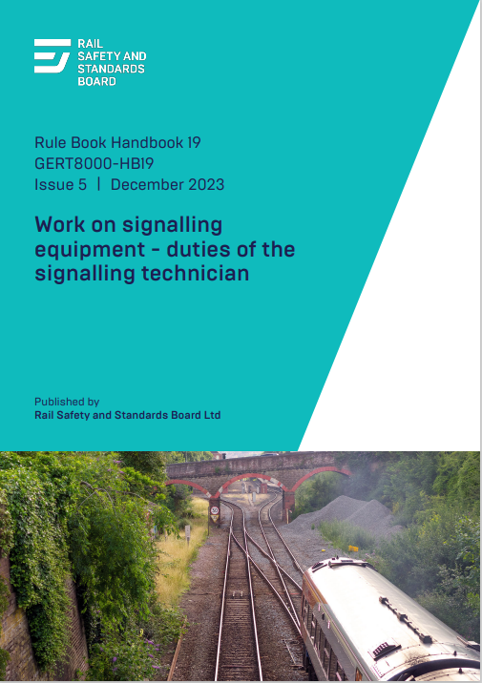
Changes to Standards – September 2023
GERT8000-HB19 Issue 5 – Handbook 19 Work on signalling equipment – duties of the signalling technician
Gender-specific language removed from the Rule Book. The term ‘pilotman’ has been replaced by ‘pilot’. This change was previously published in the December 2022 Periodical Operating Notice.
Safe work leader (SWL) is no longer a recognised competency and all references have been removed.
There has been an incident in which signal engineering work being carried out from outside the limits of a possession had the effect of disconnecting equipment with it. A Form RT3187 will now be used to record the details of equipment affected during a possession when the person in charge of that work is not located within the limits of the possession. This is intended to avoid a similar incident in the future.
RU
IM
Suppliers

Slide 6
Changes to Standards – September 2023
GERT8000-HB20 Handbook 20 – Issue 4 (Withdrawn)
Safe work leader (SWL) is no longer a recognised competency and this handbook has been withdrawn. It will be a COSS who carries out the equivalent rules.
GERT8000-HB21 Handbook 21 – Issue 5 (Withdrawn)
Safe work leader (SWL) is no longer a recognised competency and this handbook has been withdrawn. It will be an TWA, COSS or PC who carries out the equivalent rules.
GERT8000-OTM Issue 11 – Working of on-track machines (OTM)
All OTMs can now be relied upon to operate track circuits, and all the rules referring to ones that cannot have been removed.
An OTM on which a track circuit actuator (TCA) has failed will, as now, be dealt with as shown in module TW5.
Safe work leader (SWL) is no longer a recognised competency and all references have been removed.
RU

Slide 7
Changes to Standards – September 2023
GERT8000-Module S5 Issue 11 – Passing a signal at danger or an end of authority (EoA) without a movement authority (MA)
Section 2.3 has been corrected. A signaller has never been required to observe personally that a facing point lock is properly engaged, but can rely on being told this. The wording did not say this.
It has been pointed out that section 4.6 can also apply to movements towards semaphore shunting signals. The rule has been changed to include these, and the terminology has been altered to agree with other references in the Rule Book to ‘position-light signals not associated with a main aspect signal’. An instruction to ‘obey all other signals’ has been removed. Although these words have often been used, they have never been a Rule Book requirement.
Section 8 has been changed to say that it only applies to a signal box on an absolute block line. This is the intended meaning, and in fact, is the only time it can happen, but it has been included for clarity.
In the same section, the requirement concerning level crossings is now stated to apply to any type of level crossing which is more correct.
Section 9.3 has been changed. All ERTMS trips have been dealt with as though they are the equivalent of passing a signal at danger. In practice, trips can be caused by a variety of reasons. This section will now only apply when an end of authority (EoA) has been passed without authority. All other ERTMS trips will be dealt with as shown in module S7.
To remove gender-specific language from the Rule Book, the term ‘pilotman’ has been replaced by ‘pilot’.
RU
IM
Suppliers

Slide 8
Changes to Standards – September 2023
GERT8000-Module S7 Issue 6 – Observing and obeying signalling indications. Train warning
systems. Reporting signalling failures and irregularities
Section 8.3 has been changed. All ERTMS trips have up until now been treated as though they were the equivalent of a signal passed at danger. In practice, there are a considerable number of reasons for a trip, and only those that involved an end of authority (EoA) without authority have to be dealt with as shown in module S5.
When a trip occurs, the driver must tell the signaller what indications are shown on the DMI before acknowledging the trip. If this allows them to decide that the trip has not been caused by passing an EoA, the signaller will complete form RT3188, which has been revised to include ERTMS trips, and the train can continue its journey.
The instructions concerning a report from a driver of a signal that is difficult to see because of trees, foliage or other obstructions have been expanded following discussion of a case where this was reported. It was not clear whether the signal was to be treated as defective, and there was no requirement to obtain details that would be useful to signal engineering staff in responding to the report.
If a driver reports difficulty in seeing a signal, the signaller must stop the next train and ask the driver to report whether the signal is difficult to see. The driver must also be asked to say which aspects or indications are difficult to see and whether a junction indicator is affected.
If the driver reports the signal is not difficult to see, trains can be allowed to proceed normally.
If the signal is reported as difficult to see, it must be treated as a defective signal not showing a correct aspect or indication. Trains must only be allowed to approach the defective signal as shown in regulation 7.1 or 8.1 of module TS11. If the signal is a junction signal, the forward route must be set. Form RT3185 has been updated to include these new instructions.
Trains must continue to be dealt with in this way until a signalling technician advises that normal working can be resumed.
RU
IM
Suppliers

Slide 9
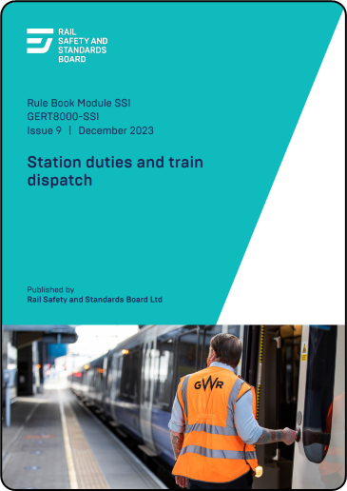
Changes to Standards – September 2023
GERT8000-Module SS1 Issue 9 – Station duties and train dispatch
The arrangements for blocking a line when it is necessary to go onto the line to retrieve an item that has been dropped will now also apply if an object is to be retrieved from the platform by using equipment such as grabbers without going onto the line. The risks to the person concerned would be similar in either case.
Section 2.5 has been changed so that it refers to the corresponding situation on an ERTMS line. In that case, the signaller’s permission is required before moving a train after station duties have been completed if this would mean the train is to move towards the end of its movement authority which is within or shortly beyond the station platform.
As it was not mentioned in section 3.8, that section has been changed to include defective on-train cameras or monitors as reasons why an alternative method of dispatching a DO train from an unstaffed platform are necessary.
RU
IM
Suppliers

Slide 10
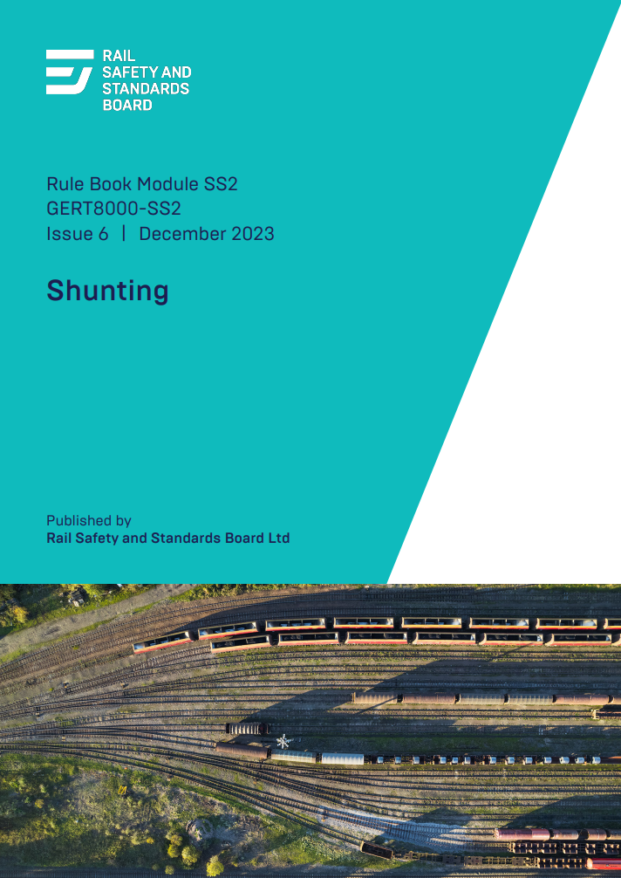
Changes to Standards – September 2023
GERT8000-Module SS2 Issue 6 – Shunting
‘Pushing through’ trailing points is a long-established practice, but where more robust point mechanisms have been introduced, it has a potential for causing damage. Section 4.2 has been amended in the Periodical Operating Notice since 2021 to say this must not be done unless it is permitted by local operating instructions. Those instructions would be issued if the operator responsible for the location has confirmed that there are trailing points at the location of a type that can be ‘pushed through’ without any risk of damage.
Section 9.4 requires a red or white light to be placed on the end of vehicles
stabled on dead-end lines. This is on the assumption that those vehicles would
not be visible to any approaching movement. This has now been changed to
say that this is not necessary if this is allowed by a local instruction. That
instruction would be issued if it has been confirmed that lighting conditions
are sufficiently good for the vehicles to be clearly visible.
Safe work leader (SWL) is no longer a recognised competency and the
reference in section 10.2 has been removed. It will always be an ES who
carries out the relevant rule.
RU
IM
Suppliers

Slide 11
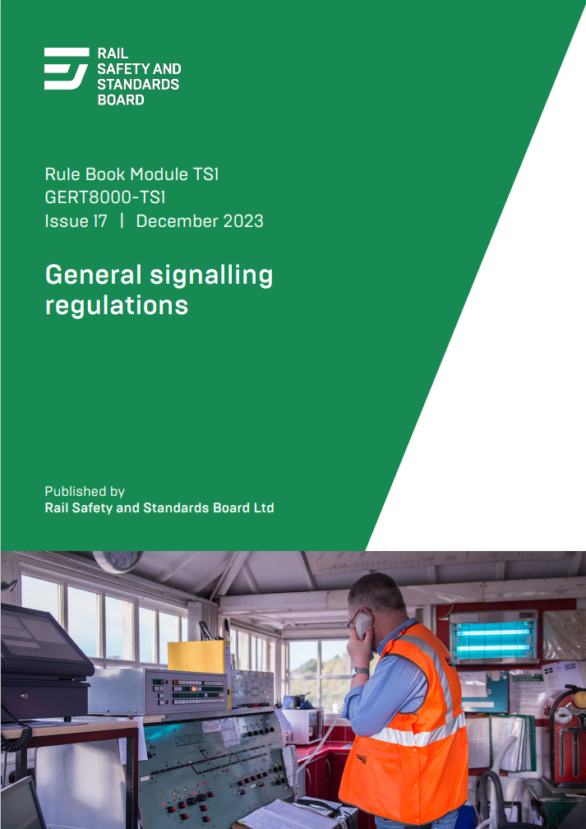
Changes to Standards – September 2023
GERT8000-Module TS1 Issue 17 – General signalling regulations (slide 1 of 2)
Regulations 3.5.1 and 3.5.2 have been changed to refer to the use of reminder appliances on route setting positions so that the equivalent actions on an ERTMS line are dealt with more completely.
Regulation 10.2 now includes a reference to the equivalent situation on an ERTMS line, which is that this will be done before the signaller a train operating in ERTMS to begin a propelling movement.
All OTMs can now be relied upon to operate track circuits, and references in regulation 12.1 to ones that cannot have been removed.
An OTM on which a track circuit actuator (TCA) has failed will, as of now, be dealt with as shown in module TW5.
The arrangements in regulation 13.1 for blocking a line when it is necessary to go onto the line to retrieve an item that has been dropped will now also apply if an object is to be retrieved from the platform by using equipment such as grabbers without going onto the line. The risks to the person concerned would be similar in either case.
Safe work leader (SWL) is no longer a recognised competency and all references have been removed. The regulations will always be carried out by someone with one of the alternative competencies.
RU
IM
Suppliers
TS1 Continued

Slide 12
Changes to Standards – September 2023
GERT8000-Module TS1 Issue 17 – General signalling regulations (slide 2 of 2)
An explanation is now included of the purpose of using a staff or token as additional protection. This is to prevent a train being permitted to enter a single line where there is a line blockage.
Regulation 17.1.3 has been changed, as it was found that the instructions for dealing with a report of one broken fishplate of a pair were different from those that are applied by track engineers.
If this report is made by a rail defect examiner (RDE), a rail defect nominee (RDN) or someone carrying out a basic visual inspection, trains can continue to run over the line affected providing the train has been stopped and the driver told not to pass over the broken fishplate at more than 20 mph (30 km/h). Trains can pass normally over any adjacent line.
This must continue until the defect is repaired, an RDE or competent engineer authorises a higher speed, or an emergency speed restriction is imposed.
If the report is from an RDN, or an RDN attends the site before any authorisation is received from an RDE or competent engineer, the RDN will examine the fishplate fixings to make sure they are secure. The RDN will tell the signaller that this is the case and will then remain on site to make sure the defect does not worsen. If this does happen, for example, the other fishplate brakes, the RDN will tell the signaller, and the instructions in regulation 17.1.2 for a pair of broken fishplates will apply.
RU
IM
Suppliers
TS1 Back

Slide 13
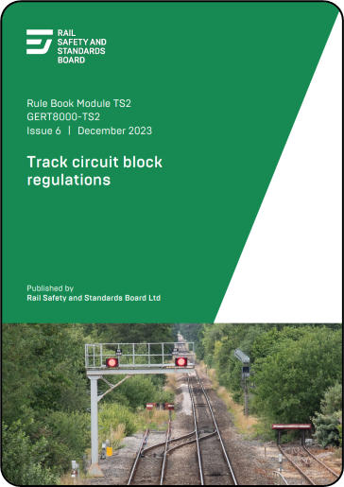
Changes to Standards – September 2023
GERT8000-Module TS2 Issue 6 – Track circuit block regulations
Regulation 3.3 contains instructions for the signaller concerning the management of permissive movements on platform lines. This includes making sure there is room to accommodate the second train, and that two trains are not allowed to be moving within the same signal section.
In some cases, the use of automatic route setting, or controls within the
signalling system will avoid the need for the signaller to carry out these checks.
The regulation has been rewritten to say that a signaller will not have to do so
if the signalling equipment at that location will prevent the situations arising.
To remove gender-specific language from the Rule Book, the term ‘pilotman’
has been replaced by ‘pilot’. This change was previously published in the
December 2022 Periodical Operating Notice.
RU
IM
Suppliers

Slide 14
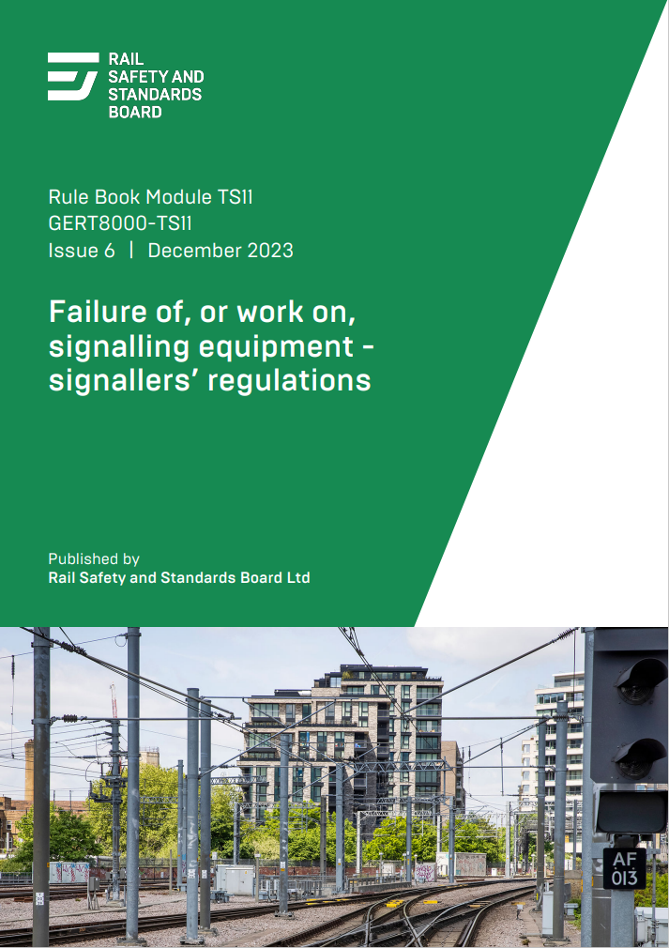
Changes to Standards – September 2023
GERT8000-Module TS11 Issue 6 – Failure of, or work on, signalling equipment – signallers’
regulations
There has been an incident in which signal engineering work being carried out from outside the limits of a possession had the effect of disconnecting equipment with it. A Form RT3187 will now be used to record the details of equipment affected during a possession when the person in charge of that work is not located within the limits of the possession. This is intended to avoid a similar incident in the future.
To remove gender-specific language from the Rule Book, the term ‘pilotman’ has been replaced by ‘pilot’. This change was previously published in the December 2022 Periodical Operating Notice.
RU
IM
Suppliers

Slide 15
Changes to Standards – September 2023
GERT8000-Module TW1 Issue 19 – Preparation and movement of trains (slide 1 of 2)
Section 1 was amended in December 2022 to include situations in which the unsolicited brake application had reduced the speed of the train, as well as having brought it to a stand. However, train protection systems such as ERTMS will reduce the speed of trains by a small amount, which is a normal function and is not reportable to a signaller. Section 1 has been changed again so that it only applies if a train has been brought to a stand. This amendment was previously published in the March 2023 Periodical Operating Notice.
Section 29.1 concerning the responsibilities of a conductor driver and 39.1 (now 40.1) on using the train radio safely have been changed so that they explain the corresponding arrangements on an ERTMS line.
Instructions originating in European legislation and carried forward in this country place some restrictions on using manual sanding equipment near points and crossings and other situations as this can cause infrastructure damage or failures. A new section 30 has been introduced to say that this should be avoided except in situations where it is necessary. For trains fitted with automatic sanding apparatus, a train operating company can issue instructions allowing the equipment to be isolated in these circumstances. This would be done if the train operator considered it appropriate.
Because this new section has been introduced, the subsequent sections 30 to 37 have been renumbered 31 to 48.
RU
IM
Suppliers
TW1 Continued

Slide 16
Changes to Standards – September 2023
GERT8000-Module TW1 Issue 19 – Preparation and movement of trains (slide 2 of 2)
Questions have been raised about the need to display a red light on the rear of vehicles stabled on dead-end platform lines where there is a red light on the buffer stop. This is referred to only in module SS2 for shunting movements but is also relevant to train movements. Section 37.2 (previously 36.2) has been changed to include a new instruction to say that the display of a red light is not necessary when train operating company instructions permit this. That instruction would be issued if it has been confirmed that lighting conditions are sufficiently good for the vehicles to be clearly visible.
Safe work leader (SWL) is no longer a recognised competency and the reference in the new section 48 has been removed. The rule will always be carried out by an engineering supervisor.
New instructions have been included in the new section 40 concerning GSM-R radio. When this has failed in the leading cab, a person competent to make or respond to a railway emergency call (REC) and to stop a train in an emergency can be located in another cab on the train with a working radio. Direct cab-to-cab communication must be available. The purpose of this new arrangement is to allow a train to proceed with an alternative means of radio communication that can be used in an emergency.
The competent person will be required to make a REC when requested by the driver, or if unable to speak to the driver when an emergency is suspected.
If a REC is received, the competent person must stop the train, listen to the REC and tell the driver.
RU
IM
Suppliers
TW1 Back

Slide 17
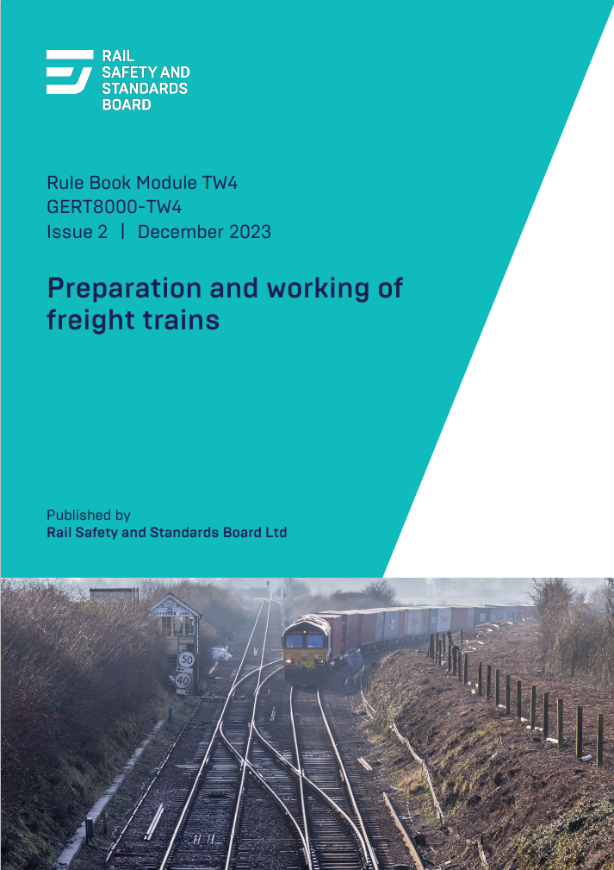
Changes to Standards – September 2023
GERT8000-Module TW4 Issue 2 – Preparation and Working of Freight Trains
Following a change in regulations, a small change has been made to the definition of high-consequence dangerous goods as far as class 5.1 is concerned.
Additional UN numbers 2908 to 2911 have been added to the list of those not always requiring warning placards.
It has been suggested that the instructions concerning carriage of dangerous goods in a wagon on which the brakes are isolated are not completely clear following the last revision, when no specific instruction was included. To clarify this, section 9.5 has been changed to state that this is permitted as long as the marshalling requirements for wagons with isolated brakes in section 2.6 are carried out.
Difficulties have arisen with the movement of empty coaching stock trains which are subject to ‘out-of-gauge’ conditions. A new section 6.5 has been introduced explaining that when this is necessary, such trains can be operated with train identities of ‘’3X—’ or ‘%X—’.
RU
IM
Suppliers

Slide 18
Changes to Standards – September 2023
GERT8000-Module TW5 Issue 12 – Preparation and movement of trains: Defective or isolated
vehicles and on-train equipment
A new alternative arrangement has been introduced when GSM-R radio has become defective in the leading cab. This gives some additional ability to have a working radio for emergency situations.
This involves a competent person being located in another cab with a working radio, who is able to make or respond to RECs.
Cab-to-cab communication must be available.
If it is possible to provide portable GSM-R equipment within 75 miles, this should be done rather than making use of a competent person.
RU
IM
Suppliers

Slide 19
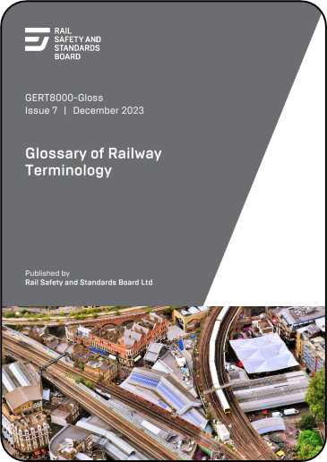
Changes to Standards – September 2023
Glossary
A new definition of additional protection for line blockages has been added, which explains that additional protection is an additional safeguard against a train being allowed towards a line blockage and is an added safeguard to the primary protection of keeping a signal at danger.
It is applied independently of that action to reduce the chances of accidental removal.
This definition has been introduced following a request to provide some clarity to the use of the term.
RU
IM
Suppliers

Slide 20
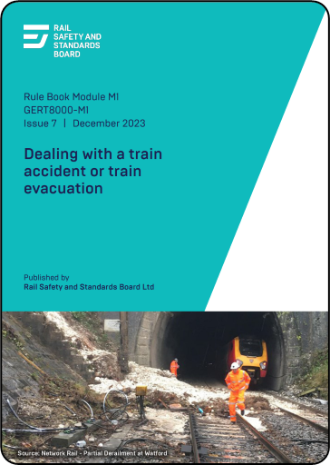
Changes to Standards – September 2023
GERT8000-Module M1 Issue 7 – Dealing with a train accident or train evacuation
A review has been carried out of the use of detonators as a form of protection.
It will no longer be necessary to use detonators to protect a portion of a divided train that has been left in section.
Instead, a red light must be displayed on the rear of the divided portion, and a white light on the front. Instructions have been introduced for signallers and drivers dealing with a train entering a section as an assisting train to remove a portion of a divided train, which have previously not been spelt out.
A dedicated briefing webpage has been created, containing videos showing the revised process in action and the roles of players involved, downloadable flowcharts and an interactive self-assessment form.
RU
IM
Suppliers

Slide 21
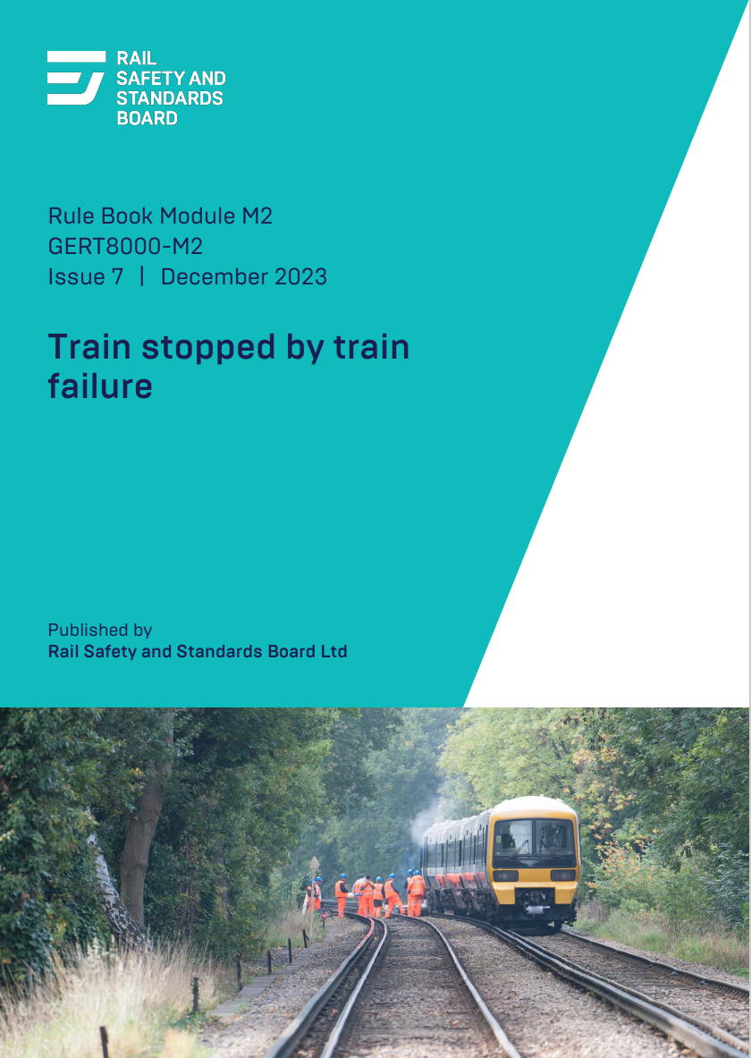
Changes to Standards – September 2023
GERT8000-Module M2 Issue 7 – Train stopped by train failure (slide 1 of 2)
These rules have been reviewed as part of a wider consideration of reducing the use of detonators. Risk assessment work has demonstrated that the possible risks to a driver leaving the failed train are greater than the contribution of detonators to reducing the risk of collision between the assisting train and the failed train.
Based on the findings of that work the rules have been changed so that the
driver of the failed train is no longer required to place assistance protection, but
will normally remain with the failed train.
This requires the signaller to put the two drivers in communication by GSM-R,
principally so that the driver of the assisting train can be given as exact info
as possible about the location of the failed train, and any other relevant details.
The assisting train, as well as being required to proceed at caution, must not
exceed a speed of 25 mph (40 km/h) at any point. This speed approximates to
the required braking distance that would be available under the present rules
if the assisting train had not stopped at the assistance protection point and
exploded detonators at approximately 300 metres from the failed train.
RU
IM
Suppliers
M2 Continued

Slide 22
Changes to Standards – September 2023
GERT8000-Module M2 Issue 7 – Train stopped by train failure (slide 2 of 2)
GSM-R communication is not a requirement if the failed train can clearly be seen from the location where the assisting train is waiting to proceed towards it, as this method of communication would add little to an understanding of where the failed train is situated.
However, if GSM-R communication cannot be set up during poor visibility, the driver of the failed train is still required to leave that train and meet the assisting train at a location normally the same as the former assistance protection point. The rules cater for a variety of circumstances including those in which emergency protection is required during emergency special working or temporary block working. In that situation, the rules explain the actions of the driver of the failed train, which are not made clear at present.
As there is no longer a need to provide assistance protection, section 1.5 has been deleted. This means that the present exemption from any of the requirements in this module on a permissive line no longer applies, as there is no obvious reason why they should be any different.
A dedicated briefing webpage has been created, containing videos showing the revised process in action and the roles of players involved, downloadable flowcharts and an interactive self-assessment form.
RU
IM
Suppliers
M2 Back

Slide 23
Changes to Standards – September 2023
Four Rule Book forms have been revised
Form RT3185 Reporting a signal / AWS / TPWS / ATP / TVM failure or irregularity (issue 12/23)
RU
Form NR3189 Signal Passed at Danger (SPAD) or Train Trip or Unauthorised Movement (Issue 2)
IM
Form RT3188 Activation of TPWS or ERTMS trip (issue 12/23)
Suppliers
Form RT3973NUC Advice to Train Crews – Conveyance of Radioactive Flask

Slide 24
Changes to Standards – September 2023
The following Rule Book histories and briefing notes have been revised
GERT8001 Issue 79 – Changes to National Operations Publications for September 2023
RU
GERT8000-RBBL Issue 39 – Rule Book Briefing Leaflet
IM
GERT8000 Issue 36 – Rule Book Module Issue History
Suppliers
GERT8000 Issue HB Issue 17 – Rule Book Handbook Issue History

