Slide 1
Changes to Standards – December 2023 Interactive Briefing Slide Deck Please view in slideshow mode for the links to work.
The presentation is interactive. You decide how to navigate through it, (use the arrow buttons) but you can always return to the main menu by clicking on the home icon
Some slides contain links to additional online content. These are indicated with this icon, click on the icon and it will take you to the content.
You can close the presentation at any time by clicking on the exit icon.

Slide 2
Changes to Standards – December 2023
Changes to standards in the December 2023 Standards Update
Deviations granted against standards September 2023- December 2023
Draft standards in the pipeline for consultation and publishing in 2024
Click on a button to proceed to that section

Slide 3
Changes in the December 2023 Standards Update
Data, Systems, and Telematics
Plant
Rolling Stock
0 new standards
2 new Technical Notes
0 new standards
Control, Command, and Signalling
Non-RSSB standards
Infrastructure
0 new standards
2 new standard
3 new standards and 3 new posters
Energy
Rail-related legislation
Operations
1 Rule Book point release
0 new standards
Updates to Safety and Interoperability legislation and Guidance
Click on the icons with red rings for more detail on those changes

Slide 4
Changes to Standards – December 2023
Two new Rolling Stock Technical Notes have been published in the December 2023 Standards catalogue.
TN111 Issue 1 - Cyber Security Essentials This technical note sets out types of cyber security control measures that may be put in place when designing a new component or function to help mitigate against malicious or non-malicious cyber-attacks on operational and information technology software systems on rolling stock.
TN112 Issue 1 - Driver-Controlled and Driver Only Operation On-Train Camera Monitoring Systems This technical note provides additional guidance to RIS-2703-RST Issue 2 - Driver Controlled Operation (DCO) On-Train Camera/Monitors (OTCM).
Click on the link to go to the Technical Note on the RSSB website

Slide 5
Changes to Standards – December 2023
One Rule Book point release has been revised in the December 2023 Standards catalogue
GERT8000-T3 Issue 11.1 - Possession of a running line for engineering work. Following a recent incident in which an OTM entered a possession at an intermediate point without getting the necessary authority from the PICOP or the signaller, instructions in T3 on who can give that authority have been amended. Sections 9.1 a) and 9.1 c) have been changed to say where a PICOP, ES, or a competent person on their behalf will meet the train, which will depending on where the train is to enter the possession. Section 9.1 b) has not been changed as the PICOP when authorising the movement from an adjacent siding will give the driver any necessary instructions.
This change has also been reflected in the following manuals
GERM8000 – Signaller and signalling technician Manual Issue 13.1
GERM8000 – Train Driver Manual Issue 13.1
GERM8000 – Possession workers Manual Issue 9.1
Click on the link to go to the Rule Book Module on the RSSB website

Slide 6
Changes to Standards – December 2023
Two Infrastructure standards have been revised in the December 2023 Standards catalogue
RIS-7707-INS Issue 1 - Switches and Crossings
GCRT5021 Issue 6 - Track System Requirements
Click on a play button to find out more about the change

Slide 7
Changes to Standards – December 2023
RIS-7707-INS Issue 1 - Switches and Crossings
Overview – RIS-7707-INS issue one Switches and Crossings is a new rail industry standard that includes requirements and guidance for the identification, design, and maintenance of S&C. It includes requirements for point identification to facilitate a consistent approach for industry. It addresses facing point locks, detection, and train-operated points.
Following a review of GCRT5021 issue five Track System Requirements, those requirements specific to S&C deemed out of scope of railway group standards, and which are valid and useful to the rail industry, have been retained in RIS-7707-INS. The requirements are supported by rationale and guidance.
Benefits – In conjunction with GCRT5021, RIS 7707 INS contributes to the estimated total value to industry of £1.83 million over five years.
Audience – This standard will be of interest to project entities, infrastructure managers and railway undertakings, as well as designers and suppliers of S&C components and point equipment.
RU
IM
Suppliers
Project Entities
Designers

Slide 8
Changes to Standards – December 2023
GCRT5021 Issue 6 - Track System Requirements
Overview – GCRT5021 sets out requirements and guidance for track geometry, track systems, and track components to provide for the safe guidance and support of rail vehicles.
Issue six incorporates the amendments, deviations, and clarifications which have been submitted since the publication of issue five. It also includes findings from RSSB research report T1073 and research report COF UOH 59 (2023), including The requirements regarding cant deficiency at switch toes.
The standard now only contains requirements that are in the scope of Railway Group Standards (RGS). Requirements relating to S&C that were previously contained within issue 5, but which are outside the scope of RGS, have been incorporated into Rail Industry Standard, RIS-7707-INS.
Benefits – The benefits from this issue are realised in three areas:
1. Potential to improve line speeds resulting from the changed curving rules could provide a cost benefit of around £233,000 over five years.
2. By defining lower track loading parameters to reduce track design, installation, and maintenance costs a saving of £1.6 million over five years could be achieved.
3. This update has reduced the number of national technical rules. This means less approved body assessments facilitating efficiencies and reduced costs in the design and project phases.
Audience – This issue can benefit all those who are involved in the design, installation, and maintenance of the track system, including Track designers, Infrastructure managers and Project entities
IM
Project Entities
Designers

Slide 9
Changes to Standards – December 2023
Three new pieces of Safety and Interoperability related legislation and guidance have been published
Safety – Guidance on Entities in charge of maintenance (ECMs)
Safety - The Private Crossings (Signs and Barriers) Regulations 2023 (S.I. 2023/1112)
Interoperability - Extension of CE mark recognition
Click on a play button to find out more about the change65

Slide 10
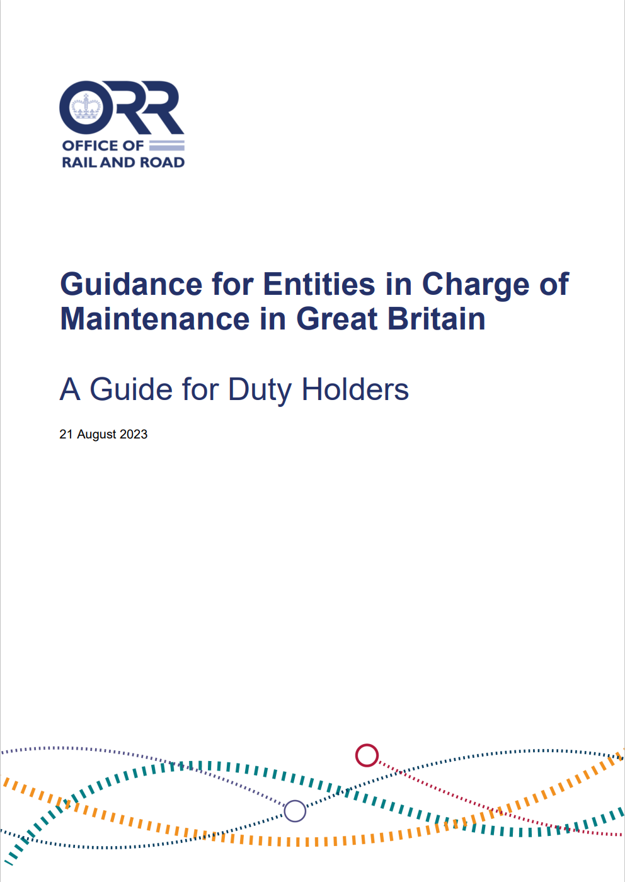
Changes to Standards – December 2023
Guidance on Entities in charge of maintenance (ECMs)
Overview – The Department for Transport (DfT) and the Office of Rail and Road (ORR) have jointly published revised guidance on the requirements for entities in charge of maintenance (ECMs) in Great Britain. This follows amendments made to the Railways and Other Guided Transport Systems (Safety) Regulations 2006 (ROGS) to end the recognition of EU-issued ECM certificates for domestic-only-use freight wagons on 30 June 2023.
The revised guidance, Guidance for Entities in Charge of Maintenance in Great Britain (published 29 August 2023), can be found on the ORR website. It will be of particular interest to ECMs, certification bodies, wagon keepers, and railway undertakings responsible for the maintenance or operation of vehicles involved in domestic and cross-border services.
RU
IM
Suppliers

Slide 11
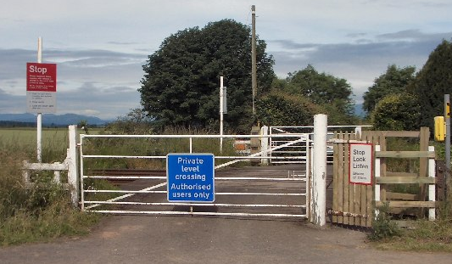
Changes to Standards – December 2023
The Private Crossings (Signs and Barriers) Regulations 2023 (S.I. 2023/1112)
Overview – The Department for Transport (DfT) laid before Parliament on 26 October 2023 the Private Crossings (Signs and Barriers) Regulations 2023 (S.I. 2023/1112) (the 2023 Regulations), which enter into force on 18 November 2023. They prescribe the type, design, and size of signs and barriers to be placed near private level crossings on the rail network in Great Britain.
The 2023 Regulations replace the Private Crossings (Signs and Barriers) Regulations 1996 (S.I. 1996/1786) (the 1996 Regulations), which previously prescribed the type, design, and size of barriers.
The DfT states in the explanatory memorandum to the 2023 Regulations that it does not expect the changeover to new signs by operators of private level crossings on the mainline network to be complete until at least 2029.
The 2023 Regulations were made following two public consultations and the Government’s response to these consultations.
The signage in the 2023 Regulations is in English but DfT will be consulting in due course on proposals to legislate for signage in Welsh at private level crossings in Wales.
RU
IM

Slide 12
Changes to Standards – December 2023
Extension of CE mark recognition
Overview – The Department for Business and Trade (DBT) recently announced its intention to extend indefinitely the recognition of the CE marking for placing
most goods on the market in Great Britain. CE marking indicates that the manufacturer or importer affirms the goods’ conformity with European health, safety, and environmental protection standards.
This CE marking recognition approach will apply to regulations covering 18 sectors that the DBT is responsible for. As part of the Government’s drive for smarter regulation, the extension will cut business costs and the time required to place products on the market and benefit consumers. This decision was taken following extensive engagement with industry, delivering on a key ask from businesses to ease burdens and boost growth for the UK economy. Further information on this can be found on the Government website.
For rail products regulated under the Railways (Interoperability) Regulations 2011, the DfT is reviewing its policy on the recognition of EU conformity assessments in light of the intention to extend recognition of the CE marking. No decisions have been taken yet and the DfTs current position remains that it will end recognition of EU conformity assessment documentation for rail interoperability constituents and subsystems at the end of 2024.
RU
IM
Suppliers

Slide 13
Changes to Standards – December 2023
Three Non-RSSB standards and three posters have been published on the RSSB website
COP0025 Issue 5 - Code of Practice for Brake Testing of OTP
COP0125 Issue 5 - Code of Practice for Management of Sidings Safety Surveys
COP0128 Issue 3 - Code of Practice for Route Knowledge within Possessions
Poster I3 Issue 3 - Seasonal Operating of OTP
Poster L8 Issue 3 - OTP Mechanical Movement Limiting Device Awareness
Poster L9 Issue 3 - Rail Handling – Rail Turner Awareness
Click on the title to access the standard on the RSSB website

Slide 14
Five deviations have been published since September 2023
23-028-DEV; GERT8000-SS1 Issue 9 - Station duties and train dispatch. Use of illuminated dispatch batons alone during degraded dispatch of Elizabeth Line train services vice platform mounted train dispatch equipment at five platforms on the Elizabeth Line route
23-019-DEV; GERT8000‑HB8 Issue 9 - IWA, COSS or PC blocking a line. Application of an ACOD in axle counter areas in a line blockage where EPR has been applied
23-035-DEV; GIRT7020 Issue 2 - GB Requirements for Platform Height, Platform Offset and Platform Width. Temporary deviation allowing the hoarding line at 2m away from the platform edge at Kildale Railway Station
23-037-DEV; GIRT7020 Issue 2 - GB Requirements for Platform Height, Platform Offset and Platform Width. Temporary deviation allowing the hoarding line at 2m away from the platform edge at Prudhoe Railway Station.
23-030-DEV; GERT8402 Issue 2 - ERTMS/ETCS DMI National Requirements Speed display in mph only for Class 345 units, this is an extension of deviation application 19‑046‑DEV, that has now expired
Click on the title to access the deviation on the RSSB website

Slide 15
Standards in the pipeline for publishing in March 2024
TN110 Issue 1 - Compliance with noise and vibration legislation
GMGN2460 Issue 1 Withdrawal ‐ Guidance on Compliance with Noise and Vibration Legislation in the Railway Environment
RIS-2712-RST Issue 1.2 - Forward Facing CCTV
Draft standards in the pipeline for consultation in December 2023
RIS‐0793‐CCS Issue 1 ‐ Level Crossing System Integration
RIS‐0792‐CCS Issue 1 Withdrawal ‐ Level Crossing Operational Interfaces with Trains

Slide 16
Draft standards in the pipeline for consultation in January 2024
GKRT0057 Issue 2 ‐ Lineside Signal and Indicator Product Design and Assessment Requirements
GKGN0657 Issue 1 ‐ Guidance on Lineside Signal and Indicator Product Design and Assessment Requirements
RIS‐2701‐RST Issue 2 ‐ Rail Industry Standard for NDT Processes on Rail Vehicles
GMGN2460 Issue 1 Withdrawal ‐ Guidance on Compliance with Noise and Vibration Legislation in the Railway Environment

Slide 17
Draft standards in the pipeline for consultation in February 2024
RIS‐2702‐RST Issue 3 ‐ In‐service Examination and Reference Limits for Freight Wagons
GMGN2641 Issue 1.1 ‐ Guidance Note on Vehicle Static Testing
GMRT2141 Issue 4.2 ‐ Permissible Track Forces and Resistance to Derailment and Roll‐Over of Railway Vehicles
RIS‐2761‐RST Issue 2 ‐ Rail Industry Standard for Driving Cabs

Slide 18
Draft standards in the pipeline for consultation in March 2024
GERT8000 TW1 Issue 21 ‐ Preparation and movement of trains
GERT8000 TW5 Issue 14 ‐ Defective or isolated vehicles and on-train equipment
GMGN2694 Issue 1 ‐ Rolling Stock Subsystems and Electromagnetic Compatibility with CCS Subsystems

Slide 19
Draft standards in the pipeline for consultation in April 2024
RIS‐3771‐TOM Issue 1 ‐ Operation of Route and Line Proving Trains
GERT8000 HB1 Issue 8 ‐ General duties and track safety for track workers
GERT8000 HB8 Issue 10 ‐ IWA, COSS or PC blocking a line
GERT8000 TS1 Issue 18 ‐ General Signalling Regulations
GERT8000 TW1 ‐ Issue 20 ‐ Preparation and movement of trains

Slide 20
Draft standards in the pipeline for consultation in April 2024 (continued)
GERT8000‐SP Issue 7 ‐ Speeds
GERT8000 TW7 Issue 10 ‐ Wrong Direction Movements
RIS‐0733‐CCS Issue 2 ‐ Lineside Operational Signs
Draft standards in the pipeline for consultation in May 2024
RIS‐3751‐TOM Issue 4 ‐ Rail Industry Standard for Train Driver Selection

Slide 21
Draft standards in the pipeline for consultation in June 2024
GMRT8073 Issue 5 ‐ Application of Standard Vehicle Gauges
Draft standards in the pipeline for consultation in July 2024
RIS‐2704‐RST Issue 2 ‐ Rail Industry Standard for Wheelsets Handling and Storage
RIS‐2709‐RST Issue 2 ‐ Rail Industry Standard for the Identification of Roller Bearings Defects
RIS‐8034‐INS Issue 2 ‐ Maintenance of Signal and Operational Sign Visibility

Slide 22
Draft standards in the pipeline for consultation in August 2024
RIS‐3789‐TOM Issue 1 ‐ Medical Fitness Requirements
RIS‐3451‐TOM Issue 2 ‐ Train Drivers ‐ Suitability and Medical Fitness Requirements
RIS‐3452‐TOM Issue 2 ‐ Train Movement ‐ Medical Fitness Requirements
GOGN3655 Issue 2 Withdrawal ‐ Guidance on Medical Fitness for Railway Safety
RIS‐0386‐CCS Issue 2 ‐ Rail Industry Standard on Signal Overrun Risk Evaluation and Assessment

Slide 23
Draft standards in the pipeline for consultation in August 2024
RIS‐3787‐TOM Issue 1 ‐ Secondary Communications in the Absence of GSM‐R
GERT8000‐M1 Issue 7 ‐ Dealing with a train accident or train evacuation
GERT8000‐M2 Issue 7 ‐ Train stopped by train failure
GOGN3677 Issue 2 Withdrawal ‐ Guidance Note on the Provision of Lineside Telephones

