Slide 1




Changes to Standards –
March 2021 interactive briefing slide deck
Please view in slideshow mode for the links and audio to work
The presentation is interactive, you decide how to navigate through it, but you can always return to the main menu by clicking on the home icon.
Some slides contain links to additional online content, these are indicated with an icon.
This presentation contains audio content. An icon will appear in the top left hand corner when it is playing.

Slide 2
Changes to Standards – March 2021
Changes to the Standards Framework in 2021
Changes to standards in March 2021
Click on a button to proceed to that section

Slide 3





Changes to the Standards Framework in 2021
Changes to Standards – March 2021
With the UK no longer part of the European Union and new trade deals secured and in place, the legislative framework surrounding Railway standards has changed a little…..

Slide 4
With the UK no longer part of the European Union and new trade deals secured and in place, the legislative framework surrounding Railway standards has changed a little…..

Slide 5
EU Directives
e.g. The Safety Directive 2004/49
EU Regulations -
Common Safety Methods
EU Regulations -
Technical Specifications
for Interoperability
EU Directives
e.g. The Interoperability Directive 2008/57
National Operations Publications (NOPs)
e.g. The Rulebook
UK Regulations e.g. The Railways and Other Guided Transport System (Safety) Regulations 2006
UK Regulations e.g. The Railways (Interoperability) Regulations 2011
European Standards
(BS EN)
Rail Industry
Standards (RIS)
National Rules
e.g. Railway Group Standards (RGS)
Rail industry
Guidance (GN)
All the requirements that were in place in 2020 are still in place now, but they might have slightly different names or titles

Slide 6
EU Directives
e.g. The Safety Directive 2004/49
EU Regulations -
Common Safety Methods
UK Technical Standards –
National Technical Specification Notices (NTSNs)
EU Regulations -
Technical Specifications
for Interoperability
EU Directives
e.g. The Interoperability Directive 2008/57
National Operations Publications (NOPs)
e.g. The Rulebook
UK Regulations e.g. The Railways and Other Guided Transport System (Safety) Regulations 2006
UK Regulations e.g. The Railways (Interoperability) Regulations 2011
European Standards
(BS EN)
Rail Industry
Standards (RIS)
National Rules
e.g. Railway Group Standards (RGS)
Rail industry
Guidance (GN)
All the requirements that were in place in 2020 are still in place now, but they might have slightly different names or titles
RSSB with industry support, still drafts and publishes Rail Industry Guidance Notes, Rail Industry Standards, The Rule Book and National Rules, badged as Railway Group Standards.

Slide 7
EU Regulations -
Common Safety Methods
European Standards
(BS EN)
UK Technical Standards –
National Technical Specification Notices (NTSNs)
UK Regulations e.g. The Railways and Other Guided Transport System (Safety) Regulations 2006
UK Regulations e.g. The Railways (Interoperability) Regulations 2011
National Operations Publications (NOPs)
e.g. The Rulebook
National Rules
e.g. Railway Group Standards (RGS)
Rail Industry
Standards (RIS)
Rail industry
Guidance (GN)
RSSB with industry support, still drafts and publishes Rail Industry Guidance Notes, Rail Industry Standards, The Rule Book and National Rules, badged as Railway Group Standards.
These documents are managed through the Code and Manual, which specifies when information we can draft and the process we must follow when we do.

Slide 8
Definition
Decision to proceed
Idea evaluation
Drafting
Idea form on RSSB website
Idea
Draft
consensus
National Rules
e.g. Railway Group Standards (RGS)
Rail Industry
Standards (RIS)
Rail industry
Guidance (GN)
National Operations Publications (NOPs)
e.g. The Rulebook
Manged through the Code and Manual
Review
Consultation
Implementation
Revision
Publication
Approval
These documents are managed through the Code and Manual, which specifies when information we can draft and the process we must follow when we do.
If you would like any of these documents changed or have an idea for a new standard, then you can find details of how to request this under the standards tab on the RSSB website

Slide 9
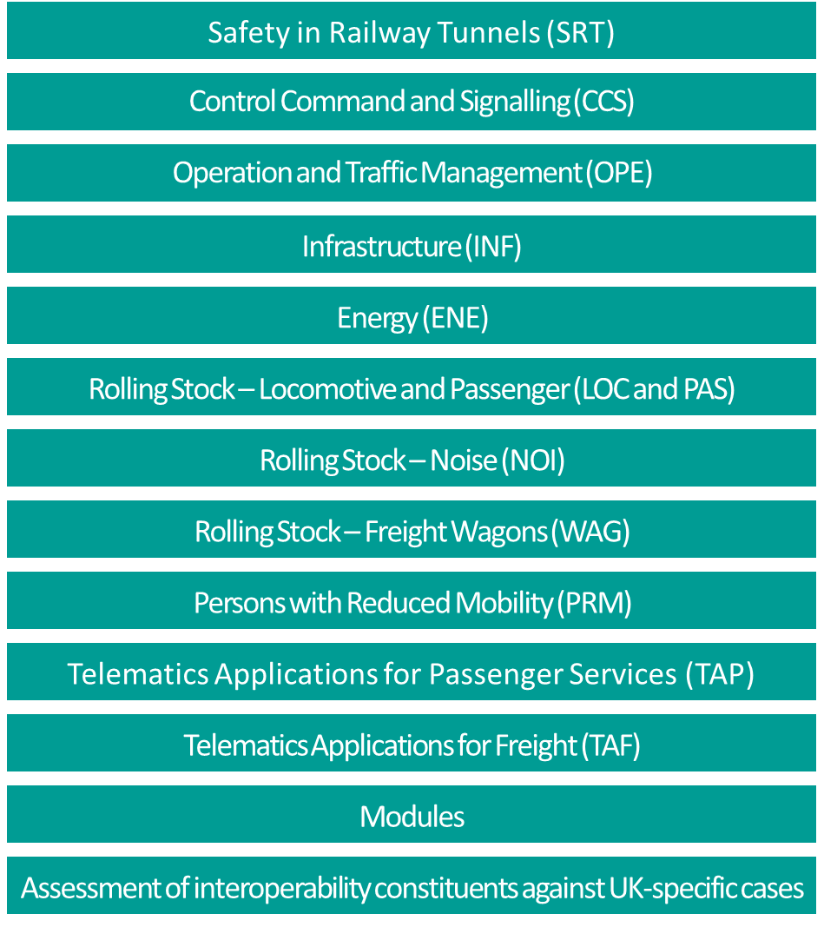
EU Regulations -
Common Safety Methods
European Standards
(BS EN)
UK Technical Standards –
National Technical Specification Notices (NTSNs)
UK Regulations e.g. The Railways and Other Guided Transport System (Safety) Regulations 2006
UK Regulations e.g. The Railways (Interoperability) Regulations 2011
Amended
Amended
National Operations Publications (NOPs)
e.g. The Rulebook
National Rules
e.g. Railway Group Standards (RGS)
Rail Industry
Standards (RIS)
Rail industry
Guidance (GN)
The Rail Industry still has the same suite of UK legislation in place, as we did in 2020, although some of it has been amended to reflect the UK’s position after leaving the EU
New though in 2021 is a suite of UK technical regulations, called National Technical Specification Notices (NTSNs)
They replace the European Regulations - The Technical Specifications for Interoperability (TSIs), which are no longer valid in the UK.

Slide 10
EU Regulations -
Common Safety Methods
European Standards
(BS EN)
UK Technical Standards –
National Technical Specification Notices (NTSNs)
UK Regulations e.g. The Railways and Other Guided Transport System (Safety) Regulations 2006
UK Regulations e.g. The Railways (Interoperability) Regulations 2011
Amended
Amended
National Operations Publications (NOPs)
e.g. The Rulebook
National Rules
e.g. Railway Group Standards (RGS)
Rail Industry
Standards (RIS)
Rail industry
Guidance (GN)
There are currently 13 NTSNs published by the Department of Transport, they have the same technical requirements as the TSIs abut are now only applicable in the UK

Slide 11
DfT reviews against gov. policy
RSSB drafts
BCfC
SC develops recommendation
RSSB develops the Proposal & rationale
ISCC agrees recommendation
✓
✓
✓
✓
✓
✓
Need to change/ diverge
from TSI
DfT agrees update
UK Technical Standards –
National Technical Specification Notices (NTSNs)
SC reviews fitness for industry
NTSN Published
SoS
Signed by Secretary or State
Industry Consultation
Parliamentary scrutiny
DfT legal and economic scrutiny
RSSB reviews & amends
When a reason for updating an NTSN is identified, for example by a change request made by industry or if the corresponding TSI is changing, it will triggers a process managed by RSSB,
but unlike RSSB published standards, the revised NTSN has to be agreed by parliament (including publishing a parliamentary statement) and is signed off by the Secretary of State.

Slide 12
Common safety method for supervision by national safety authorities
EU Regulations -
Common Safety Methods
European Standards
(BS EN)
UK Technical Standards –
National Technical Specification Notices (NTSNs)
Common safety method for risk evaluation and assessment
UK Regulations e.g. The Railways and Other Guided Transport System (Safety) Regulations 2006
UK Regulations e.g. The Railways (Interoperability) Regulations 2011
Common safety method assessing conformity with the requirements for obtaining railway safety certificates
National Operations Publications (NOPs)
e.g. The Rulebook
National Rules
e.g. Railway Group Standards (RGS)
Common safety method for assessing conformity with the requirements for obtaining a railway safety authorisation,
Rail Industry
Standards (RIS)
Common safety method for monitoring
Rail industry
Guidance (GN)
The current suite of Common Safety Methods will continue to apply in the UK. The UK adopted 5 of these, before leaving which is different to the rest of the EU

Slide 13
Common safety method for supervision by national safety authorities
EU Regulations -
Common Safety Methods
European Standards
(BS EN)
UK Technical Standards –
National Technical Specification Notices (NTSNs)
Common safety method for risk evaluation and assessment
UK Regulations e.g. The Railways and Other Guided Transport System (Safety) Regulations 2006
UK Regulations e.g. The Railways (Interoperability) Regulations 2011
Future decided on a case by case basis by Government
Common safety method assessing conformity with the requirements for obtaining railway safety certificates
National Operations Publications (NOPs)
e.g. The Rulebook
National Rules
e.g. Railway Group Standards (RGS)
Common safety method for assessing conformity with the requirements for obtaining a railway safety authorisation,
Rail Industry
Standards (RIS)
Common safety method for monitoring
Rail industry
Guidance (GN)
The current suite of Common Safety Methods will continue to apply in the UK. The UK adopted 5 of these, before leaving which is different to the rest of the EU
When a reason for updating these is identified, for example change request is made to the regulator by industry, or the EU proposes a change,
the UK government will decide on a case by case basis on what will happen .

Slide 14
Common safety method for supervision by national safety authorities
EU Regulations -
Common Safety Methods
European Standards
(BS EN)
UK Technical Standards –
National Technical Specification Notices (NTSNs)
Common safety method for risk evaluation and assessment
UK Regulations e.g. The Railways and Other Guided Transport System (Safety) Regulations 2006
UK Regulations e.g. The Railways (Interoperability) Regulations 2011
Future decided on a case by case basis by Government
Common safety method assessing conformity with the requirements for obtaining railway safety certificates
National Operations Publications (NOPs)
e.g. The Rulebook
National Rules
e.g. Railway Group Standards (RGS)
Common safety method for assessing conformity with the requirements for obtaining a railway safety authorisation,
Rail Industry
Standards (RIS)
BREXIT FAQ webpage
Common safety method for monitoring
Complying with legislation webpage
Rail industry
Guidance (GN)
If you require more detailed information on changes made please visit the BREXIT FAQ and the complying with legislation pages on the RSSB website

Slide 15
Common safety method for supervision by national safety authorities
EU Regulations -
Common Safety Methods
European Standards
(BS EN)
UK Technical Standards –
National Technical Specification Notices (NTSNs)
Common safety method for risk evaluation and assessment
UK Regulations e.g. The Railways and Other Guided Transport System (Safety) Regulations 2006
UK Regulations e.g. The Railways (Interoperability) Regulations 2011
Future decided on a case by case basis by Government
Common safety method assessing conformity with the requirements for obtaining railway safety certificates
National Operations Publications (NOPs)
e.g. The Rulebook
National Rules
e.g. Railway Group Standards (RGS)
Common safety method for assessing conformity with the requirements for obtaining a railway safety authorisation,
Rail Industry
Standards (RIS)
BREXIT FAQ webpage
Common safety method for monitoring
Complying with legislation webpage
Rail industry
Guidance (GN)
If you require more detailed information on changes made please visit the BREXIT FAQ and the complying with legislation pages on the RSSB website

Slide 16
Useful Links
BREXIT FAQ webpage
Complying with legislation webpage
RSSB webinar Part 1 - EU Exit Legislation and Standards - What has changed for railway standards and
legislation due to EU exit? (1.5 hours including 30 min Q&A)
RSSB webinar Part 2 - EU Exit Legislation and Standards - After EU exit, how will standards and associated domestic and international influence be managed? (1.5 hours including 30 min Q&A)
Full list of the latest National Technical specification Notices
How to change an RSSB managed standard and NTSNs

Slide 17
Changes to Standards – March 2021
Changes to the Standards Framework in 2021
Changes to standards in March 2021
Click on a button to proceed to that section

Slide 18






Changes to Standards – March 2021
Non
RSSB
Plant
Rolling Stock
RDG and
Plant COPs
0 new standards
0 new standards
5 new standards
Control Command
and Communication
Rail related legislation
Infrastructure
3 new standards
2 new standards
New legislation has been published
Operational rules
Energy (AC & DC systems)
Deviations
0 new standards
2 new standards and
8 Rulebook/Handbook
changes
9 deviations requests received
1 deviations issued
Click on the icons for more detail on those changes
Notes:
Here are the headlines - Click on the icons for more detail on those changes

Slide 19

Changes to Standards – March 2021
Two new or updated Infrastructure standard have been published in the March 2021 standards catalogue.
GERT8006 Issue 3 - Route Availability Number for Assessment of Compatibility between Rail Vehicles and Underline Bridges
RIS-8706-INS Issue 1- Route Level Assessment of Technical Compatibility between Rail Vehicles and Underline Bridges
Click on a standard to find out more
Notes:
Headlines ……….

Slide 20


Changes to Standards – March 2021
GERT8006 Issue 3 - Route Availability Number for Assessment of Compatibility between Rail Vehicles
and Underline Bridges
RUs
Overview - The Route Availability (RA) system provides a simple method for undertaking an assessment of compatibility of the weight of rail vehicles with the load carrying capacity of underline bridges so that a bridge is not overloaded. A vehicle's weight is expressed as an RA number and similarly, the load carrying capacity of an underline bridge is also expressed as an RA number
The requirements for compatibility of trains and underline bridges are included in the Infrastructure National Technical Specification Notice (NTSN). The NTSN permits an alternative approach, based on historic GB practice, and this standard sets out those requirements.
Issue three of the standard incorporates guidance on the use of differential speeds, taking into account that different rail vehicle types generate different dynamic load increments on a bridge at different speeds. Compatibility with the European Train Control System speed and axle loading categories is also addressed. The content has also been extensively revised with additional rationale and guidance and is aligned to the current regulatory framework.
Benefits - Perpetuating availability of the RA system provides a simple, proportionate and economic means of assessing compatibility between rail vehicles and underline bridges. The refinements to the process and better clarity of the requirements are estimated to bring at least an additional £600,000 of benefits over five years.
Audience - This standard is targeted at engineers who need to determine the RA number of either rail vehicles or underline bridges.
IMs
Operations
Notes:
Headlines ……….

Slide 21


Changes to Standards – March 2021
RIS-8706-INS Issue 1- Route Level Assessment of Technical Compatibility between Rail Vehicles and
Underline Bridges
RUs
Overview - This is the first issue of this standard, but the content was previously largely in GERT8006 issue two Assessment of Compatibility of Rail Vehicle Weights and Underline Bridges (now superseded by issue three).
During the review of GERT8006 issue two, some of the content was found not to meet the criteria to be a National Technical Rule. The content still deemed useful and was therefore moved into a Rail Industry Standard. This change does not affect the principles of the requirements.
This standard also sets out the two further stages of assessment of compatibility to include the case when a proposed vehicle or speed of operation exceeds the limits of validity for the RA system, and to establish whether an underline bridge is vulnerable to excessive dynamic effects.
Benefits - Perpetuating availability of the RA system provides a simple, proportionate and economic means of assessing compatibility between rail vehicles and underline bridges. The refinements to the process and better clarity of requirements in this standard and the associated GERT8006 Issue 3 are estimated to bring at least an additional £600,000 of benefits over five years.
Audience - This standard is
targeted at engineers,
operators and planners who
need to assess compatibility
between trains and
infrastructure on specific routes.
IMs
Operations
Notes:
Headlines ……….

Slide 22
Changes to Standards – March 2021
Three new or updated Control Command and Communications standard have been published in the March 2021 standards catalogue.
GERT8075 Issue 4 - AWS and TPWS Interface Requirements
RIS-0775-CCS Issue 3 - AWS and TPWS Application Requirements
GERT8402 Issue 3 - ERTMS/ETCS DMI National Requirements
Click on a standard to find out more
Notes:
Headlines ……….

Slide 23



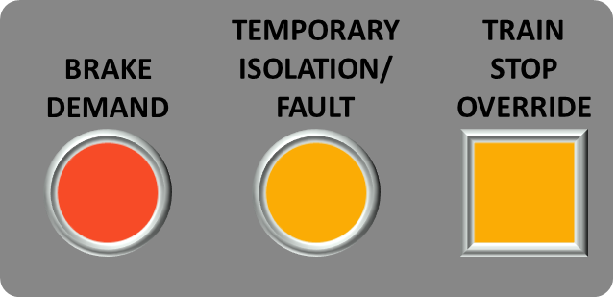
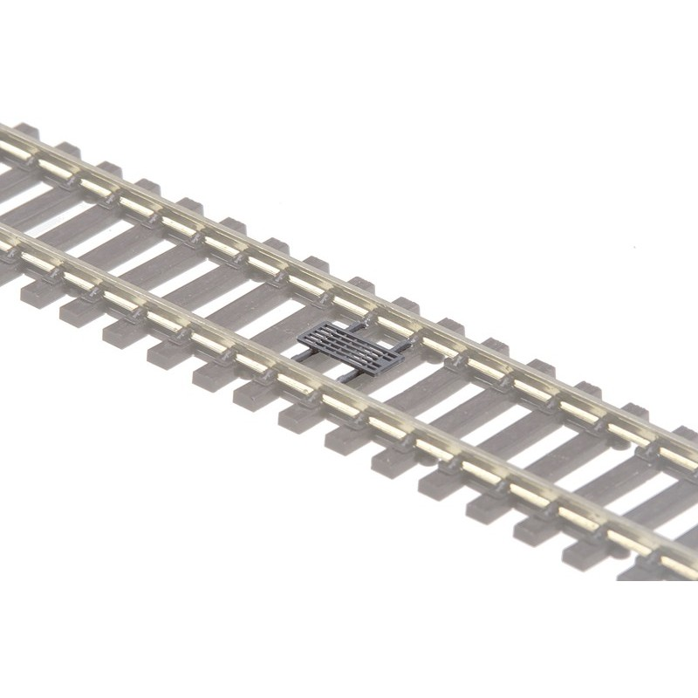
Changes to Standards – March 2021
GERT8075 Issue 4 - AWS and TPWS Interface Requirements
RUs
Overview – GERT8075 issue four clarifies the scope of national technical rules (NTRs) for the AWS and TPWS trackside and onboard subsystems. Some requirements in GERT8075 issue three that were not relevant to technical compatibility and therefore did not meet the criteria to be a National Technical Rule have been moved to RIS-0775-CCS issue three. Changes to this issue of GERT8075 can be broken down into four areas -
AWS trackside subsystem requirements - All the rationales reviewed and
updated, and the guidance has been reviewed, expanded and updated.
TPWS trackside subsystem requirements - Good practice in specifying
technical compatibility of the trackside subsystem with onboard
subsystems, including TPWS trackside equipment configuration,
mini-loops, loop ariels and TPWS OSS loop configuration added.
AWS onboard subsystem requirements - Good practice in specifying
technical compatibility of the maximum and minimum sensitivity
levels of AWS receivers with AWS magnets added.
TPWS onboard subsystem requirements - Good practice in specifying
technical compatibility of the onboard subsystem with TPWS loops,
inc. Power up over an active TPWS loop and Effective train speeds.
IMs
Suppliers
Continued
Notes:
Headlines ……….

Slide 24
Changes to Standards – March 2021
GERT8075 Issue 4 - AWS and TPWS Interface Requirements
RUs
Benefits – The changes made is expected to
Provide a cost benefit to rail vehicle suppliers, rolling stock owners and AWS/TPWS product suppliers, through efficiencies in the authorisation of new and upgraded rail vehicles and AWS/TPWS subsystems.
Help applicants to define the required scope of DeBo assessment and avoid unnecessary and duplicated effort.
Reduce costs through efficiencies in the application of the Common Safety Method on Risk Evaluation and Acceptance, which could equate to £20,000 over five years.
Realise substantial benefits on the control of SPAD risk and overspeed risk. This could equate to savings of at least £60,000 over five years.
Although, these standards are unlikely to result in significant safety, performance benefits or reduction of design effort, the changes will though increase the visibility of good practice to designers and will reduce the regulatory burden and reduce confusion around the legitimacy of certain requirements as NTRs
Audience – Rail vehicle suppliers AWS and TPWS equipment suppliers, Rolling stock owners, Designated Bodies and those specifying AWS and TPWS trackside equipment.
IMs
Suppliers
Go back
Notes:
Headlines ……….

Slide 25
Changes to Standards – March 2021
RIS-0775-CCS Issue 3 - AWS and TPWS Application Requirements
RUs
Overview – Some requirements in GERT8075 issue three that were not relevant to technical compatibility and therefore did not meet the criteria to be a National Technical Rule have been moved into a Rail Industry Standard - RIS-0775-CCS issue three. In addition RIS-0775-CCS issue three provides a more comprehensive set of requirements that can be used when taking decisions about integration of changes to AWS and TPWS subsystems with train operations on the GB mainline railway. This includes -
The application of the TPWS trackside subsystem to control signal overrun risk, beyond that which is necessary to meet the minimum requirements of the Railway (Safety) Regulations 1999.
The configuration of the TPWS trackside subsystem to reflect the good practice set out in Network Rail standards NR/SP/SIG/10137 and NR/SP/SIG/10138, as amended by Network Rail technical instruction TI-022.
Benefits – Incorporating the requirements from legislation and NR company into the RIS is likely to result in a substantial cost benefit, as it will help those involved to manage the consultation of planned changes more efficiently.
Reviewing and updating the application requirements for AWS and TPWS trackside subsystems should accrue benefits through efficiencies in the design and assessment of lineside signalling projects.
Audience – Rail vehicle suppliers AWS and TPWS equipment suppliers, Rolling stock owners, Designated Bodies and those specifying AWS and TPWS trackside equipment.
IMs
Operations
Notes:
Headlines ……….

Slide 26
Changes to Standards – March 2021
GERT8402 Issue 3 - ERTMS/ETCS DMI National Requirements
RUs
Overview – This standard has been updated in conjunction with train operators, suppliers and the Digital Railway programme, to address new functionality in the Baseline 3 Release 2 ERTMS/ETCS DMI Specification, forthcoming changes as a result of ATO over ETCS, and to include clarifications identified through application of the standard. Including -
The display of mph speed values at speed profile discontinuities in the Planning Area;
The provision of a “km/h” speed unit label when speed is displayed in km/h;
Parent child relationships for train running number entry windows.
The location of the speed unit labels on ERTMS/ETCS DMIs that implement display area B8 proposed for ATO over ETCS use; and
Benefits – Suppliers and operators of ERTMS/ETCS onboard
subsystems will benefit from a GB ERTMS/ETCS DMI Specification
that is consistent with, and applicable to, all the ERTMS/ETCS
baselines currently available for use within the CCS NTSN and
with the AoE specifications, to the order of £500k over five years
Audience – The standard is intended for suppliers and procurers of
ERTMS /ETCS onboard equipment that will be operated on the GB
mainline railway.
IMs
Operations
Notes:
Headlines ……….

Slide 27
Changes to Standards – March 2021
Three new or updated standards and eight updates to rulebook modules have been published in the March 2021 standards catalogue.
GEGN8613 Issue 1 - Application of human factors within safety management systems
RIS-3781-TOM Issue 1 - Requirements for the operation of freight trains and the conveyance of dangerous goods by any train
RS524 Issue 1 - List of Dangerous Goods and their United Nations (UN) Numbers
GERT8000-TW4 Issue 1 - Preparation and working of freight trains
GERT8000-OTM Issue 10 - Working of on-track machines (OTM)
Click on a standard to find out more
More Standards
Notes:
Headlines ……….

Slide 28
Changes to Standards – March 2021
Three new or updated standards and eight updates to rulebook modules have been published in the March 2021 standards catalogue.
GERT8000-HB14 Issue 3 - Duties of the person in charge of loading and unloading rail vehicles during engineering work
GERT8000-M3 Issue 4 - Managing incidents, flood and snow
GERT8000-TW1 Issue 16 - Preparation and movement of trains
GERT8000-HB1 Issue 6 - General duties and track safety for track workers
GERT8000-G1 Issue 8 - General safety responsibilities and personal track safety for non-track workers
Click on a standard to find out more
Notes:
Headlines ……….

Slide 29










Changes to Standards – March 2021
GEGN8613 Issue 1 - Application of human factors within safety management systems
RUs
Overview - Industry approaches to the management of risks associated with human factors
have developed since RS232 was written in 2008. GEGN8613 expands on the information
in RS232, providing a more holistic approach to human factors, providing greater breadth
than its predecessor. The Guidance document is divided into six sections -
Understanding what Human Factors is and how to apply it.
Investigating incidents and learning from staff experiences.
Applying human factors in design and change management.
Applying human factors in risk assessment and management.
Optimising operations and maintenance with human factors.
Optimising organisational and safety culture.
Benefits - When adopted, the guidance will support the development of robust safety management systems that address human performance considerations. It contains comprehensive, industry agreed good practice on managing human factors and human performance and the improved
identification and implementation of health and safety controls
Audience – Anyone on the Railway with a Safety Management System
IMs
Suppliers
Notes:
Headlines ……….

Slide 30

Changes to Standards – March 2021
RIS-3781-TOM Issue 1 - Requirements for the operation of freight trains and the conveyance of dangerous
goods by any train
RUs
Overview - The White Pages (GORT3056) and the Pink Pages (GORT3053) both contain content which is a mixture of frontline instructions and company level requirements and guidance. The contents of both, and the associated Guidance Notes (GOGN3653 and GOGN3676), were reviewed to determine what should be retained as direct instructions to railway staff, or as company level requirements and guidance, and content that can be published elsewhere or removed.
RIS-3781-TOM was developed to contain the content in GORT3056 and GORT3053 that was identified as company requirements or guidance.
Some of the guidance has been retained as guidance and some converted to new Requirements. All requirements are now supported with new Rationale and Guidance
The new RIS also incorporates relevant guidance from GOGN3653 and GOGN3676, as well as new guidance on securing and loading.
It also includes signposts to a new page on the RSSB website that hosts the J Tables, which means that new data can be included in a spreadsheet as and when it becomes available.
Benefits – Most benefit will likely be obtained from newer freight operators who will find company level requirements, supported by guidance, all in one place. However, it is difficult to estimate or quantify the benefits of these changes.
Audience – Freight Operators
Operations
Freight
Notes:
Headlines ……….

Slide 31
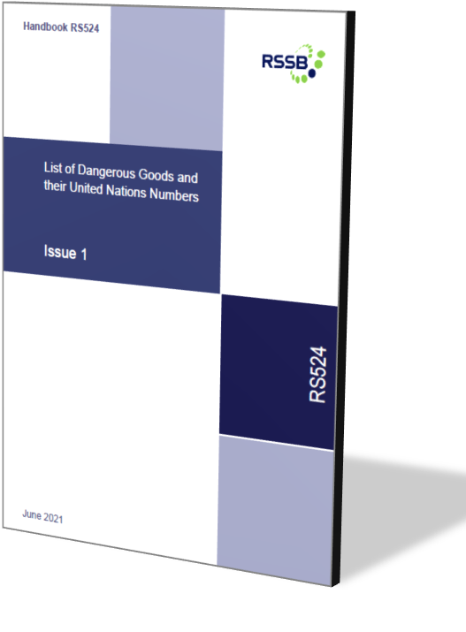
Changes to Standards – March 2021
RS524 Issue 1 - List of Dangerous Goods and their United Nations (UN) Numbers
IMs
Overview - The Pink Pages (GORT3053) contains a mixture of frontline instructions and company level requirements and guidance. Its contents were reviewed to determine what should be retained as direct instructions to railway staff, or as company level requirements and guidance, and content that can be published elsewhere or removed. The content covering the List of Dangerous
Goods and their United Nations (UN) Numbers contained in Appendix 1
to the Pink Pages has been retained and published in Information
handbook RS524
Audience – Freight Operators
Operations
Freight
Notes:
Headlines ……….

Slide 32
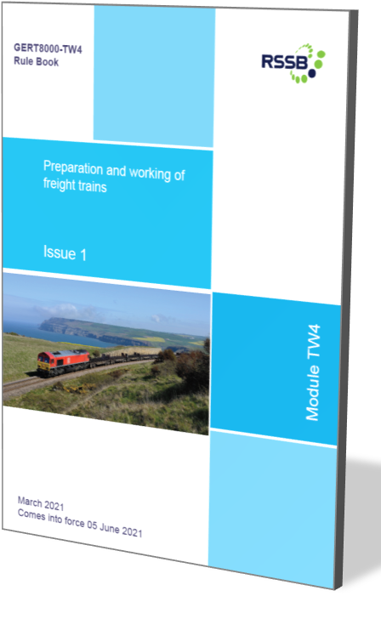
Changes to Standards – March 2021
GERT8000-TW4 Issue 1 - Preparation and working of freight trains
RUs
Overview - The White Pages (GORT3056), Pink Pages (GORT3053) and associated Guidance Notes (GOGN3653 and GOGN3676) have been withdrawn. The information in them have been retained as direct instructions to
railway staff, as company level requirements and guidance, published elsewhere or removed where they were no longer valid .
Clauses that are instructions for front-line staff have been transferred into the following
documents - GERT8000-OTM, GERT8000-G1 and GERT8000-HB14, new information
handbook RS524 and new rulebook module GERT8000-TW4.
GERT8000-TW4 incorporates Appendix 2 to the GORT3053-2.
In addition several minor change shave made to the module, the most significant ones are -
Section 2.5 Maximum speed - It is now explained for completeness that Network Rail would
have to agree operation at a reduced speed.
Section 2.6 Braking requirements and brake force - The Working Manual instruction on (Cartic-4
vehicles) now applies to any fixed-formation wagons
Section 2.12 Unregistered wagons - A reference has been added to the possible need
for a form RT3973EXL
Operations
Freight
Continued
Notes:
Headlines ……….

Slide 33
Changes to Standards – March 2021
GERT8000-TW4 Issue 1 - Preparation and working of freight trains
RUs
Overview (continued) -
Section 4.5 Maximum speed - Instead of applying a default speed of 45 mph, which may be unrealistically low, a speed shown in train operating company's instructions or obtained from the train operator's control is to be used.
Section 4.6 Brake force - There is a new requirement to obtain agreement from Network Rail before departure for the train to operate at a reduced speed.
Section 9 Dangerous goods - The prohibition on naked lights now applies to all dangerous goods, not just explosives, and a distance of 20 metres is specified
Section 9.4 High-consequence dangerous goods - There is a new requirement for the traincrew to obtain permission from the train operator before accepting a route into a yard or siding that the train is not scheduled to enter. This is because these trains have a security plan.
The previous instruction concerning detachment of a wagon of dangerous goods from a train is now shown to apply to high consequence dangerous goods only and requires specific permission from the train operator,
Such trains are now not to be left unattended without permission of the train operator.
Operations
Freight
Continued
Back
Notes:
Headlines ……….

Slide 34
Changes to Standards – March 2021
GERT8000-TW4 Issue 1 - Preparation and working of freight trains
RUs
Overview (continued) -
Section 9.12 Class 1: explosives – additional instructions
A requirement is now shown for containers containing class 1 to be secured to the wagon with twist locks, auto locks or spigots, which has not previously been published to train preparers.
Section 9.13 Class 2.3: toxic gases – additional instructions
The requirement for a guard to ride in the vehicle has been changed to the rear locomotive cab as for class 7 flask traffic with the same requirement of having a mobile telephone. This provides the same safety arrangements that are provided for trains carrying class 7 traffic.
Audience - Freight Operators
Operations
Freight
Back
Notes:
Headlines ……….

Slide 35
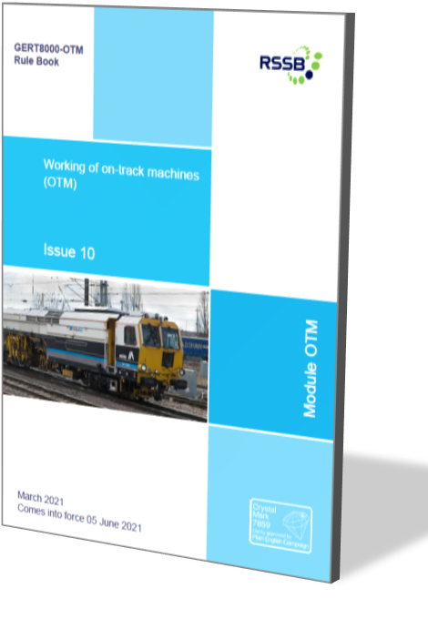

Changes to Standards – March 2021
GERT8000-OTM Issue 10 - Working of on-track machines (OTM)
IMs
Overview - The White Pages (GORT3056), Pink Pages (GORT3053) and associated Guidance Notes (GOGN3653 and GOGN3676) have been withdrawn. The information in them have been retained as direct instructions to
railway staff, as company level requirements and guidance, published elsewhere or removed where they were no longer valid .
Clauses that are instructions for front-line staff have been transferred into the
following documents - GERT8000-OTM, GERT8000-G1 and GERT8000-HB14,
new information handbook RS524 and new rulebook module GERT8000-TW4
The contents of GORT3053 section E6 (Self-propelled On-track Machines and
Power-driven Rail Cranes) are now included in this module as a new section 2.3.
The wording and format have been changed into the style of the Rule Book,
but the requirements have not been changed.
Audience – Freight Operators and OTM operators
IMs
Operations
Freight
Plant
Notes:
Headlines ……….

Slide 36
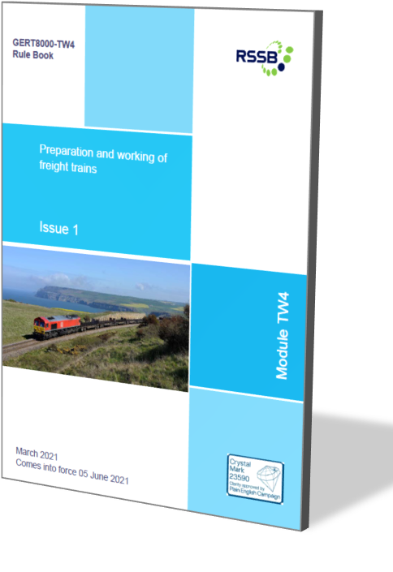
Changes to Standards – March 2021
GERT8000-HB14 Issue 3 - Duties of the person in charge of loading and unloading rail vehicles during engineering work
IMs
Overview - The White Pages (GORT3056), Pink Pages (GORT3053) and associated Guidance Notes (GOGN3653 and GOGN3676) have been withdrawn. The information in them have been retained as direct instructions to railway staff, as company level requirements and guidance, published elsewhere or removed where they were no longer valid .
Clauses that are instructions for front-line staff have been transferred into the
following documents - GERT8000-OTM, GERT8000-G1 and GERT8000-HB14,
new information handbook RS524 and new rulebook module GERT8000-TW4
The contents of GORT3053 section C5 (Preparation of vehicles intended for
movement from engineering work sites) has been retained in GERT8000-HB14
Section 10. The wording and format have been changed, but the requirements
have not been changed.
Audience - Freight Operator, OTM operators and Track workers
IMs
Freight
Plant
Notes:
Headlines ……….

Slide 37
Changes to Standards – March 2021
GERT8000-M3 Issue 4 - Managing incidents, flood and snow
IMs
Overview - On 12 August 2020, a passenger train was derailed after striking a landslip near Carmont in Scotland. This prompted the rail industry to make some changes to the Rule Book. These changes were published initially via the WON on 5 September 2020, by limited change releases in the Rule Book App and standards catalogue on the RSSB website on 5 December 2020 and in the December PON.
Changes to Module M3 – new requirements have been added covering -
The driver reporting to the signaller -
any damage to structures or earthworks above or below the line giving the exact location and details of the damage including which lines are affected; and
any flowing or pooling water that might affect structures or earthworks
How the signaller must respond in relation to train running when a report from a driver is received concerning flowing or pooling that might affect structures or earthworks
How the signaller must respond in relation to train running when no report of possible damage to structures or earthworks is received but Ops Control reports extreme weather in the signaller’s area
The option for signallers to use GSM-R broadcasts as a new method of implementing precautionary blanket speed restrictions in targeted areas where adverse conditions are expected.
Audience – Drivers and Signallers
IMs
Operations
Notes:
Headlines ……….

Slide 38
Changes to Standards – March 2021
GERT8000-TW1 Issue 16 - Preparation and movement of trains
IMs
Overview - On 12 August 2020, a passenger train was derailed after striking a landslip near Carmont, in Scotland. This prompted industry to make some changes to the Rule Book. These changes were published via the WON on 5 Sept 2020, by limited change releases in the Rule Book App and in the standards catalogue on the RSSB website on 5 Dec 2020 and in the Dec PON.
On 1 August 2019 there was a loss of brake control on a sleeper train approaching Edinburgh, RAIB recommended that changes were made to the Rule Book to make it clear that the brake continuity test should be undertaken after all coupling-related activities have been completed. The intent of this recommendation is to ensure the integrity of the mandated brake continuity test when coupling a locomotive to a train.
Changes to Module TW1 - A new clause has been added to support the changes made to GERT8000-M3 - Damage to structures or earthworks which could cause danger to trains’ as one of the things that can put other trains in danger that, if seen by the driver, the driver must follow the instruction set out.
Section 4.2 has been amended to state that a brake continuity test on loco-hauled trains should not be carried out until all coupling operations have been completed.
A brake continuity test must also be carried out if any jumper cables have been disconnected or reconnected during a journey.
Audience – Drivers, guards and train preparers.
IMs
Operations
Notes:
Headlines ……….

Slide 39
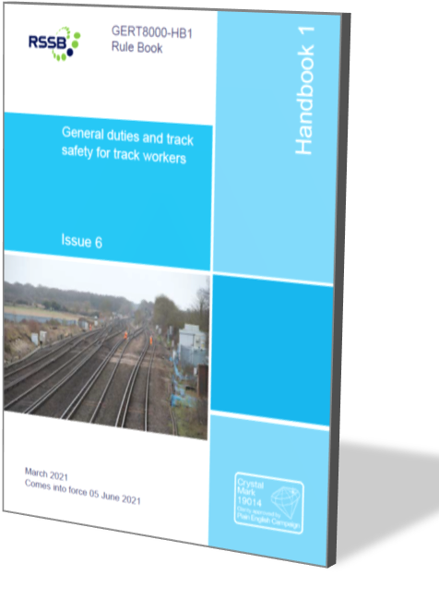
Changes to Standards – March 2021
GERT8000-HB1 Issue 6 - General duties and track safety for track workers
IMs
Overview - On 12 August 2020, a passenger train was derailed after striking a landslip near Carmont,n Scotland. This prompted industry to make some changes to the Rule Book. These changes were published via the WON on 5 Sept 2020, by limited change releases in the Rule Book App and in the standards catalogue on the RSSB website on 5 Dec 2020 and in the Dec PON.
Changes to Module HB1 - As a result of the changes made to module M3,
consequential changes were required to GERT8000-HB1 to
include ‘damage to structures or earthworks above or below the line’
as a hazard that might put approaching trains in danger; and
insert a new requirement for all concerned to report to the signaller
or Operations Control any flowing or pooling water that might affect
structures or earthworks.
Audience – Track workers
IMs
Operations
Notes:
Headlines ……….

Slide 40
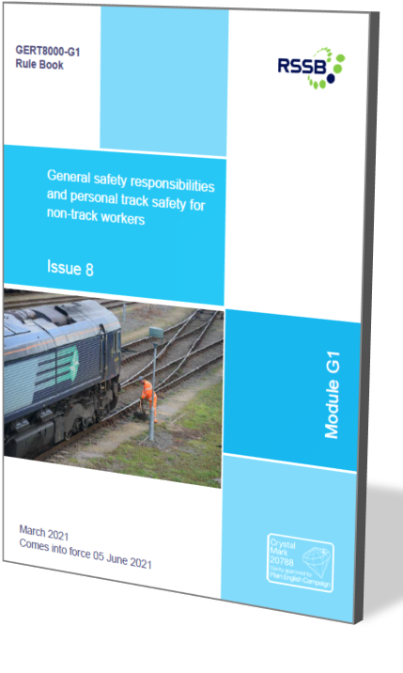
Changes to Standards – March 2021
GERT8000-G1 Issue 8 - General safety responsibilities and personal track safety for non-track workers
IMs
Overview - On 12 August 2020, a passenger train was derailed after striking a landslip near Carmont, in Scotland. This prompted industry to make some changes to the Rule Book. These changes were published via the WON on 5 Sept 2020, by limited change releases in the Rule Book App and in the standards catalogue on the RSSB website on 5 Dec 2020 and in the Dec PON.
In addition The White Pages (GORT3056), Pink Pages (GORT3053) and associated Guidance Notes (GOGN3653 and GOGN3676) have been withdrawn. Clauses that are instructions for front-line staff have been transferred into GERT8000-OTM, GERT8000-G1 and GERT8000-HB14, new information handbook
RS524 and new rulebook module GERT8000-TW4
Changes following Carmont – two new clauses were added –
include ‘damage to structures or earthworks above or below the line’ as a hazard
that might put an approaching train in danger; and
insert a new requirement for all concerned to report to the signaller or Ops Control
any flowing or pooling water that might affect structures or earthworks.
Changes following withdrawal of GORT3056 and GORT3053 -
The instructions concerning anyone being contaminated by dangerous goods, which
could apply to anyone holding this module have been added to section 4.4
Audience – Track workers
IMs
Operations
Notes:
Headlines ……….

Slide 41

Changes to Standards – March 2021
Click on the title to find out more
New Railway Specific legislation has been published since December 2000
13 new National Technical Specification Notices (NTSN) replacing the suite of Technical Specification for Interoperability (TSIs) (Depart of Transport webpage)
RSSB Legislation News page
BREXIT FAQ page
RSSB webinar Part 1 - EU Exit Legislation and Standards - What has changed for railway standards and
legislation due to EU exit? (1.5 hours including 30 min Q&A)
RSSB webinar Part 2 - EU Exit Legislation and Standards - After EU exit, how will standards and associated domestic and international influence be managed? (1.5 hours including 30 min Q&A)
Notes:
Headlines ……….

Slide 42
Changes to Standards – March 2021
Click on the title to access the standard on the RSSB website
Non
RSSB
5 Non RSSB standards have been published on the RSSB website
COP0012 Issue 7 - Code of Practice for Defect Reporting for OTP, Plant and Equipment
COP0021 Issue 5 - Code of Practice for Safe use of Quick Hitches
COP0043 Issue 2 - Code of Practice for Hydraulic Hose In-use Repair
COP0129 Issue 1 - Code of Practice for Control of Mobile Communication Equipment Use in Driving Cabs
COP0130 Issue 1 - Code of Practice for OTM Route Conducting Policy
Notes:
Headlines ……….

Slide 43
Changes to Standards – March 2021
1 Deviations issued
20-003-DEV; GERT8000-TW1 Preparation and movement of trains and GERT8000-SP Speeds
Link to deviations page on RSSB website
Notes:
Headlines ……….

