Slide 1
Changes to Standards – September 2021 interactive briefing slide deck Please view in slideshow mode for the links and audio to work
The presentation is interactive, You can use the icons and text on the screen to navigate through it and you can always return to the main menu at anytime by clicking on the home icon.
Some slides contain links to additional online content, these are indicated with an icon.

Slide 2
Changes to Standards – September 2021
Changes to the Standards September 2021
Standards planned for publishing in December 2021 and March 2022
Standards currently being drafted and due for consultation
Click on a button to proceed to that section

Slide 3
Changes to Standards – September 2021
Non RSSB
Plant
Rolling Stock
RDG and Plant COPs
2 point releases
1 new standard 2 point releases
4 new standards
1 new poster
Control Command and Communication
Rail related legislation
Infrastructure
0 new standards
1 new standard
1 point release
No new legislation has been published
Energy (AC & DC systems)
Operational rules
Deviations
19 new RB modules/HB
1 point release
0 new standards
8 deviations issued
Click on the icons for more detail on those changes
Notes:
Here are the headlines - Click on the icons for more detail on those changes

Slide 4
Changes to Standards – September 2021
One new rolling stock standards has been published in the September 2021 standards catalogue.
RIS-2700-RST Issue 2 - Rail Industry Standard for Verification of Conformity of Engineering Change to Rail Vehicles
Click on a standard to find out more
Two point release have been published in the September 2021 standards catalogue.
GMRT2130 Issue 5.1 - Vehicle Fire Safety
RIS-2730-RST Issue 1.1 - Vehicle Fire Safety and Evacuation
Click on the title to access the standard on the RSSB website
Notes:
Headlines ……….

Slide 5
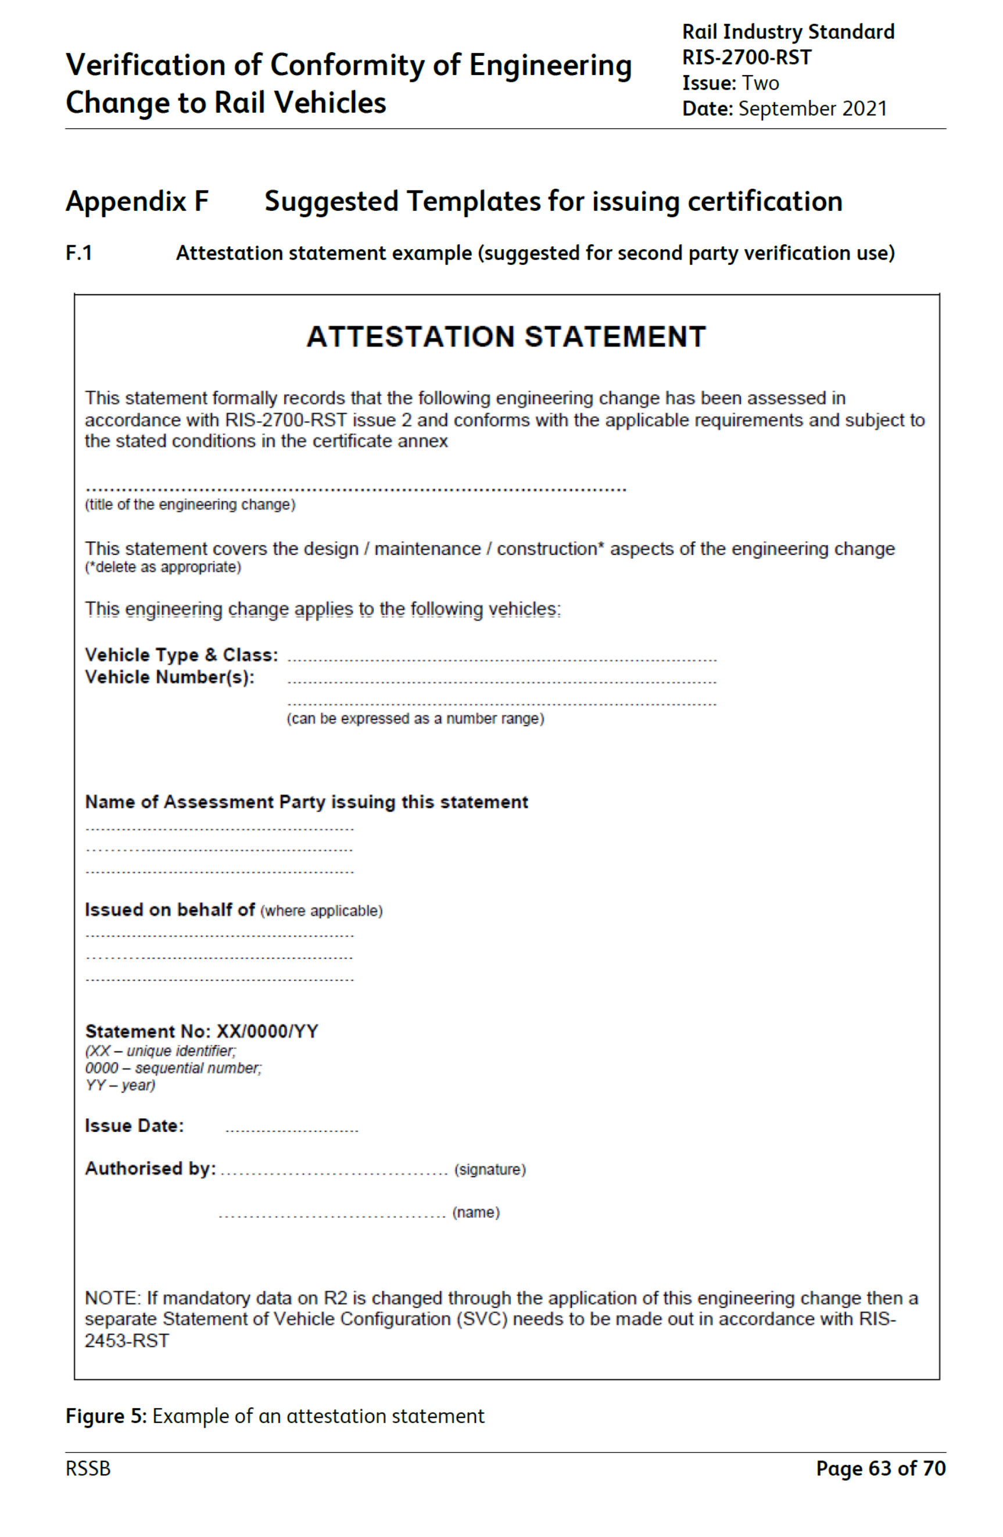
Changes to Standards – September 2021
RIS-2700-RST Issue 2 - Rail Industry Standard for Verification of Conformity of Engineering Change to Rail Vehicles
RUs
Overview – This standard sets out a process that can be adopted by organisations undertaking projects that require verification of conformity of an engineering change to rail vehicles and by organisations that carry out the verification work.
Issue 2 has been updated to the latest standards format with minor revisions to improve the clarity of guidance, rationale and to align it with the current versions of related standards.
In addition, two new templates offering a suggested format for Attestation Statements have been included.
Benefits – The update has improved the document's readability and clarity, restores compatibility with other related standards and maintains alignment with current industry regulatory requirements, enhancing its integrity and value to industry stakeholders when used to provide the necessary assurance for engineering change projects
Audience – This standard is intended for use by organisations undertaking projects that require verification of conformity of an engineering change to rail vehicles that are outside the scope of RIR and by organisations that carry out the verification work.
ROSCOS
Notes:
Headlines ……….

Slide 6
Changes to Standards – September 2021
One updated Infrastructure standard has been published in the September 2021 standards catalogue.
RIS-7773-INS Issue 1 - Rail Industry Standard for Infrastructure Gauging Data Format
Click on the title to find out more
One point release has been published in the September 2021 standards catalogue.
RIS-7016-INS Issue 1.2 - Interface between Station Platforms, Track, Trains and Buffer Stops
Click on the title to access the standard on the RSSB website
Notes:
Headlines ……….

Slide 7
Changes to Standards – September 2021
RIS-7773-INS Issue 1 - Rail Industry Standard for Infrastructure Gauging Data Format
IMs
Overview – The commonly used format for the exchange of infrastructure gauging data, SC0 file format, was developed around 30 years ago with the introduction of computer methods for gauging assessment. The format continues to be widely used, however in the absence of an industry agreed standard setting out the format of the data fields, individual projects can add or alter fields and change the data structure. This can create issues using the data in software applications. In addition, the incorrect specification of data could result in invalid decisions being made in the gauging assessment.
This new Standard sets out requirements for infrastructure gauging data. Furthermore, this standard establishes an industry agreed structure for the commonly used SC0 file format providing industry with a formal reference for its consistent application in the exchange of infrastructure gauging data.
Benefits – This standard will contribute to an estimated £2.4m in cost saving to industry over the next fifteen years in data cleansing and, in some cases, remeasurement of infrastructure.
The standard will also help to reduce the risk of miscalculation of clearances resulting in poor data quality. An underestimation of clearances could lead to unnecessary infrastructure interventions, whilst an overestimation could lead to the potential for vehicles to come in to contact with infrastructure.
Audience – Those involved in the collection, exchange and application of infrastructure data used in the assessment of gauging compatibility.
Suppliers
Notes:
Headlines ……….

Slide 8
Changes to Standards – September 2021
Twenty Five rulebook modules and handbooks have been updated in the September 2021 standards catalogue.
GERT8000-G1 Issue 9 - General safety responsibilities and personal track safety for non-trackworkers
GERT8000-P1 Issue 7 - Single line working
GERT8000-P2 Issue 6 - Working single and bi-directional lines by pilotman
GERT8000-S5 Issue 10 - Passing a signal at danger or an end of authority (EoA) without a movement authority
GERT8000-S7 Issue 5 - Observing and obeying signalling indications. Train warning systems. Reporting signalling failures and irregularities
GERT8000-SP Issue 6 - Speeds
GERT8000-SS1 Issue 7 - Station duties and train dispatch
GERT8000-SS2 Issue 6- Shunting
GERT8000-T3 Issue 10 - Possession of a running line for engineering work
GERT8000-T10 Issue 5 - Duties of a designated person (DP) and people working on rail vehicles
GERT8000-TS1 Issue 15 - General signalling regulations
GERT8000-TS3 Issue 7 - Absolute block regulations
Click on the title to find out more
More
Notes:
Headlines ……….

Slide 9
Changes to Standards – September 2021
Twenty Five rulebook modules and handbooks have been updated in the September 2021 standards catalogue.
GERT8000-TW1 Issue 17 - Preparation and movement of trains
GERT8000-HB1 Issue 7 - General duties and track safety for track workers
GERT8000-HB6 Issue 7 - General duties of an individual working alone (IWA)
GERT8000-HB7 Issue 8 - General duties of a controller of site safety (COSS)
GERT8000-HB8 Issue 8 - IWA, COSS or PC blocking a line
GERT8000-HB11 Issue 9 - Duties of the person in charge of the possession (PICOP)
GERT8000-HB20 Issue 4 - General duties of a safe work leader (SWL) working outside a possession
GERT8000-HB21 Issue 5 - Safe work leader (SWL) blocking a line
GERM8000-trackworkers Issue 9
GERM8000-signaller, signalling technician Issue 10
GERM8000-master-module Issue 10
GERM8000-train operations staff Issue 10
GERM8000-traindriver Issue 10
GERM8000-possession workers Issue 7
Click on the title to find out more
Back
Notes:
Headlines ……….

Slide 10
Changes to Standards – September 2021
One point release has been published in the September 2021 standards catalogue.
RIS-3703-TOM Issue 4.1 - Passenger Train Dispatch and Platform Safety Measures
Click on the title to access the standard on the RSSB website
Notes:
Headlines ……….

Slide 11
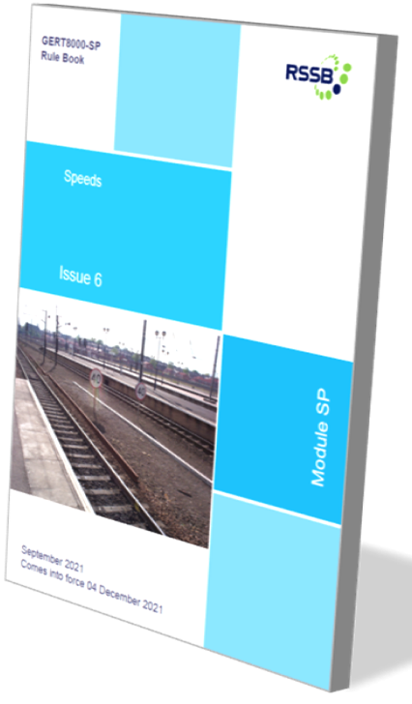
Changes to Standards – September 2021
Updates to Rulebooks and handbooks
RUs
A detailed presentation covering all the changes is available on the latest update to standards pages on the website
Overview –The majority of the changes in this update are relatively minor, being mostly clarifications of meaning, or updates to better represent present practices.
There are however three changes, that require some supporting work by train operators if they are to be given full effect -
Module SP Speeds; Section 2.2 – This concerns speed reductions for light locomotives and short formations of loco-hauled passenger stock.
At present the rule states that the restrictions do not apply, and the reference to not applying when permitted by train operating company instructions. This has now been amplified to explain the basis on which those instructions can be issued. Brake power of a sufficient number of coaches is necessary to run at normal permissible speeds and older classes of diesel locomotive may not have enough brake power. If the train operating company can confirm that a class of loco has enough brake power for the train formation concerned it can issue instructions that the restrictions in this section do not apply.
IMs
Operations
continued
Notes:
Headlines ……….

Slide 12
Changes to Standards – September 2021
Updates to Rulebooks and handbooks
RUs
Module TW1 Preparation and movement of trains; Section 4.4 – This states that if the brakes are isolated on no more than 1 vehicle in 5 on a train formed of coaching stock vehicles, a reduction in speed is necessary.
Some types of modern multiple units are provided with a brake system that automatically compensates for brake isolation on one vehicle by increasing the braking effort on others. When this is the case, train operating company instructions can be issued to allow exemption from this reduction in speed required in section 4.4. This exemption can be shown in train operating company instructions if the train operator
Module SS2 Shunting - The practice of ‘pushing through’ trailing points is a long established one, which can result in damage to the infrastructure. This now has the potential for more significant consequences as a result of the widespread introduction of more robust point mechanisms that are not designed to be ‘pushed through’. A new requirement was introduced in the June PON to section 4.2 to check that both facing and trailing hand-points are in the correct position before a shunting movement commences, preventing any ‘pushing through’ trailing points. However, some train operators identified that at some locations under their control there are hand points that can be pushed through without any adverse effects, and that applying the revised rule gave no advantages. This has been further amended in the September PON to state that the practice can continue where local instructions specifically allow trailing points to be pushed through. These local instructions can be issued if it the responsible operator can confirm that some or all trailing points at a particular location are a type where this can be allowed.
IMs
Operations
Notes:
Headlines ……….

Slide 13
Changes to Standards – September 2021
Two Plant point releases have been published in the September 2021 standards catalogue.
GMRT2400 Issue 6.1 - Engineering Design of On-track Machines in Running Mode
GMGN2615 Issue 2.2 - Guidance on the Application of the Locomotives and Passenger Rolling Stock NTSN
Click on the title to access the standard on the RSSB website
Notes:
Headlines ……….

Slide 14
Changes to Standards – December 2020
Non RSSB
4 Non RSSB standards and 1 poster have been published on the RSSB website
COP0002 Issue 11 - Code of Practice for Planning for the Use of Mobile Operated Plant
COP0025 Issue 4 - Code of Practice for Brake Testing of RRVs
COP0028 Issue 1 - Code of Practice for Planning for the use of Non-rail mounted plant
COP0040 Issue 1 - Code of Practice for Loose Material on OTMs
Poster OTM1 Issue 5 - Autumn Poster 2021
Click on the title to access the standard on the RSSB website
Notes:
Headlines ……….

Slide 15
Changes to Standards – September 2021
8 Deviations issued
21-017-DEV; GIRT7033 - Lineside Operational Signs - Product Requirements
21-020-DEV; GMRT2173 - Size of Vehicles and Position of Equipment
21-025-DEV; GIRT7020 - GB Requirements for Platform Height, Platform Offset and Platform Width
20-026-DEV; GERT8000-TS1, GERT8000-HB8, GERT8000-HB21
Continued
Link to deviations page on RSSB website
Notes:
Headlines ……….

Slide 16
Changes to Standards – September 2021
8 Deviations issued
21-002-DEV; GIRT7020 - GB Requirements for Platform Height, Platform Offset and Platform Width
21-013-DEV; GLRT1210 - AC Energy Subsystem and Interfaces to Rolling Stock Subsystem
21-015-DEV; GERT8000-TW1 - Preparation and movement of trains
18-072-DEV; GMRT2472 - Requirements for Data Recorders on Trains
Back
Link to deviations page on RSSB website
Notes:
Headlines ……….

Slide 17
Standards planned for publishing in December 2021
RSSB-GBMR-OC Issue 3 - Operational Concept for the GB Mainline Railway
GERT8000 AC Issue 7 – AC electrified lines
GERT8000 DC Issue 5 – DC electrified lines
GERT8000 HB16 Issue 5 – AC electrified lines
GERT8000 HB17 Issue 4 – DC electrified lines
Continued

Slide 18
Standards planned for publishing in December 2021
GMRT2453 Issue 2.1 - Vehicle registration, marking and numbering (Point release)
GMRT2472 Issue 1.1 - Data recorders on trains (Point release)
GMRT2461 Issue 3.1 - Sanding equipment (Point release)
RIS-2712-RST Issue 1 On-train camera monitoring systems (post 12 month review)
GEGN8575 Issue 1 – Guidance Note on the management of electrical risk related to operational tasks on electrified lines
Continued
Back

Slide 19
Standards planned for publishing in March 2022
RIS-3784-TOM Issue 1 – Multi-mode signage
RIS-8070 -TOM Issue 2 – Testing railway critical workers for drugs and alcohol
GEGN8570 Issue 2 – Guidance on the Management of Drugs and Alcohol (withdrawal)
RIS-3119-TOM Issue 3 Accident Incident Investigation
Back

Slide 20
Standards currently being drafted and due for consultation
November 2021
GIRT7020 Issue 2 - GB Requirements for Platform Height, Platform Offset and Platform Width
RIS-7016-INS Issue 2 - Interface between Station Platforms, Track, Trains and Buffer Stops
RIS-7706-INS Issue 1 - Processes for adding, removing or updating Differential Permissible Speeds
RIS-2711-RST Issue 2 - Rail Vehicle Lettered Differential Speeds Clarification
GMGN2571 Issue 2 - Storage and Recommissioning of Rail Vehicles
More Standards

Slide 21
Standards currently being drafted and due for consultation
December 2021
GLRT1210 Issue 3 - AC Energy Subsystem and Interfaces to Rolling Stock Subsystem
GMRT2111 Issue 3 - Rolling Stock Subsystem and Interfaces to AC Energy Subsystem
GLGN1610 Issue 1 - Guidance on AC Energy Subsystem and Interfaces to Rolling Stock Subsystem
GMGN2611 Issue 1 - Guidance on Rolling Stock Subsystem and Interfaces to AC Energy Subsystem
January 2022
GERT8000 TW5 Issue 11 - Preparation and movement of trains: Defective or isolated vehicles and on- train equipment
Continued
Back

Slide 22
Standards currently being drafted and due for consultation
January 2022
RIS-3437-TOM Issue 3 - Defective On-Train Equipment
GIRT7073 - issue 3 - Requirements for the Position of Infrastructure and for Defining and Maintaining Clearances
February 2022
RIS-8040-TOM Issue 2 - Low Adhesion between the Wheel and the Rail - Managing the Risk
GEGN8540 Issue 2 - (Withdrawal) Guidance on Low Adhesion between the Wheel and the Rail - Managing the Risk
March 2022
RIS-1530-PLT Issue 7- Technical requirements for OTP and their associated equipment and trolleys
Back

