Slide 1
Changes to standards June 2024 Interactive briefing slide deck
Navigate using the arrows buttons
Return to main menu by clicking the home icon
This icon links to online content
Click this icon to exit the presentation
This icon will be displayed when slide have audio
View in slideshow mode for live links

Slide 2
Changes in the June 2024 standards update
Deviations granted against standards March 2024 - June 2024
Draft standards scheduled to be published in September
Consultation schedule for draft standards
Standards News
Click a button to proceed

Slide 3
Changes in the June 2024 standards update
Plant
Rolling stock
Data, Systems, and Telematics
No new standards
5 standards updates and 1 Technical Note
No new standards
Control, Command, and Signalling
Non-RSSB standards
Infrastructure
3 standards updates
1 new standard
1 standard update
Operations
Energy
Rail-related legislation
No new standards
No new standards
1 update: safety
Click the icons with red rings for detail on those changes

Slide 4
Changes to standards – June 2024
Five Rolling Stock standards have been updated in the June 2024 Standards Catalogue.
GMGN2688 Issue 3 – Application of the WAG NTSN and NOI NTSN to the Design of Freight Wagons
RIS-2701-RST Issue 2 – Rail Industry Standard for NDT Processes on Rail Vehicles
RIS-2761-RST Issue 2 – Rail Industry Standard for Driving Cabs
GMGN2641 Issue 2 – Guidance Note on Vehicle Static Testing.
GMRT2141 Issue 5 – Permissible Track Forces and Resistance to Derailment and Roll-Over of Railway Vehicles.
Click on a play button to find out more about the change.

Slide 5
Changes to standards – June 2024
One Technical note has been updated in the June 2024 Standards Catalogue.
TN2314 Issue 1: Route availability

Slide 6
Changes to standards – June 2024
GMGN2688 Issue 3 – Application of the WAG NTSN and NOI NTSN to the Design of Freight Wagons
Overview – This document gives guidance on the design of rail freight wagons, including rail tank wagons. The previous issue was revised to reflect the introduction of the Rolling Stock – Freight Wagons National Technical Specification Notice Issue 1 (WAG NTSN). This replaced the WAG Technical Specification for Interoperability (WAG TSI) in the UK.
The sections on design guidance and the requirements of the WAG TSI have been combined. Now all content on a particular subject is in one place.
Additional guidance on the relevant requirements in the NOISE (NOI) NTSN has been included. Links to ENs and other RSSB documents are now the latest versions.
Benefits – The guidance note will help industry comply with the requirements in the WAG and NOI NTSNs. This supports a smooth authorisation process and the development of appropriate wagon designs for operation on the GB mainline railway.
Audience – Anyone involved in the design, development, manufacture, modification, assessment or authorisation of freight wagons for operation on the GB mainline railway.
RU
Builders
Suppliers
Assessment bodies
Designers
Click on the link icon to go to the standard

Slide 7
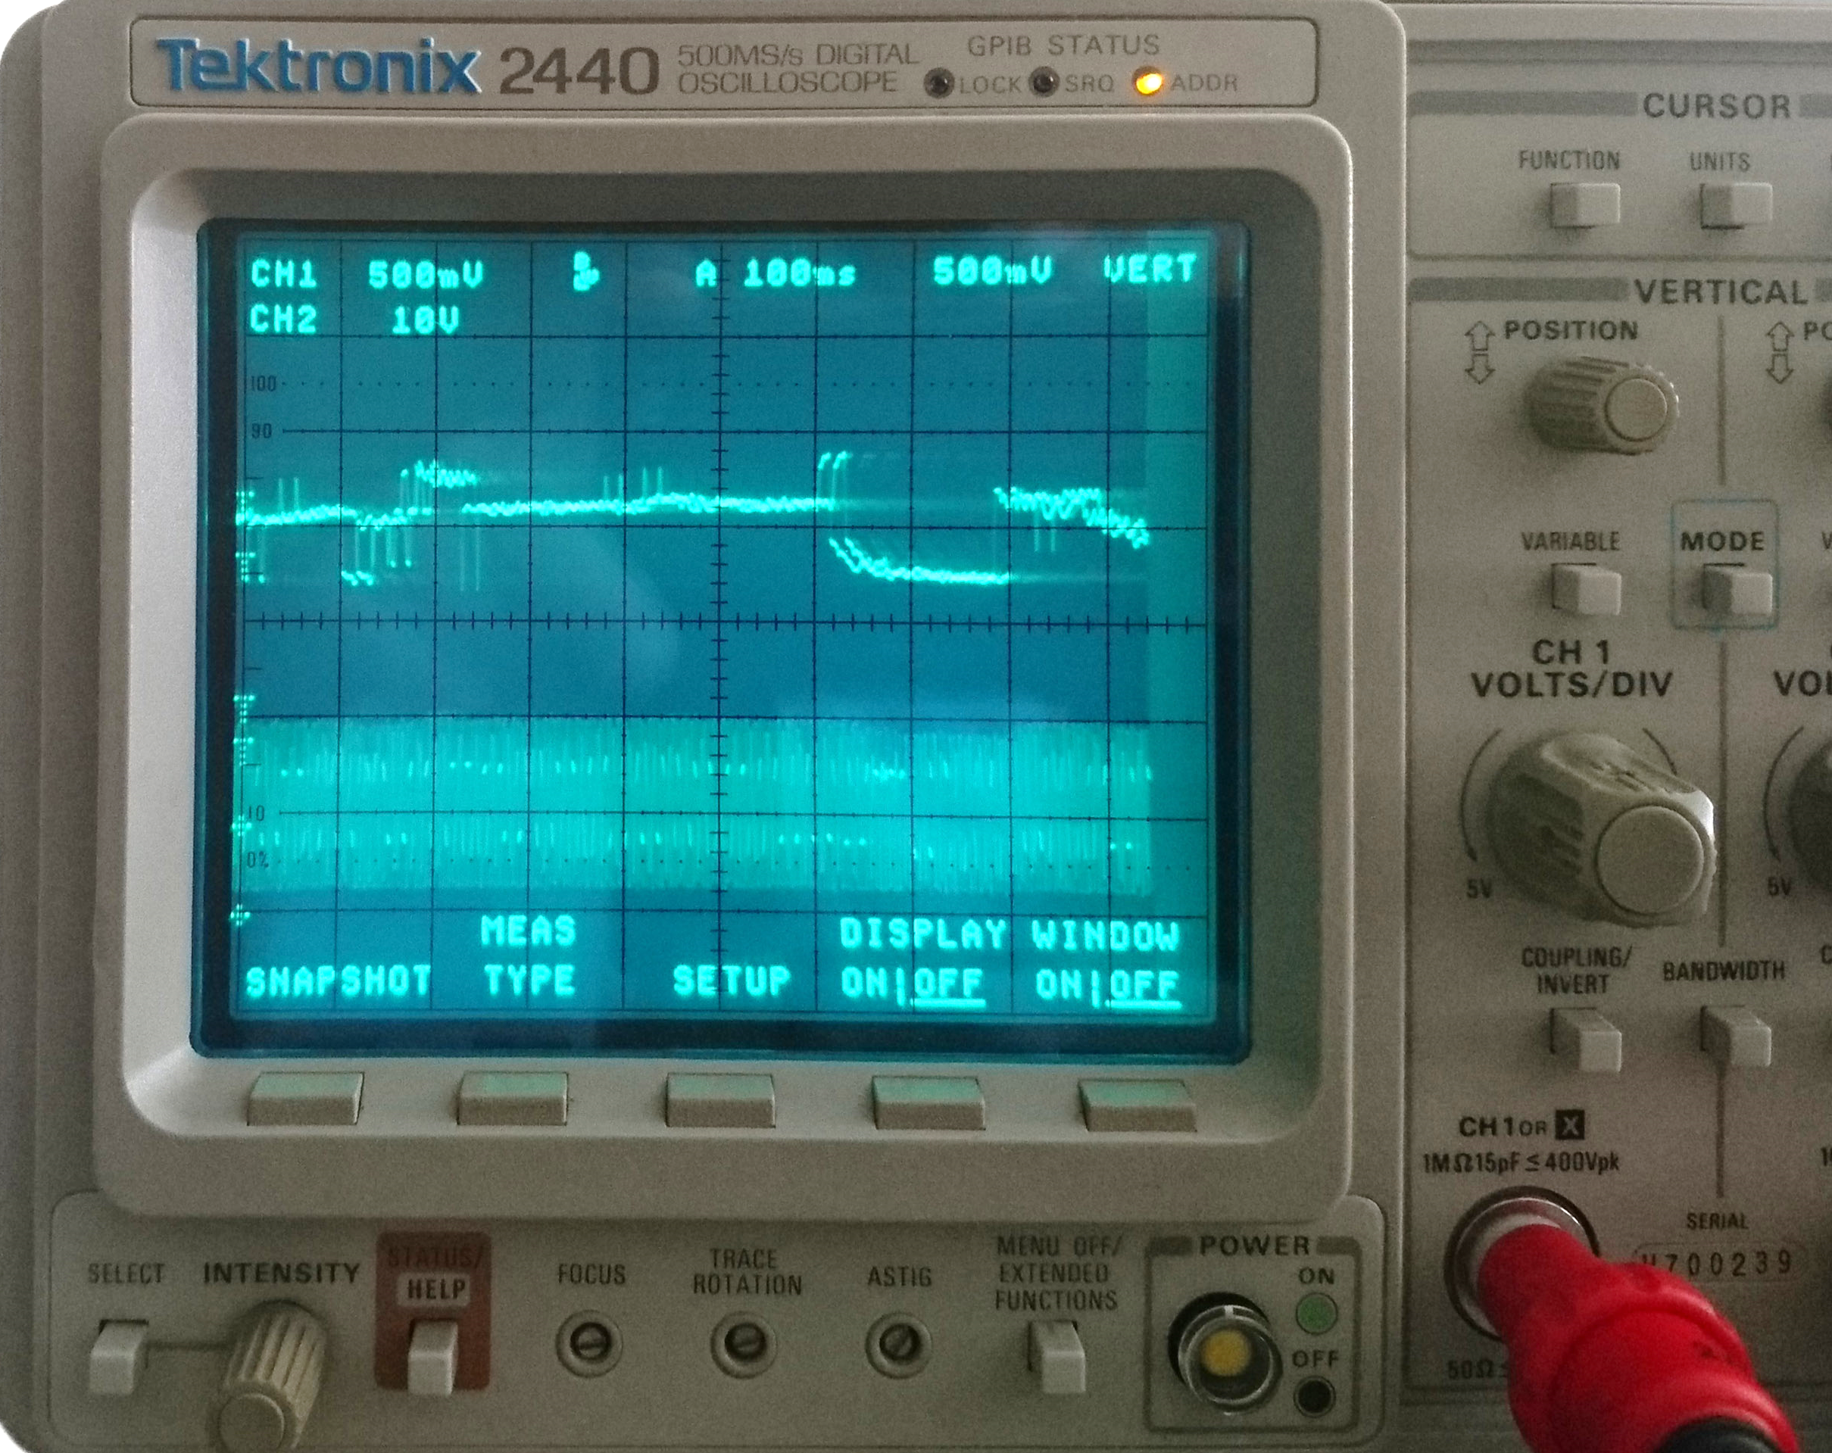
Changes to standards – June 2024
RIS-2701-RST Issue 2 – Rail Industry Standard for NDT Processes on Rail Vehicles
Overview – RIS-2701-RST sets out requirements and guidance for the certification of operatives, equipment, and facilities used to undertake NDT of components on rail vehicles. Issue 2 includes updates to the sequence, structure, and layout of its clauses. This improves readability and usability.
References to external standards have been updated to the latest versions. Where possible, these now point to recognised European or international standards. The technical content has not altered significantly. Requirements are now clearly distinguished. Rationale is provided for each requirement to clarify their intent or purpose. The associated guidance has been refined to better assist the user.
Benefits – The revision is clearer in preparing test procedures, approval of new techniques, the certification of equipment, facilities, and operatives. This should improve these procedures in organisations conducting NDT, with the aim of introducing efficiencies, new techniques, and improving overall safety.
RU
NDT Operators
Audience – Individuals and organisations that undertake NDT on railway vehicles, NDT operative training, preparation of NDT procedures, and validate and authorise NDT procedures, equipment, and facilities. It is also aimed at organisations that own, operate, or maintain rolling stock that requires NDT to be performed on it.
Click on the link icon to go to the standard

Slide 8
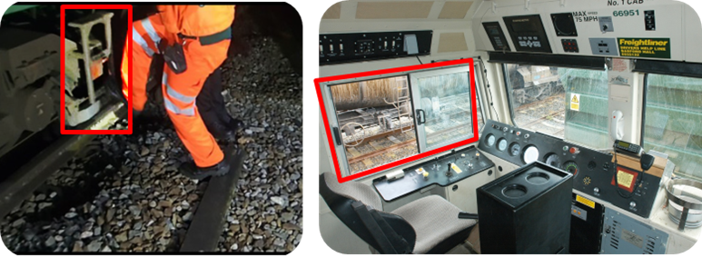
Changes to Standards – June 2024
RIS-2761-RST Issue 2 - Rail Industry Standard for Driving Cabs
Overview – Driving cab design requirements and guidance contain gaps that have led to differences in cab design. This has resulted in the introduction of some cabs with features that caused discomfort or injury to drivers and increased operational risk. RIS-2761-RST Issue 2 sets out new requirements for side glazing in driving cabs to support drivers aligning with station features. Also, for thermal comfort including air conditioning. It requires the illumination of cab footsteps to reduce the risk of injury when accessing or egressing the driving cab during hours of darkness. Guidance on good practice in human factors for driving cab design has been added as an appendix .
Benefits – This approach to driving cab design puts a human at the centre of the design process. Considering how they interact with the vehicle will result in improved comfort for drivers and reduce instances of discomfort or injury to drivers. This can, in turn, reduce operational risks such as train stop-shorts and station over runs.
Audience – This standard update is intended for Rolling stock owning companies (ROSCO), Train and freight operating companies, Assessment bodies and Vehicle manufacturers When designing and specifying new rolling stock and changes to existing rolling stock.
RU
Builders
Assessment bodies
Designers
Click on the link icon to go to the standard

Slide 9
Changes to Standards – June 2024
GMGN2641 Issue 2 – Guidance Note on Vehicle Static Testing
Overview – This document gives guidance on meeting the requirements of GMRT2141 'Permissible Track Forces and Resistance to Derailment and Roll-Over of Railway Vehicles'.
Additional guidance, provided by industry, was added to the section on the wheel unloading test for vehicles carrying intermodal load units. This includes some worked examples to suggest how the required load and offset can be determined. Editorial changes have been made to improve the clarity of one of the diagrams and to update references.
Benefits – Improved guidance will simplify projects working on new or modified vehicles for carrying intermodal load units. This will speed up the process and reduce the amount of unnecessary work. It will lead to improved vehicles being able to enter service more efficiently. The changes GMGN2641 Issue 2 and GMRT2141 Issue 5 together are estimated to benefit the industry by £3M over 5 years.
Audience – It is relevant to anyone involved in specifying, designing, procuring, or approving new or modified rolling stock for use on the GB mainline railway.
RU
Builders
Suppliers
Designers
Click the link icon to go to the standard

Slide 10
Changes to Standards – June 2024
GMRT2141 Issue 5 – Permissible Track Forces and Resistance to Derailment and Roll-Over of Railway Vehicles
Overview – This document sets out requirements for railway vehicles regarding permissible track forces, derailment resistance, and resistance to roll-over due to overspeed.
GMRT2141 Issue 4 required vehicles carrying intermodal load units to undertake the twist test in conditions of offset loading. Experience in applying this requirement has enabled improved guidance to be added in Issue 5.
A permission is also included for the case where the specified offset loads cannot be achieved within the wagon’s approved loading. Editorial changes have been made to update references to NTSNs and ENs. A flow chart was added to show the process.
Benefits – Additional clarification will make demonstrating compliance more straightforward for projects. This will reduce costs and may shorten timescales for the introduction of new or modified wagons. Together, the changes in GMRT2141 Issue 5 and GMGN2641 Issue 2, are estimated to benefit the industry by £3M over 5 years. This is from improved efficiency of a range of new and modified vehicle projects.
Audience – This document is relevant for anyone involved in the specification, design, build or approval of new or modified vehicles for use on the GB mainline railway.
RU
Builders
Suppliers
Designers
Click the link icon to go to the standard

Slide 11
Changes to Standards – June 2024
TN2314 Issue 1: Route availability
Overview – TTN2314 describes the standards associated with rail vehicle route availability (RA) numbers and provides guidance on the application of those standards to new rail vehicles and existing rail vehicles where a modification changes their weight.
This technical note has been produced because the precise method of determining a rail vehicle’s route available number has changed over time, with the result that some older vehicles, particularly passenger multiple units, may be incorrectly classified. This technical note aims to clarify the correct method of classification.
Audience –
This Technical Note is intended to support:
• rolling stock owners and leasing companies;
• railway undertakings;
• vehicle manufacturers;
• entities in charge of maintenance; and
• project entities.
RU
Builders
Project Entities
ECMs
ROSCOS
Click on the link icon to go to the standard

Slide 12
Changes to Standards – June 2024
One Control, Command and Signalling standard has been updated in the June 2024 Standards Catalogue
GKRT0057 Issue 2 – Lineside Signal and Indicator Product Design and Assessment Requirements
Click play to find out more about the change

Slide 13
Changes to Standards – June 2024
GKRT0057 Issue 2 – Lineside Signal and Indicator Product Design and Assessment Requirements
Overview – GKRT0057 mandates the technical parameters for lineside signalling hardware and displays, and the scope of readability assessment applicable to production certification.
Issue two sets out requirements for lineside signalling products to support their readability, interpretability, and driveability. This is so the signal aspects and indications they display can be read when used as intended.
It also specifies readability assessment requirements for products used as lineside signals and indicators. This is so that authorised users can read their displays. This is a pre-requisite of obtaining an authorisation for placing a new or modified lineside signalling product into service.
GKRT0057 incorporates the Guidance from GKGN0657 Issue 1 which has now been withdrawn.
Benefits – This standard provides a single document with all the requirements, rationale, and associated guidance for lineside signal and indicator product design and assessment.
Audience – GKRT0057 Issue 2 is for lineside signalling product manufacturers, infrastructure managers (IMs), product performance assessors and product performance facilitators.
IM
Suppliers
Product Assessors
Designers
Click the link icon to go to the standard

Slide 14
Changes to Standards – June 2024
Three Infrastructure standards have been updated in the June 2024 Standards Catalogue.
RIS-8706-INS Issue 2 – Route Level Assessment of Technical Compatibility between Rail Vehicles and Underline Bridges.
GERT8006 Issue 4 – Route Availability Number for Assessment of Compatibility between Rail Vehicles and Underline Bridges.
GEGN8616 Issue 1 – Guidance on evaluating excessive dynamic effects in underline bridges.
Click on a play button to find out more about the change

Slide 15
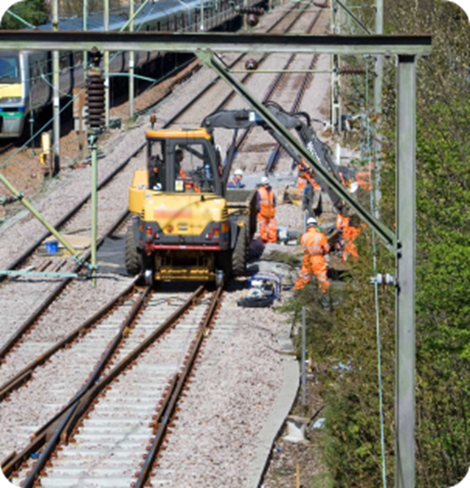
Changes to Standards – June 2024
RIS-8706-INS Issue 2 – Route Level Assessment of Technical Compatibility between Rail Vehicles and Underline Bridges
Overview – This document sets out requirements and guidance for the assessment of compatibility between rail vehicles and underline bridges at route level on the GB mainline network.
RIS-8706-INS Issue 2 has new requirements covering the compatibility process and plant travelling in possessions. More guidance has been added.
Benefits – The RA system provides a simple, proportionate, and economic means of assessing compatibility between rail vehicles and underline bridges.
Audience – This standard is targeted at engineers, operators, and planners who need to assess compatibility between trains and infrastructure on specific routes.
RU
Engineers
Planners
Click the link icon to go to the standard

Slide 16
Changes to Standards – June 2024
GERT8006 Issue 4 – Route Availability Number for Assessment of Compatibility between Rail Vehicles and Underline Bridges
Overview – This document sets out requirements for finding and using the Route Availability number to assess compatibility between rail vehicles and underline bridges. In detail, how to find the static load characteristics of rail vehicles and assess if underline bridges can carry them, and what to do with that information.
GERT8006 Issue 4 has amendments, additional requirements, and guidance for better clarity. This includes clarifications on the application of loadings to remove potential incorrect results from the calculation.
Benefits – The RA system provides a simple, proportionate, and economic means of assessing compatibility between rail vehicles and underline bridges.
Audience – Engineers who need to determine the RA number of rail vehicles or underline bridges.
RU
Engineers
Click the link icon to go to the standard

Slide 17
Changes to Standards – June 2024
GEGN8616 Issue 1 – Guidance on evaluating excessive dynamic effects in underline bridges
Overview – This is a new document providing additional guidance in carrying out the Stage 3 compatibility assessment between trains and infrastructure.
Benefits – The assessment techniques in GEGN8616 come from years of experience. They are collected in this document so that the wider industry can benefit from that. The new guidance can be used to assess and mitigate the risks of excessive dynamic effects in underline bridges.
Audience – Engineers, operators, and planners who need to carry out the Stage 3 compatibility assessment where the proposed operating speed of a train exceeds the limits of validity of the RA system.
RU
Engineers
Planners
Click the link icon to go to the standard

Slide 18
Changes to Standards – June 2024
One non-RSSB standard has been published on the RSSB website.
COP0131 Issue 2 – Code of Practice for OTM Driver Communication Review Group (CRG)
Click the link icon to go to the standard

Slide 19
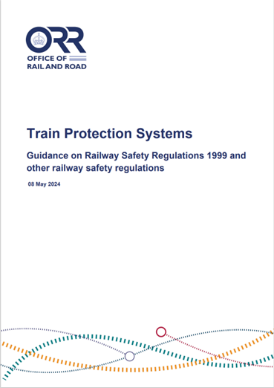
Changes to Standards – June 2024
Legislation news related to guidance on the Railway Safety Regulations 1999
On 8 May 2024, the Office of Rail and Road (ORR) published updated guidance on the Railway Safety Regulations 1999 (RSR99). The document clarifies the interpretation of RSR99 for train protection systems. This includes how ORR expects duty holders to manage migration to Automatic Train Protection. It also gives guidance on other legal requirements relevant to train protection systems.
The document can be accessed here on the ORR’s website.

Slide 20
Nine deviations have been published since March 2024 (Slide 1 of 2)
22-101-DEV; GERT8000-T3 Issue 11.1 – Possession of a running line for engineering work Deviation is intended to provide a better alternative by removing the need for track workers to go on or near the line to place or remove detonators as part of the protection arrangements.
23-016-DEV; GIRT7020 Issue 2 – GB Requirements for Platform Height, Platform Offset, and Platform Width
The existing platforms require some reduction in width to support construction activities.
23-041-DEV; GERT8000-M3 Issue 4 – Managing incidents, floods, and snow The current level of flood water is approaching the bottom of the rail head and is steadily rising based on the level sensor deployed in the tunnel.
23-042-DEV; GERT8402 Issue 3 – ERTMS/ETCS DMI National Requirements
There is not a planned further software release for the CL180 project – all future Alstom contracts use EVC3 and the small CL180 fleet uses the EVC2.
Click the link to access the deviation on the RSSB website

Slide 21
Nine deviations have been published since March 2024 (Slide 2 of 2)
23-023-DEV; GIRT7020 Issue 2 – GB Requirements for Platform Height, Platform Offset, and Platform Width The existing platform length at Glynde Station is 133.4m, suitable for a six-car train.
24-001-DEV; GERT8402 Issue 2 – ERTMS/ETCS DMI National Requirements
The deviation applies to the first in class ETCS fitted Class43 vehicles 43013, 43014, and 43062.
24-002-DEV; GERT8402 Issue 3 – ERTMS/ETCS DMI National Requirements The deviation applies to the ETCS fitted Class 43 vehicles 43013,43014 and43062.
24-004-DEV; GERT8000-T3 Issue 11.1 – Possession of a running line for engineering work The deviation is requested to trial the proposed changes in the York Maintenance Delivery Unit,
part of the Eastern Route within Network Rail.
24-008-DEV; GIRT7020 Issue 2 – GB Requirements for Platform Height, Platform Offset, and Platform Width Tilehurst Station – adjacent to OLE gantry structure number MLN 62 126 (for all)
Click on the link to access the deviation on the RSSB website

Slide 22
Draft standards scheduled for publishing in September 2024
GSM-R Handbook updates
GERT8000-TW1 Issue 20 – Preparation and movement of trains
RS523 Issue 2 – GSM-R Handbook
Rules concerning walking on or near the line
GERT8000-HB1 Issue 8 – General duties and track safety for track workers
GERT8000-HB6 Issue 8 – General duties of an individual working alone (IWA)
GERT8000-HB7 Issue 9 – General duties of a controller of site safety (COSS)

Slide 23
Draft standards scheduled for publishing in September 2024
Operation of route and line proving trains
RIS-3771-TOM Issue 1 – Operation of Route and Line Proving Trains
GERT8000-HB1 Issue 8 – General duties and track safety for track workers
GERT8000-HB8 Issue 10 – IWA, COSS or PC blocking a line
GERT8000-TS1 Issue 18 – General Signalling Regulations
GERT8000-TW1 Issue 20 – Preparation and movement of trains

Slide 24
Draft standards scheduled for publishing in September 2024
Optimising drivers’ use of audible warnings
GERT8000-OTM - Issue 12 – Working of on-track machines (OTM)
GERT8000-SS2 Issue 7 – Shunting
GERT8000-TW1 Issue 20 – Preparation and movement of trains
GERT8000-TW5 Issue 13 – Preparation and movement of trains: defective or isolated vehicles and on-train equipment
GERT8000-TW7 Issue 10 – Wrong-direction movements
GERT8000-TW8 Issue 10 – Possession of a running line for engineering work

Slide 25
Draft standards scheduled for publishing in September 2024
New signs and rules for certain types of permissible and temporary speed restrictions
GERT8000-SP Issue 7 – Speeds
GERT8000-TW7 Issue 10 – Wrong Direction Movements
RS521 Issue 7 – Signals, Handsignals, Indicators and Signs Handbook
RIS-0733-CCS Issue 2 – Lineside Operational Signs
RIS-0734-CCS Issue 3 – Signing of Permissible Speeds
RIS-0735-CCS Issue 2 – Signing of Temporary and Emergency Speed Restrictions

Slide 26
Draft standards scheduled for publishing in September 2024
GMGN2694 Issue 1 – Rolling Stock Subsystems and Electromagnetic Compatibility with CCS Subsystems
GEGN8646 - Issue 1.1 – Guidance on the Common Safety Method for Risk Evaluation and Assessment
The use of Hydrogen a fuel source to power trains – Policy paper
Policy
The use of Hydrogen a fuel source to power trains – System Definitions and diagrams
Policy
The use of Hydrogen a fuel source to power trains – Bowtie Models
Policy

Slide 27
Draft standards scheduled for consultation in June 2024
RIS-6702-DST Issue 1 – Common reference time for railway systems
Draft standards scheduled for consultation in July 2024
RIS-2704-RST Issue 2 – Rail Industry Standard for Wheelsets Handling and Storage
RIS-2709-RST Issue 2 – Rail Industry Standard for the Identification of Roller Bearings Defects
GMRC2542 Issue 2 – Recommendations for Determination of Aerodynamic Rolling Moment Coefficient

Slide 28
Draft standards scheduled for consultation in August 2024
RIS-3781-TOM Issue 2 – Requirements for the operation of freight trains and the conveyance of dangerous goods by any train
RIS-7708-INS Issue 1 – Maintenance of Signal and Operational Sign Visibility
RIS-8034-CCS Issue 1 (withdrawal) – Maintenance of Signal and Operational Sign Visibility
RIS-0386-CCS Issue 2 – Rail Industry Standard on Signal Overrun Risk Evaluation and Assessment

Slide 29
Draft standards scheduled for consultation in September 2024
RIS-2700-RST Issue 3 - Rail Industry Standard for Verification of Conformity of Engineering Change to Rail Vehicles​
RIS-2702-RST Issue 3 - In-service Examination and Reference Limits for Freight Wagons​​
GMGN2697 - Issue 1 – Guidance on Entity in Charge of Maintenance (ECM) Regulations
GERT8073 - Issue 5 – Application of Standard Vehicle Gauges
GMRT2173 - Issue 5 – Size of Vehicles and Position of Equipment
RIS-6701-DST - Issue 1 – Unique Train Service Identifiers

Slide 30
Draft standards scheduled for consultation in September 2024 (Continued)
Medical Fitness Requirements
RIS-3789-TOM Issue 1 - Medical Fitness Requirements
RIS-3451-TOM Issue 2 - Train Drivers - Suitability and Medical Fitness Requirements​
RIS-3452-TOM Issue 2 - Train Movement - Medical Fitness Requirements​
GOGN3655 Withdrawal - Guidance on Medical Fitness for Railway Safety Critical Workers

Slide 31
Draft standards scheduled for consultation in September 2024 (Continued)
Introducing special working to the Rule Book
TN3302 – Special Working
GERT8000-HB5 Issue 3 – Handsignalling duties
GERT8000-M1 Issue 8 – Dealing with a train accident or train evacuation
GERT8000-M2 Issue 8 – Train stopped by train failure
GERT8000-S5 Issue 12 – Passing a signal at danger or an end of authority (EoA) without a movement authority (MA)

Slide 32
Draft standards scheduled for consultation in September 2024 (Continued)
Introducing special working to the Rule Book (continued)
GERT8000-TS2 Issue 7 – Track circuit block regulations
GERT8000-TW1 Issue 21 – Preparation and movement of trains
RS521 Issue 7 – Signals, handsignals, indicators and signs Handbook
RS522 Issue 4 – AWS and TPWS Handbook

Slide 33
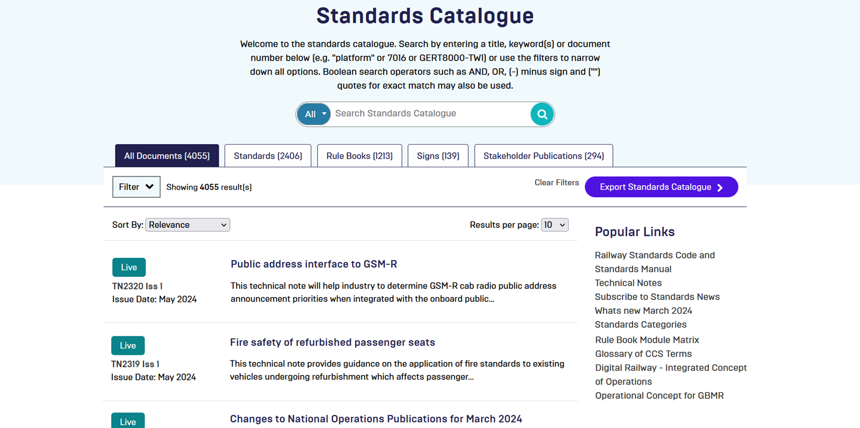
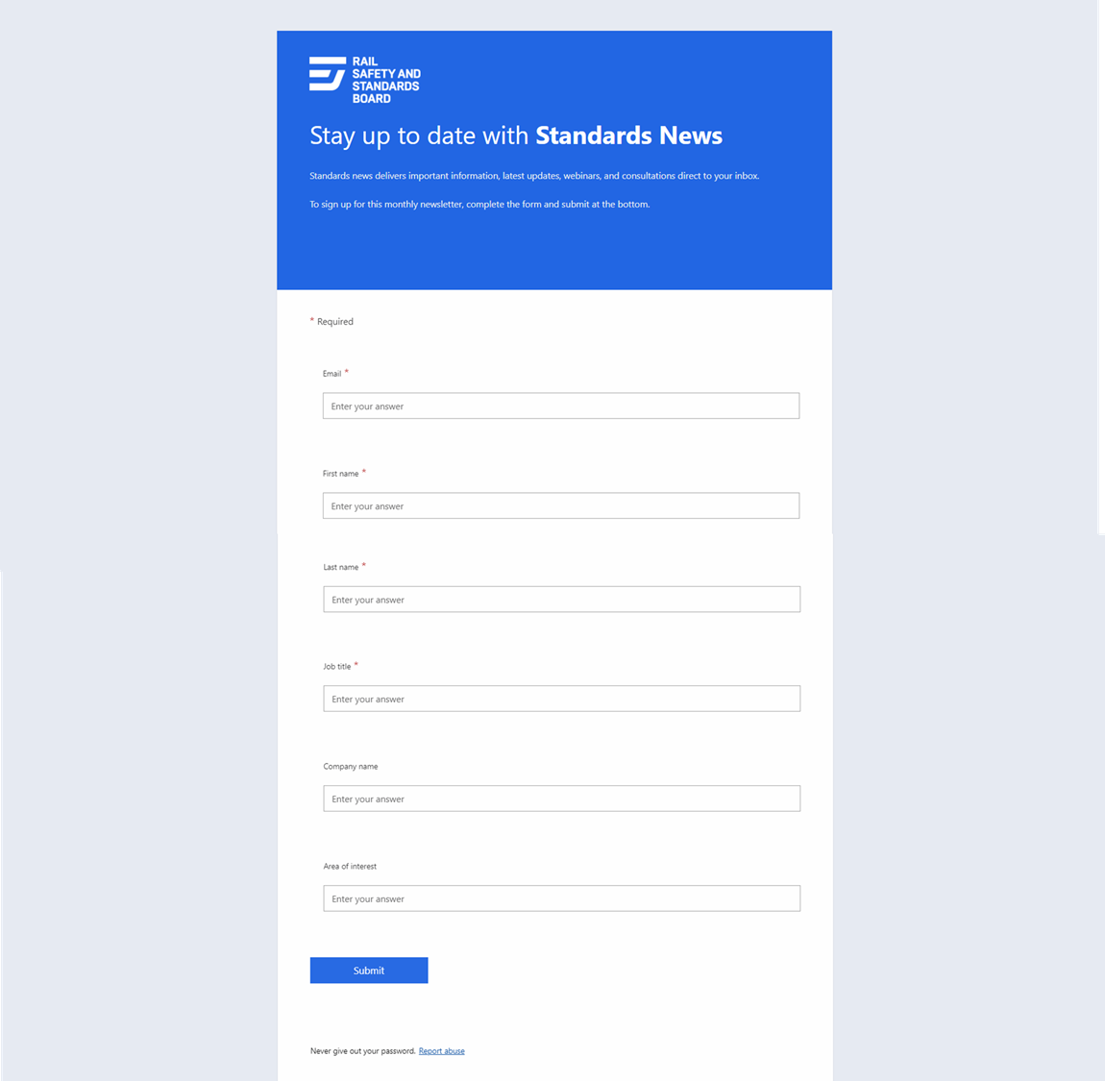
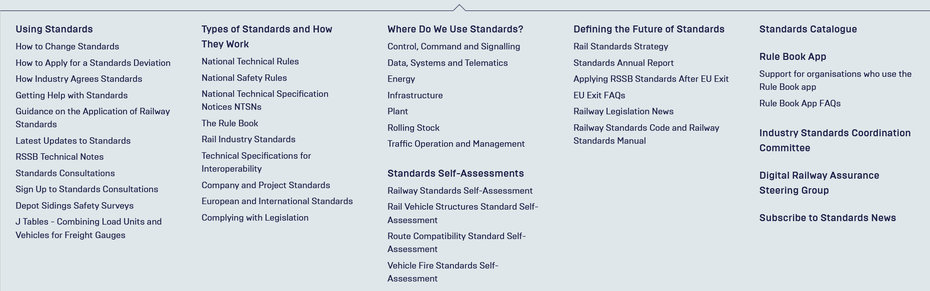
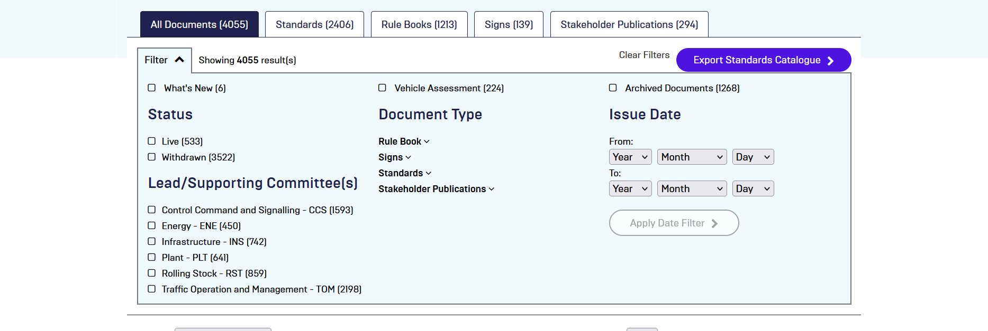
Standards News (70 seconds in length)
How to access webinars
Standards being published
Standards being Consulted on
What’s in the pipeline
Changes to process
Legislation updates

