Slide 1



Changes to Standards –
December 2020 interactive briefing slide deck
Please view in slideshow mode for the links to work
The presentation is interactive, you decide how to navigate through it, but you can always return to the main menu by clicking on the home icon.
Some slides contain links to additional online content, these are indicated with an icon.

Slide 2
Changes to Standards – December 2020
RSSB resources to help you get the most out of Standards
Changes to standards in December 2020
Link to previous standards catalogues
Click on a button to proceed to that section

Slide 3
Changes to Standards – December 2020
RSSB resources to help you get the most out of Standards
RSSB publishes new and revised standard four times a year, in March, June, September and December. To ensure that you get the most from each standard published, RSSB also publishes lots of supporting briefing materials -
Each standard is published on its own page with a business case for change and a briefing note
RSSB also publishes additional briefing content on the Latest updates to the Standards page, this includes Videos, PowerPoint slide decks, Briefing sheets, Process flowcharts Excel spreadsheets and other materials referenced in the standards published in that period
RSSB runs free Standards Update Briefing Webinars where the technical authors from RSSB, supported by representatives form industry talk through the changes to standards and answer any questions you might have. Bookings to these events can be made here - https://www.rssb.co.uk/services-and-resources/s
Recordings of previous webinars can be found here - https://www.rssb.co.uk/services-and-resources/services/events/Past-Webinars

Slide 4
Changes to Standards – December 2020
RSSB resources to help you get the most out of Standards
Changes to standards in December 2020
Link to previous standards catalogues
Click on a button to proceed to that section

Slide 5



Changes to Standards – December 2020
Non
RSSB
Plant
Rolling Stock
RDG and Plant COPs
0 new standards
2 new standards
4 new standards
Control Command
and Signalling
Rail related legislation
Infrastructure
4 new standards
0 new standards
0 new to report
Operational rules
Energy (AC & DC systems)
Deviations
0 new standards
1 new standards,
2 new forms +
1 change to the rulebooks
17 deviations requests received
9 deviations issued
Click on the icons for more detail on those changes
Notes:
Here are the headlines - Click on the icons for more detail on those changes

Slide 6

Changes to Standards – December 2020
Two new or updated Rolling Stock standard have been published in the December 2020 standards catalogue.
RIS-2646-RST Issue 1 - Requirements for Axle Bearing Maintenance
GERT8073 Issue 4 - Requirements for the Application of Standard Vehicle Gauges
Click on a standard to find out more
Notes:
Headlines ……….

Slide 7


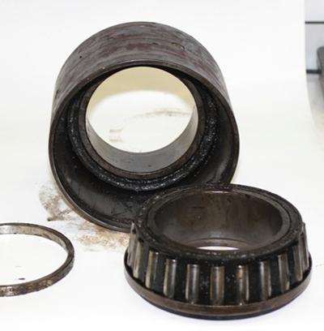
Changes to Standards – December 2020
RIS-2646-RST Issue 1 - Requirements for Axle Bearing Maintenance
RUs
Overview - This standard was drafted following the five year review of GNGM2646. It includes requirements derived from GNGM2646, as well new requirements and guidance relating to reassembly of bearings following ultrasonic axle testing (UAT), formalising the output of RSSB research project Human Factors in Axle Inspection (T774).
Benefits - The provision of clear requirements and guidance aligned
with legal obligations in one standard will enable industry to apply a
consistent approach to the management of bearing maintenance. It
is considered that this has the potential to achieve cost savings by
avoiding rework and improving processes.
Audience – Rolling Stock maintenance engineers
Suppliers
Notes:
Headlines ……….

Slide 8

Changes to Standards – December 2020
GERT8073 Issue 4 - Requirements for the Application of Standard Vehicle Gauges
RUs
Overview – This standard has been restructured, aligning it with the current format of RGS. Repetitive text has been removed, requirements and guidance are now separated, and each requirement has a rationale, making the standard more user friendly.
This standard has been updated to help industry maximise the available gauge space for vehicles by incorporating the latest gauging research and development into the standard. This includes -
● the changes to PG1, PG2 and LSVG. ● the developed PG3 26 m vehicle gauge.
● the new locomotive gauge LG2. ● T1132 supplementary freight gauges
Publishing updated gauging workbooks
In addition the standard has improved clarity in the application of lower sector gauges in the wider gauging suite of standards by incorporating the supplementary LSVG gauges for shoegear and tripcocks and adding additional guidance on the potential conflict between 3rd rail equipment and tripcocks.
Benefits – This standard will enable vehicles to be introduced to a new route with a minimum amount of gauging analysis and modification to the vehicle or infrastructure. This will reducing future gauging analysis costs, providing more opportunities for fleet deployment, and helping operators to respond more quickly and accurately to changes in demand. In addition. The restructured document will provide greater clarity and reduce the risk of conflicts and contradictions.
Audience -Rolling Stock maintenance engineers and Operations
Suppliers
ROSCOS
Operations
Notes:
Headlines ……….

Slide 9

Changes to Standards – December 2020
Four new or updated Rolling Stock standard have been published in the December 2020 standards catalogue.
RIS-0784-CCS Issue 2 - The management of Packet 44 Applications
RIS-0733-CCS Issue 1 - Lineside Operational Signs - Product Requirements
RIS-0734-CCS Issue 2 - Signing of Permissible Speeds
GIRT7033 Issue 4 - Lineside Signs
Click on a standard to find out more
Notes:
Headlines ……….

Slide 10

Changes to Standards – December 2020
RIS-0784-CCS Issue 2 - The management of Packet 44 Applications
RUs
Overview – The Standard sets out the requirements for managing packet 44 applications in GB rail, This is to prevent the proliferation of bespoke applications that provide the same functionality, resulting in repeating the installation and transmission of the same data.
Issue two was updated to improve the process requirements and the associated guidance to reduce time and effort required for proposal process and to support the reuse of existing packet 44 applications.
In addition further guidance has been included on how to apply for a new
packet 44 application or change an existing packet 44 application. The
appendices were also updated, providing one appendix for each existing
application.
Benefits – Compliance with the revised standard will reduce the number of
trackside balises required to achieve the same functions and support the
operational need for packet 44 applications. Reuse of existing balises for the
same function means that new balises do not have to bev installed, tested,
commissioned and maintained, reducing staff exposure to track hazards.
Audience – Those proposing changes to signalling systems
Suppliers
Notes:
Headlines ……….

Slide 11
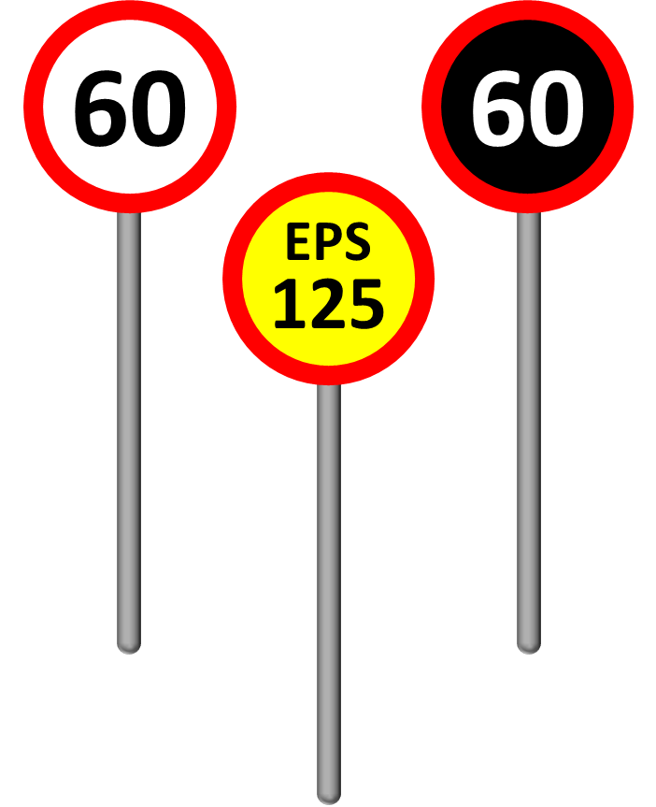
Changes to Standards – December 2020
RIS-0733-CCS Issue 1 - Lineside Operational Signs - Product Requirements
RUs
Overview – This new standard sets out the requirements, rationale and guidance for the application of the lineside operational signs published in the RSSB catalogue and the process to be followed when a new design or a change of use of a lineside operational sign is proposed.
The standard also contains the index of signs published in the RSSB standards catalogue and some requirements that were previously published in GIRT7033 issue 3 that no longer meet the criteria to be National Technical Rules. These include the permitted colours of signs, the language of text shown on signs and the process for introducing a new type of sign. A video explaining the content of this standard can be found here
A video explaining the content of this standard can be found on this page -
Latest Updates to Standards (rssb.co.uk)
Benefits – Conformity with this new standard is consistent with providing
suitable and sufficient risk controls and safe integration with train operations
in the context of applying the CSM RA. The standard will minimise the
proliferation of proposals for new and modified signs and when a sign is
proposed, to streamline the trial and validation process that supports a
decision that the sign is fit for purpose.
Audience -Those considering the introduction of a sign and the safe integration
of it with rolling stock (IMs and RUs)
IMs
Operations
Notes:
Headlines ……….

Slide 12
Changes to Standards – December 2020
RIS-0734-CCS Issue 2 - Signing of Permissible Speeds
RUs
Overview – This updated standard contains the requirements and guidance of the signing of permissible speed limits. Issue 2 better aligns the requirements with those in the Railway industry standards on lineside signalling systems and driveability assessment.
Part 1 provides an introduction to speed signage and its contribution to the train driving task
Part 2 sets out requirements and guidance on the provision, location and layout of permissible speed indictors, covering plain line applications as well as signs that indicate speed changes at diverging or converging junctions.
Part 3 sets out requirements and guidance on the provision, location and layout of permissible speed warning indictors and AWS magnets, covering plain line applications as well as signs that indicate speed changes at diverging or converging junctions.
A video explaining the content of this standard can be found on this page -
Latest Updates to Standards (rssb.co.uk)
Benefits -The requirements in RIS-0734-CCS issue two have been developed from an analysis of the hazard precursors relevant to poor interpretability and poor driveability, which means Conformity with this new standard is consistent with providing suitable and sufficient risk controls and safe integration with train operations in the context of applying the CSM RA.
Audience - Those considering the introduction of a sign and the safe integration of it with rolling stock (IMs and RUs)
IMs
Operations
Notes:
Headlines ……….

Slide 13
Changes to Standards – December 2020
GIRT7033 Issue 4 - Lineside Signs
RUs
Overview – This updated standard sets out the requirements of lineside operational signs that supports technical compatibility with rail vehicle exterior lighting and windscreens. Conformity with GIRT7033 means that the sign is capable of being distinguished and read when viewed through a windscreen at any time of day or night, if it is used as intended
A video explaining the content of this standard can be found on this page -
Latest Updates to Standards (rssb.co.uk)
Benefits -The requirements in GIRT7033 issue four have been developed from an analysis of the hazard precursors relevant to poor interpretability and poor driveability, which means Conformity with this new standard is consistent with providing suitable and sufficient risk controls and safe integration with train operations in the context of applying the CSM RA.
Audience - Those considering the introduction of a sign and the safe integration of it with rolling stock (IMs and RUs)
IMs
Operations
Notes:
Headlines ……….

Slide 14
Changes to Standards – December 2020
One new standards and urgent changes to several rulebook modules have been published in the December 2020 standards catalogue.
RIS-3782-TOM Issue 1 - Design, position and use of car stop markers
GERT8000 – Modules G1, HB1, TW1, M3 - Urgent changes covering Structures and Earthworks Rules
Two new forms linked to the Rulebook have been published in the December 2020 standards catalogue.
Form RT3198 Issue 12-20 - Possession Arrangements Form
Form RT3199 Issue 12-20 - Work-site Certificate
Click on a standard to find out more
Notes:
Headlines ……….

Slide 15
Changes to Standards – December 2020
RIS-3782-TOM Issue 1 - Design, position and use of car stop markers
RUs
Overview - This new standard contains requirements to improve
the consistency in the design, positioning and use of the signs
across the GB mainline network. It is linked to AK104 which
contains an updated sign specification for car stop markers.
Benefits - Rationalising the number of train stopping positions,
The number of car stop markers and their design will reduce the
route knowledge burden on drivers. This has the potential to
minimise stop-short door release incidents and will reduce the costs and effort associated with designing, trialling, installing and maintaining car stop markers.
Aligning the standard to AK104 issue two will support drivers in perceiving and interpreting the meaning of these signs. Reducing the likelihood of drivers to miss, mistake or misunderstand stop markers due to design variations and interference from other platform signage. The colour specification for AK104 issue two will mean that car stop markers will be easily detected when scanning the scene to locate them.
Audience - Those responsible for sign installation, platform-train interface risk management, rolling stock introduction and operational standards.
IMs
Operations
Notes:
Headlines ……….

Slide 16
Changes to Standards – December 2020
GERT800 – Modules G1, HB1, TW1, M3 - Urgent changes covering Structures and Earthworks Rules
RUs
Overview - On 12 August 2020 a passenger train was derailed by a landslip near Stonehaven in Scotland. The driver, the conductor and a passenger lost their lives. This has prompted the rail industry to make some urgent changes to the Rule Book. We have taken the opportunity to provide clearer instructions for what to do if there is damage to structures or earthworks, as well as if you see any unusual flows or pools of water that could cause damage.
The new rules are in addition to the existing rules for reporting flooding on the track or track defects.
It’s important to remember that the investigations into the Stonehaven derailment are still at an early stage – these changes aren’t intended to pre-judge the outcome of the investigation. There may be further changes over the coming weeks and months as RAIB learns more about the causes of the accident.
Additional information plus briefing videos can be found here - Structures and Earthworks Rules Changes (rssb.co.uk)
Audience – Drivers, Trackworkers, Signallers and Controllers
IMs
Operations
Notes:
Headlines ……….

Slide 17
Changes to Standards – December 2020
Click on the title to access the standard on the RSSB website
Non
RSSB
4 Non RSSB standards have been published on the RSSB website
COP0011 Issue 6 - Code of Practice for Planning and Executing Lifting Operations
COP0017 Issue 4 - Code of Practice for Loading of OTP
COP0027 Issue 4 - Code of Practice for On Track Plant Recovery
COP 0 Issue 4 - Code of Practice for M&EE Documents
Notes:
Headlines ……….

Slide 18
Changes to Standards – December 2020
9 Deviations issued
20-003-DEV; GERT8000 - TW1 Preparation and movement of trains and GERT8000-SP Speeds
20-022-DEV; GERT8000 - TW1 Preparation and movement of trains
20-032-DEV; GIRT7020 - GB Requirements for Platform Height, Platform Offset and Platform Width
20-029-DEV; GLRT1210 - AC Energy Subsystem and Interfaces to Rolling Stock Subsystem
20-018-DEV; GIRT7020 - GB Requirements for Platform Height, Platform Offset and Platform Width
More Deviations
Link to deviations page
Notes:
Headlines ……….

Slide 19
Changes to Standards – December 2020
Deviations issued
20-048-DEV; GERT8000 - TW1 Preparation and movement of trains
20-044-DEV; GMRT2400 - Engineering Design of On-track Machines in Running Mode
20-043-DEV; GIRT7020 - GB Requirements for Platform Height, Platform Offset and Platform Width
20-038-DEV; GMRT2111 - Rolling Stock Subsystem and Interface to AC Energy Subsystem
Previous Deviations
Link to deviations page
Notes:
Headlines ……….

