Slide 1





Changes to Standards –
June 2022 interactive briefing slide deck
Please view in slideshow mode for the links and audio to work
The presentation is interactive, you decide how to navigate through it, but you can always return to the main menu by clicking on the home icon.
Or you can exit the presentation by clicking the exit icon
Some slides contain links to additional online content, these are indicated with an icon.
This presentation contains audio content. An icon will appear in the bottom right hand corner when it is playing.

Slide 2
Changes to Standards – June 2022
Changes in the June 2022 Standards update
Deviations granted against standards March 2022- June 2022
Standards planned for publishing in the next six months
Standards currently being drafted and due for consultation
in the next 3 months
Video content supporting standards
Click on a button to proceed to that section

Slide 3

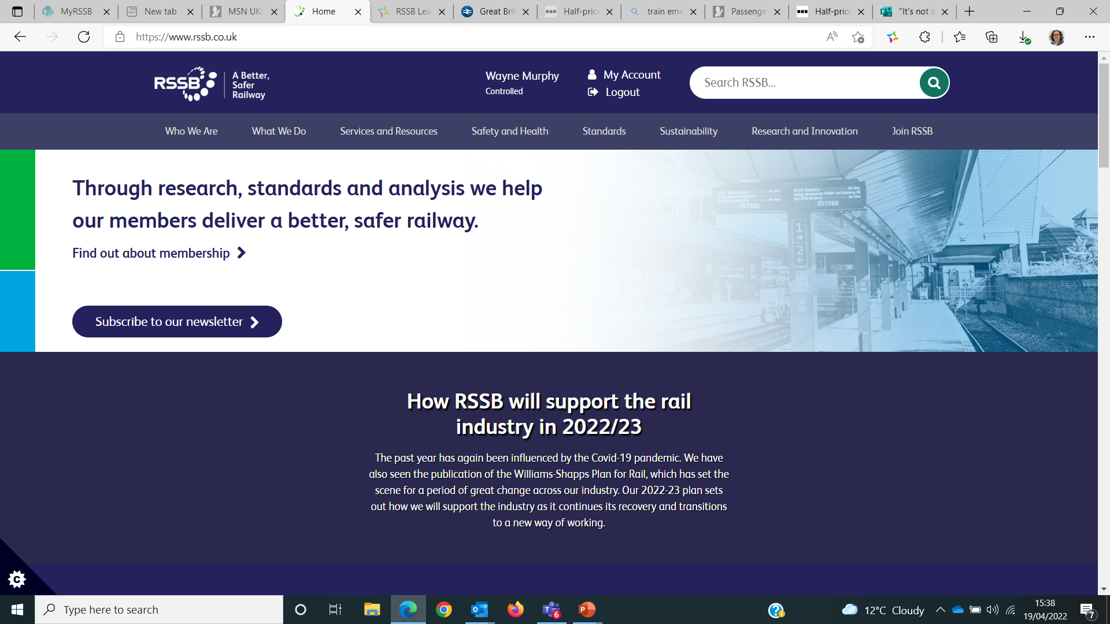


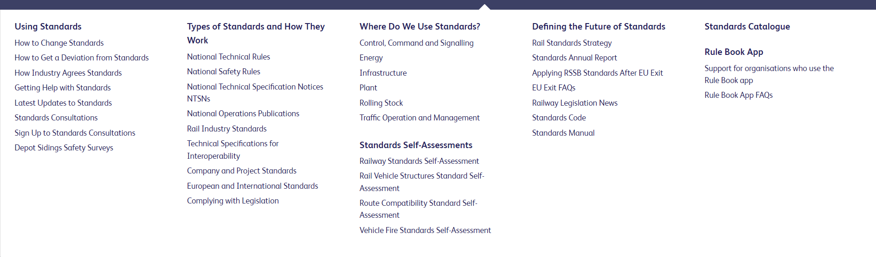
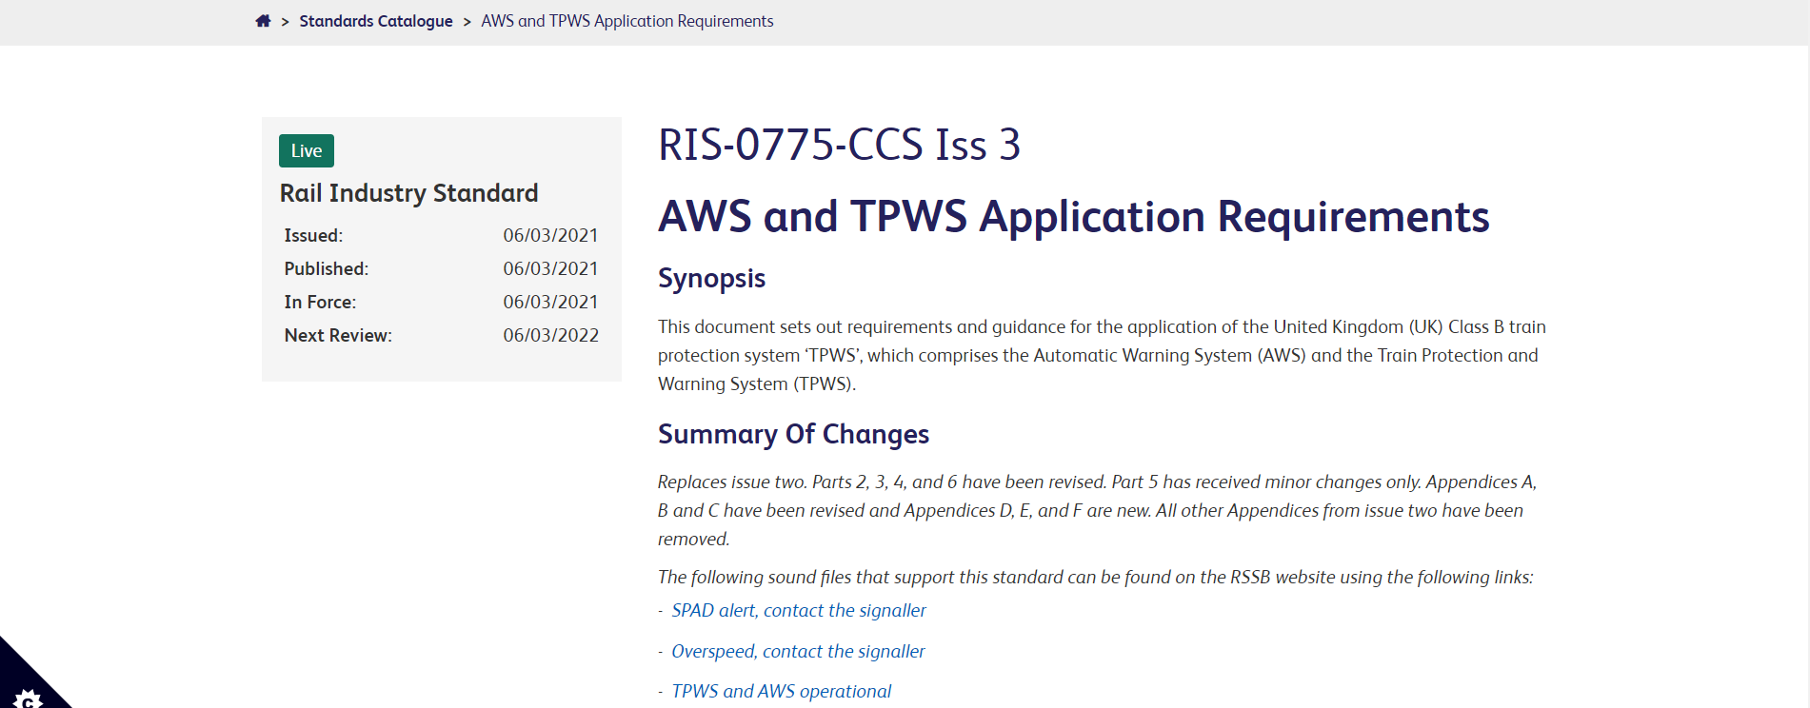
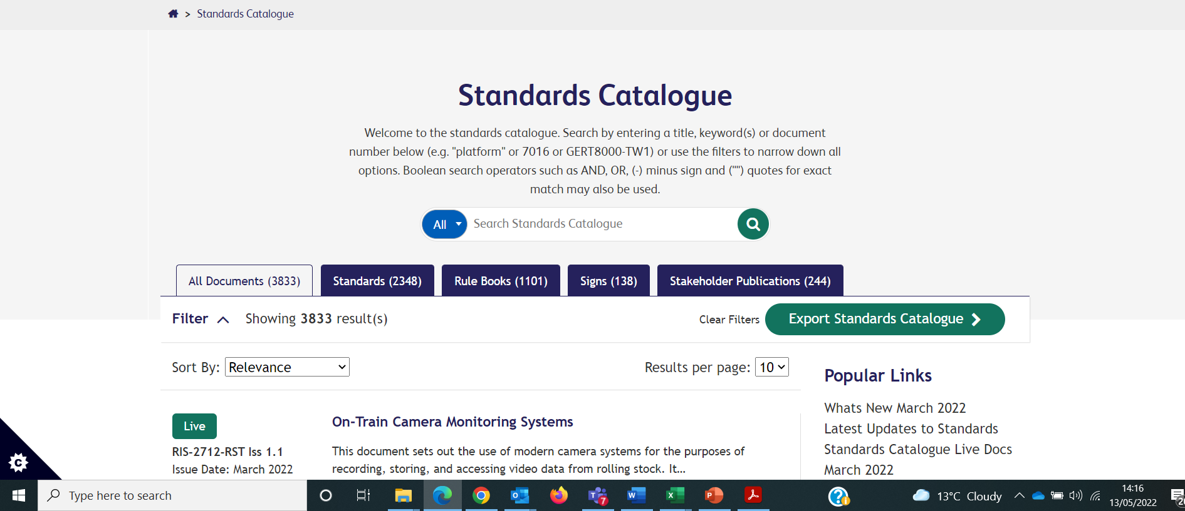
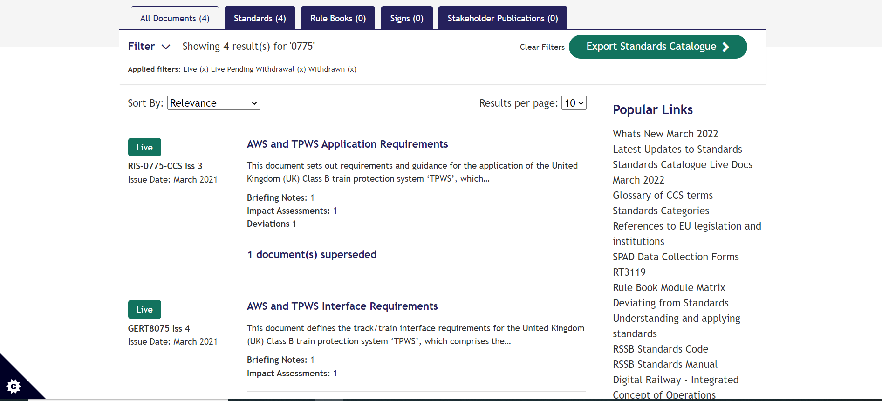

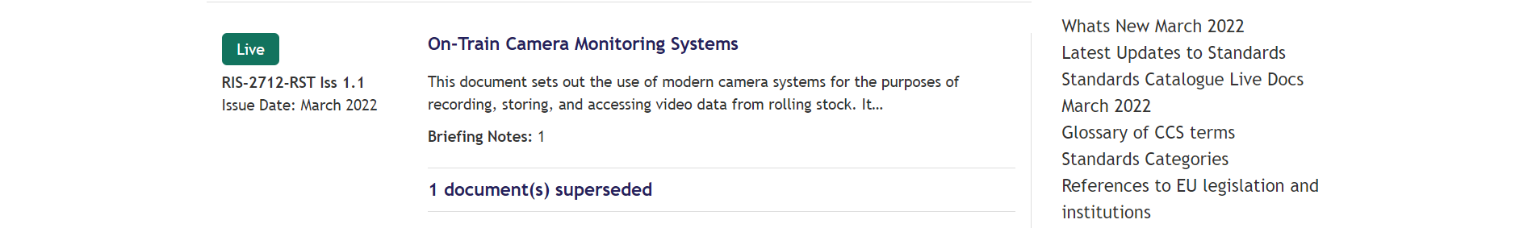
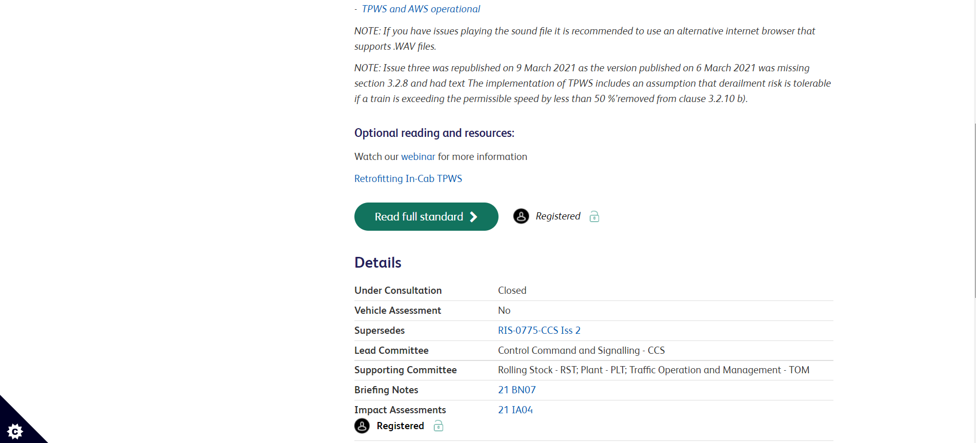
Narrated by
Wayne Murphy
Technical Policy Manager
Video content supporting standards
0775

Slide 4
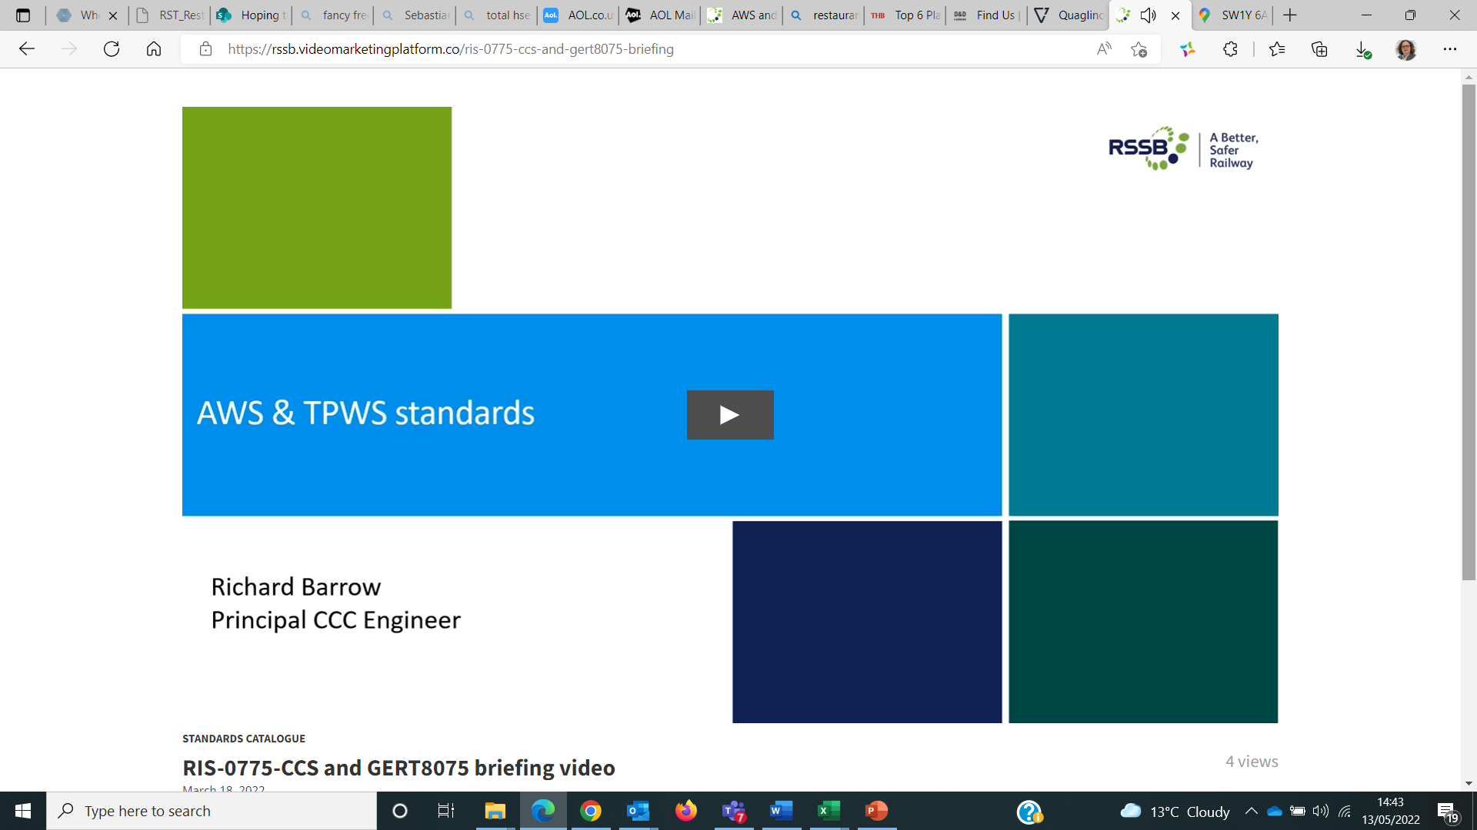
Narrated by
Wayne Murphy
Technical Policy Manager
Video content supporting standards
The videos are narrated by the subject matter expert who drafted the standard
Each video lasts between 5 and 15 minutes and contains information on -
Background to the Standard and its contents
Changes made to the latest version
The audience for the standard
Benefits of the change
Currently we have published links to 35 videos.
We plan to create new videos for each new or revised standard, as they are drafted.
These will be published quarterly at the same time the standard is published
on our website.
Wayne.murphy@rssb.co.uk

Slide 5







Changes to Standards – June 2022
Data, Systems and Telematics
Plant
Rolling Stock
0 new standards
5 new standards
0 new standards
Non
RSSB
Control Command
and Communication
Non RSSB standards
Infrastructure
0 new standards
2 new standards
6 new standards
Energy (AC & DC systems)
Rail related legislation
Operational rules
1 new standard
0 new standards
1 new item of legislation
Click on the icons for more detail on those changes
Notes:
Here are the headlines - Click on the icons for more detail on those changes

Slide 6
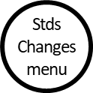
Changes to Standards – June 2022
Five Rolling Stock standards have been published in the June 2022 standards catalogue.
RIS-8273-RST Issue 1 - Assessment of Compatibility of Rolling Stock and Infrastructure – Gauging and Stepping Distances
GMRT2173 Issue 4 - Size of Vehicles and Position of Equipment
RIS-2773-RST Issue 2 - Format and Methods for Defining Vehicle Gauging Data
RIS-2711-RST Issue 2 - Rail Vehicle Lettered Differential Speeds Clarification
GMGN2571 Issue 2 - Storage and Recommissioning of Rail Vehicles
Click on a standard to find out more
Notes:
Headlines ……….

Slide 7
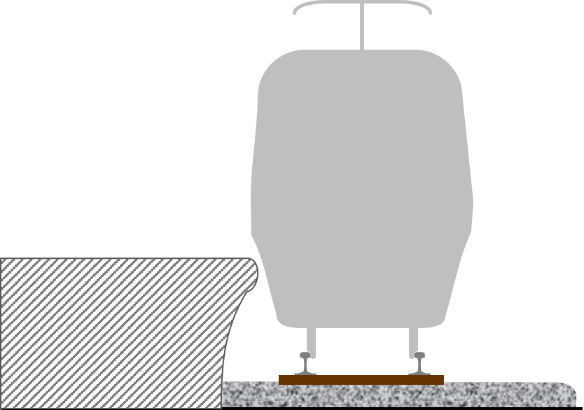

Changes to Standards – June 2022
RIS-8273-RST Issue 1 - Assessment of Compatibility of Rolling Stock and Infrastructure –
Gauging and Stepping Distances
RUs
Overview – RIS-8273-RST sets out the compatibility process for checking
gauge clearance and for assessing stepping distances; this forms part of the
route compatibility assessment detailed in RIS-8270-RST.
This new standard replaces GERT8273 as the compatibility process is no
longer in scope of a Railway Group Standard. The technical processes and
requirements for checking gauge compatibility and assessing stepping
distances have not been changed, but rationale has been added to explain
the ‘why’ as well as the ‘what’.
Additional guidance has also been provided, some from GEGN8573, some from the findings of R&D project T1166 ‘Minimising the impact of ‘high and tight’ platforms on the overall PTI step/gap dimensions‘, some from RIS-7016-INS (Information on gap-fillers) and some has been specifically developed on the assessment of stepping distances.
Benefits – This is part of a suite of standards changes which includes GMRT2173 iss 4 and RIS-2773-RST iss 2, with an overall benefit of approximately £1.5M over 5 years. This standard will Improve the management of the PTI, reducing the risk of slips, trips and falls and improve performance by reducing dwell times.
Audience – A route compatibility assessment is required whenever a change is made to infrastructure, rolling stock or operations. This standard is therefore relevant to IMs , RUs as well as infrastructure project teams.
IMs
Projects
Notes:
Headlines ……….

Slide 8

Changes to Standards – June 2022
GMRT2173 Issue 4 - Size of Vehicles and Position of Equipment
RUs
Overview – GMRT2173 sets out National Technical Rules, as mandated in the National Technical Specification Notices (NTSNs), related to the size of vehicles and position of equipment for mainline rolling stock on the GB network.
The changes in issue four include –
The requirements for the compatibility of tripcocks and collector shoegear with infrastructure have been moved to GERT8073.
The maximum vehicle overhang length has been increased to 4.2m to align with the limit set out in the NTSN.
Guidance on T1196 and the calculator for creating infrastructure gauges for pantographs has been added
as a new appendix in GMRT2173.
Rationale has been added to the requirements to explain the ‘why’ as well as the ‘what’.
Benefits – This is part of a suite of standards changes which includes RIS-8273-RST Issue 1 and RIS-2773-RST issue 2, with an overall benefit of approximately £1.5M over 5 years. The introduction of a calculator for infrastructure gauges for pantographs can be used as a tool to facilitate the process for pantograph gauging.
Audience – This document is applicable to Infrastructure Managers, Railway Undertakings and projects working on rolling stock and infrastructure.
IMs
Projects
Suppliers
Notes:
Headlines ……….

Slide 9
Changes to Standards – June 2022
RIS-2773-RST Issue 2 - Format and Methods for Defining Vehicle Gauging Data
RUs
Overview – RIS-2773-RST issue 2 sets out the requirements and good practice for generating a vehicle’s swept envelope using multibody simulations (MBS).
RIS-2773-RST issue 2 has been restructured, so that each requirement topic is now followed by the rationale
to explain ‘why’ the requirement exists. Guidance associated with the topic is also included within the topic heading.
GMGN8573 issue 4 Guidance on Gauging and Platform distances has now been superseded and any relevant sections that described a gauging methodology or other useful information have been incorporated within
this standard
Two new sections have also been added covering Pantograph Gauging and guidance on Determining the Effects of Cross-Wind Loading when Determining Swept Envelopes
Benefits – This is part of a suite of standards changes which includes RIS-8273-RST Iss 1 and RIS-2773-RST iss 2, with an overall benefit of approximately £1.5M over 5 years. The restructuring of the document and the amalgamation of other guidance notes should bring improved clarity and understanding to the user.
Audience – This document is aimed at gauging engineers and gauging practitioners as it sets out detailed methodologies for generating the appropriate vehicle gauging data required by the National Technical Rules in GMRT2173. The completed Vehicle Gauging Data (VGD) workbooks can be used by IMs and RUs to assess gauge clearance to Infrastructure and passing clearance to other vehicles respectively.
IMs
Notes:
Headlines ……….

Slide 10
Changes to Standards – June 2022
RIS-2711-RST Issue 2 - Rail Vehicle Lettered Differential Speeds Clarification
RUs
Overview – Lettered Differential Permissible Speeds (LDPSs) are used to permit certain types of rolling stock with the necessary characteristics to operate at increased speeds on particular sections of the network. There are different categories of LDPS which are indicated on the network by different combinations of letters.
RIS-2711-RST Issue 2 uses the output of research project T1163, Criteria for assigning differential speed categories, to document the required rolling stock characteristics to be able to be permitted to use LDPSs indicated by the letters ‘SP’ (Sprinter multiple-unit), ‘MU’ (Multiple Unit) and ‘HST’ (High Speed Train ). The standard also incorporates new requirements and associated guidance for rolling stock to be classified as MU or HST, in addition to the requirements for classification as SP that were documented in issue 1.
Benefits – RIS-2711-RST Issue 2 will enable existing and new vehicles to be deployed to best effect, optimising journey times, route capacity and asset utilisation. New rolling stock can now be designed with a clear understanding of which categories it will (and will not) satisfy, and the process of categorising rolling stock will be simplified by the publication of clear, agreed criteria. This, together with an upcoming RIS on the application of LDPSs on the network infrastructure, will contribute to an estimated industry net benefit of £12.5m over 10 years.
Audience – The standard is intended for use by individuals and organisations involved in the specification and design of new or modified rolling stock, as well as those involved in the introduction of new or cascaded rolling stock onto new routes, and the associated compatibility assessments.
Suppliers
Notes:
Headlines ……….

Slide 11


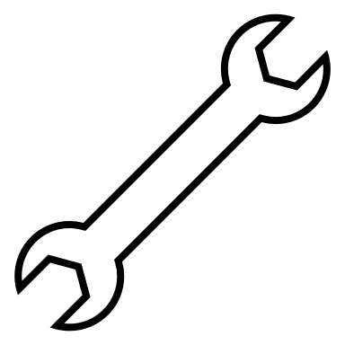

Changes to Standards – June 2022
GMGN2571 Issue 2 - Storage and Recommissioning of Rail Vehicles
RUs
Overview – GMGN2571 Issue 2, Storage and Recommissioning of Traction and Rolling Stock, gives guidance on the storage and recommissioning of rail vehicles that are not to be operated on the GB mainline railway
for an extended period. It sets out good practice for placing vehicles into storage in a safe manner and recommissioning of stored vehicles to ensure safe re-entry into service.
GMGN2571 Issue One, was published in 2002 and the legislation, reference documents, obligations and industry organisations mentioned are either out of date, no longer applicable or have been superseded by requirements in other standards or legislation.
The guidance has been rewritten so that it reflects the current legislative regime and now includes references to relevant documents and has taken account of lessons learned from industry.
Benefits – The railway industry will benefit from the improved and updated guidance that now reflects the current legal and standards framework especially on meeting the requirements for vehicle reregistration following storage. The guidance will also help to reduce the deterioration of vehicle condition, and in some cases should help reduce the risk of injuries to people. It is estimated that the benefit to industry from this improved guidance could amount to over £2M over 5 years.
Audience – This revised guidance will benefit train operators, vehicle owners and maintainers
Owners
Maintainers
Operations
Notes:
Headlines ……….

Slide 12
Changes to Standards – June 2022
Two Infrastructure standards have been published in the June 2022 standards catalogue.
GIRT7020 Issue 2 – GB Requirements for Platform Height, Offset and Width
RIS-7016-INS Issue 2 – Interface between Station platforms , Track, Trains and Buffer Stops
Click on a standard to find out more
Notes:
Headlines ……….

Slide 13
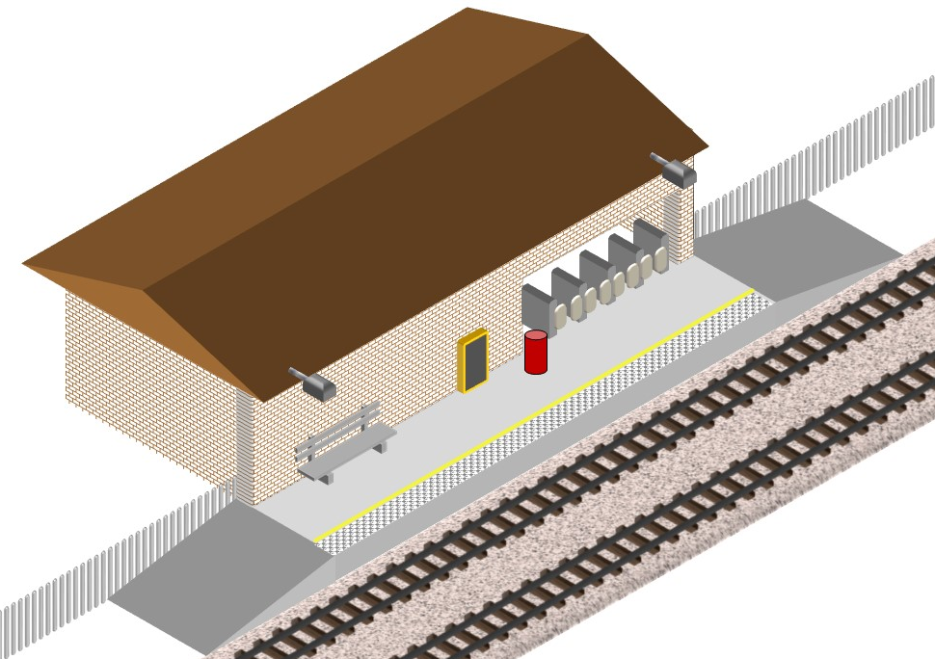
Changes to Standards – June 2022
GIRT7020 Issue 2 – GB Requirements for Platform Height, Offset and Width
RUs
Overview – The position of platforms relative to the adjacent track is a key factor in enabling passengers to safely and conveniently board and alight from trains. The requirements, rationale and guidance for the GB mainline railway are set out in GIRT7020 Issue 2. Platform width and the location of any buildings, furniture or obstructions on platforms are controlled to ensure that there is adequate waiting space for the expected number of passengers, and their belongings, with suitable clearance from passing trains.
The requirements in this issue have been updated to:
  • Make reference to GB National Technical Specification Notices (NTSNs).
  • Maintain consistency with other standards.
  • Provide additional guidance.
RIS-7016-INS provides additional requirements, rationale and guidance
regarding the interface between platforms, track, trains and buffer stops.
Benefits – This updated standard maintains consistency across the suite
of standards related to station platforms to enable those responsible to
provide the most appropriate conditions at each location.
Audience – Those responsible for designing, installing, maintaining,
approving or managing new or modified station platforms or the track
adjacent to platforms.
IMs
Suppliers
Notes:
Headlines ……….

Slide 14
Changes to Standards – June 2022
RIS-7016-INS Issue 2 – Interface between Station platforms , Track, Trains and Buffer Stops
RUs
Overview – RIS-7016-INS covers the wide range of topics that are important for designing, installing, managing and maintaining station platforms and for their interface with the adjacent track. This includes platform position, crossfall and width for passenger use as well as platform surfaces, markings, fencing and other issues.
The requirements in this issue have been updated to:
• Make reference to GB National Technical Specification Notices.
• Consolidate the interim update.
• Remove the appendix on platform gap fillers (transferred to RIS-8273-RST).
The requirements for platform crossfall were reviewed but not changed. Some requirements and associated guidance have been transferred from RIS-7700-INS so that related content is all in one place. The requirements for buffer stops in stations are unchanged in this issue. Guidance has been provided for buffer stops in other locations where an overrun might affect running lines.
Benefits – This updated standard addresses industry concerns, consolidates previous interim updates and provides requirements and guidance covering the broad range of issues to enable those responsible to provide the most appropriate conditions at each location.
Audience – Those responsible for designing, installing, managing, modifying or maintaining station platforms or track adjacent to platforms. Those responsible for buffer stops.
IMs
Suppliers
Notes:
Headlines ……….

Slide 15
Changes to Standards – June 2022
One new Operations standard has been published in the June 2022 standards catalogue.
RIS-8040-TOM Issue 2 - Low Adhesion between the Wheel and the Rail - Managing the Risk
Click on a standard to find out more
Notes:
Headlines ……….

Slide 16

Changes to Standards – June 2022
RIS-8040-TOM Issue 2 - Low Adhesion between the Wheel and the Rail - Managing the Risk
RUs
Overview – The standard sets out a framework to develop, implement, monitor and
review the effectiveness of site-specific plans to manage low adhesion at identified high-risk
sites, which helps transport operators to control risks, mitigate hazards and improve safety
and performance in preparation for low adhesion conditions. RIS-8040-TOM issue 2 has
an up-to-date framework that is easier to follow, and includes:
References to findings from recent research;
A common approach to the development of site-specific action plans and what
they should contain; and
Industry good practice on low adhesion forecasting.
GEGN8540 issue 2 has been withdrawn, with relevant content incorporated within RIS‑8040‑TOM issue 2.
Benefits – This standard will help IMs and RUs to reduce exposure to the hazards normally associated with low adhesion at known high-risk sites, such as adverse events involving trains travelling too far or too fast; and situations where trains struggle to start, accelerate or maintain their speed, which can lead to longer journey times and delays to services.
This ‘important and essential’ contribution to industry is expected to deliver a value of around £1.1 million over five years.
Audience – For those responsible for managing low adhesion and operational standards.
IMs
Notes:
Headlines ……….

Slide 17

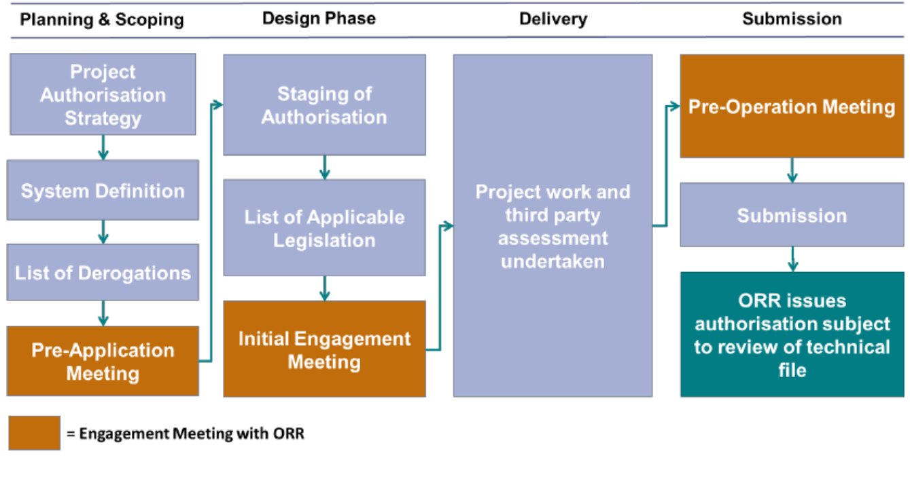
Changes to Standards – June 2022
One new piece of Railway Related Legislation news has been published since March 2022
RUs
The Railways (Interoperability) Regulations 2011 (as amended) (RIR) post-implementation review report.
The report, published by The Department of Transport (DfT) recommends that the regulations should be amended, with three main recommendations. These are to:
issue updated guidance to provide additional clarity about how the regulations operate;
explore making better use of existing provisions within the regulations; and
engage further with the rail industry to develop and assess options for potential legislative changes to RIR 2011.
The full report can be found here.
Interoperability Guidance
The DfT has published new interoperability guidance. This
guidance aims to provide an overview of the interoperability
framework and the obligations stakeholders have at various
stages in the lifecycle of a rail project, it covers the stages
from the design and construction of a structural subsystem
through to its use on the rail system.
This guidance can be found here.
IMs
Projects
Notes:
Headlines ……….

Slide 18
Changes to Standards – June 2022
Non
RSSB
6 Non RSSB standards have been published on the RSSB website
COP0019 Issue 6 - Action to be Taken in the Event of an Accident or Incident Involving OTP
COP0022 Issue 3 - Pulling Rail with Road-Rail Excavator Cranes
COP0027 Issue 5 - OTP Recovery
COP0035 Issue 2 - Plant Modules on Rail Wagons and Trailers
COP0036 Issue 2 - Planning for the Management of Points within Engineering Work Sites
COP0037 Issue 3 - Haulage Capabilities of On Track Machines
Click on the title to access the standard on the RSSB website
Notes:
Headlines ……….

Slide 19
Changes to Standards – June 2022
10 Deviations issued (8 applications submitted)
20-038-DEV; GMRT2111 Issue 2 - Rolling Stock Subsystem and Interface to AC Energy Subsystem
In-service trials of insulated pantograph horns.
21-036-DEV; RIS-0733-CCS Issue 1 - Lineside Operational Signs - Product Requirements
Trial of 'Train Accommodated' signage as an aid to Senior Conductors in establishing that it is safe to
release the train doors.
21-050-DEV; GERT8402 Issue 3 - ERTMS/ETCS DMI National Requirements
Class 717 ETCS onboard system - Continued conformity with GERT8402 issue 1.
22-012-DEV; GMRT2466 Issue 3 - Railway Wheelsets
Sheffield Tram-Train Wheelsets (Passenger Service)
22-016-DEV; GLRT1210 issue 2 - AC Energy Subsystem and Interfaces to Rolling Stock Subsystem
Transpennine route upgrade - Stalybridge Station (Overhead Contact Line Zone (OCLZ)).
More
Click on the title to access the deviation on the RSSB website
Notes:
Headlines ……….

Slide 20
Changes to Standards – June 2022
10 Deviations issued (8 applications submitted)
22-011-DEV; GERT8000-TS1 Issue 15, GERT8000-TS1 Issue 15, GERT8000-HB8 Issue 8 and
GERT8000-HB21 Issue 5 Additional protection to Track Workforce.
22-014-DEV; GERT8000-T3 Issue 10 - Possession of a running line for engineering work
Use of EPR as an additional protection in line blockage
22-015-DEV; GIRT7020 Issue 1.1 - GB Requirements for Platform Height, Platform Offset and Platform Width
Renewal of critical Train Dispatch Equipment Units on the Moorgate platforms.
22-017-DEV; GIRT7020 Issue 1.1 - GB Requirements for Platform Height, Platform Offset and Platform Width
Finsbury Park - temporary hoarding around lift shaft construction areas
22-013-DEV; GERT8000-HB12 Issue 8 - Duties of the ES or SWL in a possession
Use of EPR as an additional protection in line blockage
Back
Click on the title to access the deviation on the RSSB website
Notes:
Headlines ……….

Slide 21
Standards planned for publishing in 2022
September 2022
GERT8000-TW5 Issue 11 - Preparation and movement of trains: Defective or isolated vehicles and on- train equipment
June 2022
RIS-3437-TOM Issue 3 - Defective On-Train Equipment
RS525 Issue 1 - ERTMS Handbook
RIS-3786-TOM Issue 1 - Trespass Risk Assessment
RIS-3703-TOM Issue 5 - Passenger Train Dispatch and Platform Safety Measures
GERT8000 – 12 Rule Book modules and handbooks being updated
More

Slide 22
Standards planned for publishing in 2022
September 2022
RIS-7706-INS Issue 1 - Processes for Adding, Removing or Updating Differential Permissible Speeds
RIS-0745-CCS Issue 1 - Client safety assurance of high integrity software-based systems for railway applications
December 2022
RIS-8072-CCS Issue 2 - ERTMS National Identities Management
Back

Slide 23
Standards currently being drafted and due for consultation
June 2022
RIS-8072-CCS Issue 2 - ERTMS National Identities Management
July 2022
RIS-0703-CCS Issue 2 - Signalling Layout and Signal Aspect Sequence Requirements
GIRT7073 Issue 3 - Requirements for the Position of Infrastructure and for Defining and Maintaining Clearances
GEGN8573 Issue 4 (withdrawal) - Guidance on Gauging and Platform Stepping Distances
More Standards
Link to the standards consultation page on the RSSB website

Slide 24
Standards currently being drafted and due for consultation
September 2022
GLRT1210 Issue 3 - AC Energy Subsystem and Interfaces to Rolling Stock Subsystem
GMRT2111 Issue 3 - Rolling Stock Subsystem and Interfaces to AC Energy Subsystem
GLGN1610 Issue 1 - Guidance on AC Energy Subsystem and Interfaces to Rolling Stock Subsystem
GMGN2611 Issue 1 - Guidance on Rolling Stock Subsystem and Interfaces to AC Energy Subsystem
More Standards
Back
Link to the standards consultation page on the RSSB website

Slide 25
Standards currently being drafted and due for consultation
September 2022 (Continued)
GMRT2466 - issue 5 - Railway Wheelsets
RIS-2766-RST Issue 2 - Rail Industry Standard for Wheelsets
RIS-0799-CCS Issue 1 - ERTMS/ETCS Baseline 3 Onboard Subsystem Requirements
RIS-0797-CCS Issue 1 (withdraw) - ERTMS/ETCS Baseline 3 Onboard Subsystem Requirements: Retrofit
RIS-0798-CCS Issue 1 (withdraw) - ERTMS/ETCS Baseline 3 Onboard Subsystem Requirements
Back
Link to the standards consultation page on the RSSB website

