Slide 1
Changes to Standards – June 2023 Interactive Briefing Slide Deck Please view in slideshow mode for the links to work.
The presentation is interactive. You decide how to navigate through it, but you can always return to the main menu by clicking on the home icon, or use the red forward and back buttons.
Some slides contain links to additional online content. These are indicated with an icon.
You can close the presentation at anytime by clicking on the exit icon.

Slide 2
Changes to Standards – June 2023
Changes in the June 2023 Standards Update
Deviations granted against standards March 2023- June 2023
Draft standards scheduled to be published in the next catalogue
Draft standards consultation schedule
Click on a button to proceed to that section

Slide 3
Changes in the June 2023 Standards Update
Data, Systems, and Telematics
Plant
Rolling Stock
0 new standards
3 new standards, 1 new form, 2 new point releases, and 4 new technical notes
0 new standards
Non RSSB
Control, Command, and Signalling
Non-RSSB standards
Infrastructure
1 new standard
1 point release
0 new standards
4 new standards and 1 new poster
Energy
Rail-related legislation
Operations
2 new standards
0 new standards
No legislation updates
Click on the icons with red rings for more detail on those changes

Slide 4
Changes to Standards – June 2023
Four Rolling Stock standards have been updated in the June 2023 Standards catalogue.
RIS-8250-RST Issue 2 - Management of Safety Related Rail Vehicle Defects
Form RT8250 Issue 4 - Management of Safety Related Rail Vehicle Defects
GMGN2696 Issue 1 - Passenger seat comfort
RIS-2714-RST Issue 1 - Axle bearing condition monitoring
RIS-2714-RST Issue 1 - Axle bearing condition monitoring
Click on a standard to find out more

Slide 5
Changes to Standards – June 2023
Two Rolling Stock standards have had a point release updated in the June 2023 standards catalogue.
GMRT2100 Issue 6.2 - Rail Vehicle Structures and Passive Safety (changes section A.13.2 – forces that tables should withstand without permanent deformation)
RIS-2770-RST Issue 1.1 - Movement of Continental Wagons on the GB Network (updated to align it to current UK legislation -TSIs now NTSNs and additional guidance on COTIF added)
Click on the link icon to go to the standard on the RSSB website

Slide 6
Changes to Standards – June 2023
Four Rolling Stock technical notes have been published since March 2023
TN103 Issue 1 - Freight coupler loads
TN104 Issue 1 - Engineering change (software and firmware)
TN105 Issue 1 - Management and reporting of adverse events
TN109 Issue 1 - Fire-related properties of batteries

Slide 7
Changes to Standards – June 2023
RIS-8250-RST Issue 2 - Management of Safety Related Rail Vehicle Defects
Overview – RIS-8250-RST Issue 2 - Management of Safety-Related Rail Vehicle Defects, sets out what Railway Undertakings (RUs), infrastructure managers (IMs) and entities in charge of maintenance (ECMs) need to do to meet their legal responsibilities for reporting defects, including raising National Incident Reports (NIRs), using NIR-Online, and what to do in the (unlikely) event that the online system is unavailable. It also describes the actions necessary for other railway organisations who may raise or receive NIRs.
Form RT8250 Issue 4 - Management of Safety Related Rail Vehicle Defects, referenced in the RIS, has also been updated.
Issue 2 has been updated to align it with the current legislation. It has incorporated the contents of the two published amendments made to issue 1, by adding additional rationale and guidance. This helps the users to understand what they need to do and why. Issue 2 also includes new guidance on reporting of software and cyber security related issues.
Benefits – The revised RIS makes it much clearer as to who can raise NIRs and the timescales involved. The RIS is supported by a separate flowchart (in TN-105) which helps users to understand which reporting system to use in which circumstances. It is expected that this improved guidance will bring benefits to rail system reliability and customer perception, as well as helping users meet their legal requirements.
Audience – The revised guidance in the RIS, together with the supporting Technical Note, will benefit RUs, owners, and maintainers of rail vehicles (including plant), IMs, and others in the supply chain.
RU
IM
ROSCO
ECM

Slide 8
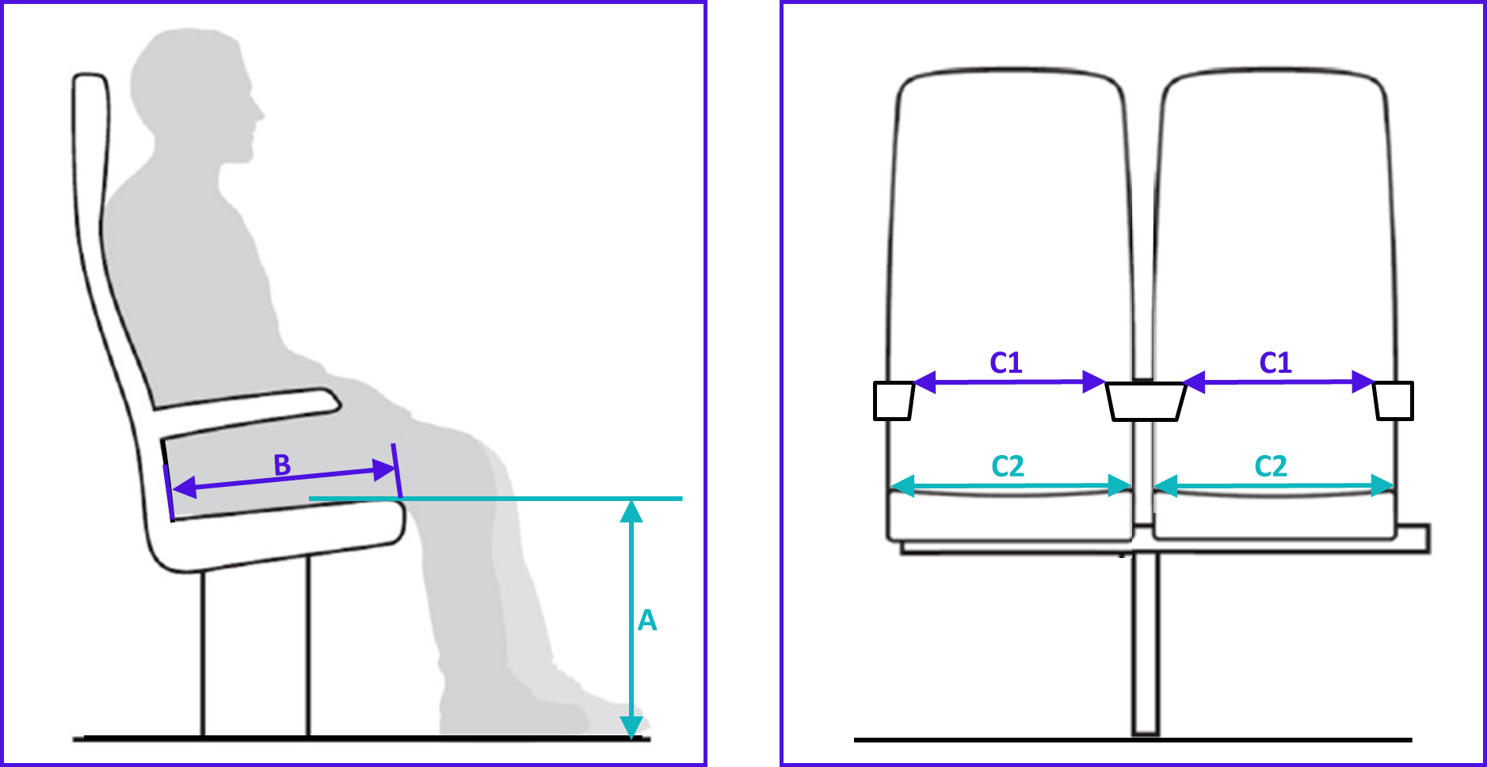
Changes to Standards – June 2023
GMGN2696 Issue 1 - Passenger seat comfort
Overview - This guidance note sets out the methodology and process for assessing seats in relation to passenger static comfort as established in T1140. A target passenger seat comfort score, suitable for the intended use of the train, has been included in the specification of new or refurbished trains. Seats can then be assessed against the target comfort score using this process. The guidance note also discusses other factors that affect the installation of seats such as interior passive safety and passengers’ perception of comfort.
Benefits – Passenger comfort during rail travel is an important aspect of the customer experience, and one key aspect is seat comfort which contributes to 5% of the overall impact on customer satisfaction. In a recent survey, only 66% of passengers reported a ‘satisfied or good’ level of comfort in the seating area. One contributing factor to this score was the lack of quantifiable parameters to sufficiently assess and demonstrate passenger seat comfort for new and refurbished trains.
Audience – This document is intended to be used by train operating companies, rolling stock owning companies, rolling stock interior designers and builders, passenger train seat designers, and builders. This document is also for use by passenger satisfaction survey groups or ergonomists seeking to quantify the level of comfort for passenger seats on railways.
RU
ROSCO
ECM
Suppliers

Slide 9
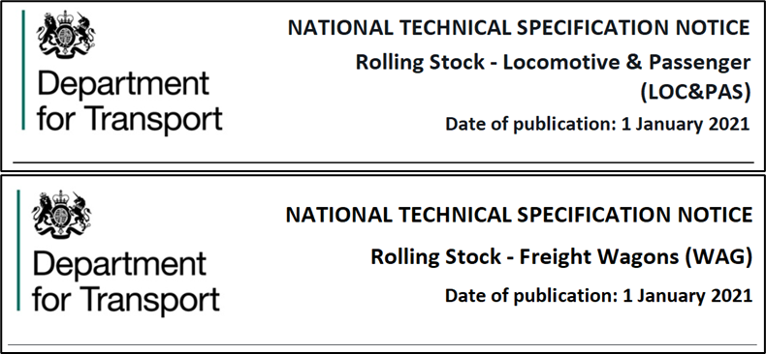
Changes to Standards – June 2023
RIS-2714-RST Issue 1 - Axle bearing condition monitoring
Overview – RIS-2714-RST contains guidance on how to meet the requirements set out in the LOC&PAS and WAG NTSNs for trackside and onboard hot axle box condition monitoring. The responsibilities of the parties involved with deploying axle bearing condition monitoring are set out. Guidance on dynamic frequency monitoring of axle bearings has been included as guidance to support the use of new technology that monitors axle bearing condition.
Benefits – Industry will benefit from the improved safety brought about by providing information on diagnostic and prognostic approaches to axle bearing maintenance. Performance improvements will be realised through adoption of condition monitoring systems that are additional to Hot Axle Box Detectors
Audience – This document is intended to be used by rolling stock owning companies, RUs, IMs, ECMs, and vehicle manufacturers.
RU
IM
ROSCO
ECM
Suppliers

Slide 10
Changes to Standards – June 2023
Two Traffic Operation and Management standards have been updated in the June 2023 standards catalogue
GOGN3616 Issue 1 ‐ Guidance on Operational Railway Safety Awareness
RIS-3350-TOM Issue 2 - Communication of Urgent Operating Advice
Click on a standard to find out more

Slide 11
Changes to Standards – June 2023
GOGN3616 Issue 1 - Guidance on Operational Railway Safety Awareness
Overview – There is currently no existing common training and competence approach associated with personal safety for RUs and any other railway actors available to industry. This guidance note provides one. It sets out a harmonised framework for training and competency, and a process to follow when developing operational railway safety awareness training and competence, including:
medical fitness, hazards, control measures, and conditions to consider when developing training for staff working on the mainline railway, as well as depots, yards, sidings, and freight terminals; competence, assessment, and review.
Appendices give worked examples of how to apply the framework, using four examples of industry roles and tasks.
Benefits – If a serious injury is caused when work is carried out on the GB mainline railway or within depots and sidings, likely outcomes may include: being issued with an improvement or prohibition notice, prosecution proceedings (which could result in a large fine and/or imprisonment), or a civil claim. The cost for a railway undertaking could total £1.65 million if such an incident happened. If the guidance note contributes to avoiding this cost by 10%, then this would equate to a total benefit of £150,000 over five years.
Audience – The guidance note is intended for those in RUs, IMs, and ECMs responsible for managing operational standards and training.
RU
IM
ECM

Slide 12
Changes to Standards – June 2023
RIS-3350-TOM Issue 2 - Communication of Urgent Operating Advice
Overview – RIS-3350-TOM issue two sets out requirements for IMs and RUs to follow when communicating urgent operating advice.
RIS-3350-TOM issue two has been updated to make it clearer for users, and to support correct use of the GB rail industry’s processes for communicating urgent operating advice. It has been redrafted throughout to make its requirements clearer for users. Each requirement is now supported by a rationale to explain why it exists, and also guidance to help users comply with the requirement.
Existing references have been updated, and new references to other documents that support the requirements of RIS-3350-TOM have been added.
Benefits – RUs and IMs are legally required to share safety learning. Further, better communication of urgent operating advice can help improve performance by reducing the chance of disruptive incidents or failures happening in the first place. Therefore the benefit of RIS-3350-TOM issue two to the GB rail industry is estimated at approximately £189,000 over five years.
Audience – RIS-3350-TOM issue two is intended for any staff working for an infrastructure manager or railway undertaking, who are responsible for making sure that urgent safety learning from operational incidents or equipment failures is shared across the GB rail industry.
RU
IM
IM
RU

Slide 13
Changes to Standards – June 2023
One Control, Command, and Signalling standard has been updated in the June 2023 standards catalogue
RIS‐0799‐CCS Issue 1 - ERTMS/ETCS Baseline 3 Onboard Subsystem Requirements
Click on a standard to find out more
One Control, Command, and Signalling standard has had a point release updated in the June 2023 standards catalogue.
GIRT7033 Issue 4.1 - Lineside Operational Signs; Product Requirements (updated to align it to current UK legislation -TSIs now NTSNs)
Click on the link icon to go to the standard on the RSSB website

Slide 14
Changes to Standards – June 2023
RIS‐0799‐CCS Issue 1 - ERTMS/ETCS Baseline 3 Onboard Subsystem Requirements
Overview – RIS-0799 CCS issue one sets out the requirements, together with their supporting rationale and guidance, for the application of ERTMS/ETCS Baseline 3 Release 2 compliant onboard subsystems to new and existing (retrofit) rail vehicles. It has been developed from and replaces RIS-0797-CCS issue one and RIS-0798-CCS issue one which are both withdrawn in their entirety. It sets out the requirements for new and existing trains where they differ together with requirements that are applicable to both where there is commonality. It also includes new requirements to align it with the GB ERTMS/ETCS baseline requirements suite. The key changes address automatic train operation (ATO), online key management, train data definition, and entry. Other changes include the need for the ETCS onboard subsystem to implement the error solutions published in ERA technical opinions, and updated requirements on the symbol and button labels displayed on the ERTMS/ETCS driver machine interface (DMI) to help the driver in correctly selecting and identifying the current ETCS level for AWS/TPWS operations.
Benefits – Having one set of requirements in one standard will reduce document maintenance, simplify compliance, and provide less opportunity for inconsistency and confusion. Aligning the standard with the GB ERTMS/ETCS requirements suite supports integration across the GB mainline railway and enables industry to procure ETCS onboard subsystems in accordance with the latest industry requirements, which will help avoid potential retrospective changes.
Audience – This standard will be of interest to project entities, IMs, and RUs, CCS suppliers and designers, rail vehicle manufacturers, designers, and owners. RIS 0799 CCS issue one can be adopted by rolling stock owners (ROSCOs), suppliers, and RUs under their respective safety/quality management systems or when specifying products and services.
RU
IM
Suppliers
Designers

Slide 15
Changes to Standards – June 2023
Non RSSB
Four Non-RSSB standards and one poster have been published on the RSSB website
COP0038 Issue 3 - Code of Practice for Defective OTP Safety Critical Equipment
COP0127 Issue 1 - Code of Practice for Route Conductor Assurance
COP0129 Issue 2 - Code of Practice for Control of Mobile Communication Equipment Use in Driving Cabs
COP0130 Issue 2 - Code of Practice for OTM Route Conducting Policy
Poster OTM13 Issue 1 - Use of mobile devices
Click on the title to access the standard on the RSSB website

Slide 16
Four deviations issued since March 2023
22-002-DEV; GIRT7073 Issue 2 - Requirements for the Position of Infrastructure and for Defining and Maintaining Clearances.
Neath Swing Bridge SDI1 207m63ch (Span 4 Up and Down mains only).
23-001-DEV; GERT8000-T3 Issue 11 - Possession of a running line for engineering work. Width. To allow all Routes and Regions to have the flexibility to use back-to-back possessions from point.
23-004-DEV; GMRT2400 Issue 6.2 - Engineering Design of On-Track Machines in Running Mode. The SIM vehicle trial operation will be on the Great Western Main Line between Paddington and Bristol.
23-005-DEV; GIRT7020 Issue 2 - GB Requirements for Platform Height, Platform Offset and Platform Width
Stowmarket Station - London End at approximately 80m 46ch on platforms 1 and 2 for lengths of approximately 27mtrs [platform 1] and 29mtrs [platform 2].
Click on the title to access the deviation on the RSSB website

Slide 17
Draft standards scheduled for publishing in September 2023
GERT8000-M1 Issue 7 - Dealing with a train accident or train evacuation
GERT8000-M2 Issue 7 - Train stopped by train failure
GERT8000‐TW1 Issue 19 ‐ Preparation and movement of trains: Defective or isolated vehicles and on‐train equipment
GERT8000‐TW5 Issue 12 ‐ Preparation and movement of trains: Defective or isolated vehicles and on‐train equipment
Amendments to 12 other Rule Book modules and Handbooks
RIS‐3780‐TOM Issue 2 ‐ Operational Requirements for GSM‐R Radio

Slide 18
Draft standards scheduled for publishing in September 2023
RIS‐1530‐PLT Issue 7 ‐ Technical requirements for On‐track Plant, their associated equipment and trolleys
RIS‐0703‐CCS ‐ issue 2 ‐ Signalling Layout and Signal Aspect Sequence Requirements
RIS‐0707‐CCS Issue 2 ‐ Management of Safety Related CCS System
Form RT8106 ‐ Example Failure Data Collection Form
RIS‐4472‐RST Issue 2 ‐ Engineering Requirements for Steam Locomotives and other Heritage Rail Vehicles

Slide 19
Draft standards scheduled for consultation in June 2023
GCRT5021 Issue 6 ‐ Track System Requirements
RIS‐7707‐INS Issue 1 ‐ Infrastructure Requirements for Switches and Crossings
Draft standards scheduled for consultation in September 2023
GMGN2688 Issue 3 ‐ Guidance on Designing Rail Freight Wagons for use on the GB Mainline Railway

Slide 20
Draft standards scheduled for consultation in November 2023
GERT8006 Issue 4 - Route Availability Number for Assessment of Compatibility between Rail Vehicles and Underline Bridges.
RIS‐8706‐INS issue 2 - Route Level Assessment of Technical Compatibility between Rail Vehicles and Underline Bridges
Draft standards scheduled for consultation in January 2024
GKRT0057 issue 2 - Lineside Signal and Indicator Product Design and Assessment Requirements
GKGN0657 issue 1 - Guidance on Lineside Signal & Indicator Product Design and Assessment Requirements

Slide 21
Draft standards scheduled for consultation in January 2024 (continued)
RIS‐0793‐CCS Issue 1 - Level Crossing System Integration
RIS‐0792‐CCS Issue 1 - Level Crossing Operational Interfaces with Trains (withdrawal)
Draft standards scheduled for consultation in February 2024
RIS-2702-RST Issue 3 - In-service Examination and Reference Limits for Freight Wagons
Draft standards scheduled for consultation in April 2024
RIS-3751-TOM Issue 4 - Rail Industry Standard for Train Driver Selection

