Slide 1
Changes to Standards – September 2022 interactive briefing slide deck Please view in slideshow mode for the links to work
The presentation is interactive, you decide how to navigate through it, but you can always return to the main menu by clicking on the home icon.
You can escape at any time by pressing this icon
Some slides contain links to additional online content, these are indicated with an icon.

Slide 2
Changes to Standards – September 2022
Changes in the September 2022 Standards update
Deviations granted against standards June 2022- September 2022
Standards planned for publishing in the next six months
Standards currently being drafted and due for consultation in the next 3 months
Click on a button to proceed to that section

Slide 3
Changes to Standards – September 2022
Data, Systems and Telematics
Plant
Rolling Stock
0 new standards
1 new point release
0 new standards
Non RSSB
Control Command and Communication
Non RSSB standards
Infrastructure
1 new standard
1 new standard
3 new standards 1 new poster
Energy (AC & DC systems)
Rail related legislation
Operations
3 new standards, updates to the Rule book and forms, inc 1 new Info. Handbook,
0 new standards
Changes to NTSNs, Interoperable Rail products and ECM certificates
Click on the icons for more detail on those changes
Notes:
Here are the headlines - Click on the icons for more detail on those changes

Slide 4
Changes to Standards – September 2022
One Rolling Stock standards has had a point release in the September 2022 standards catalogue.
RIS-8270-RST Issue1.1 Route Level Assessment of Technical Compatibility between Vehicles and Infrastructure Updated with additional guidance and supporting documents including a SOCAT template, flowcharts, case studies and a new process diagram.
Click on the link icon to go to the standard on the RSSB website
Notes:
Headlines ……….

Slide 5
Changes to Standards – September 2022
One CCS standard has been published in the September 2022 standards catalogue.
RIS-0745-CCS Issue1 - Client safety assurance of high integrity software-based systems for railway applications
Click on a standard to find out more
Notes:
Headlines ……….

Slide 6
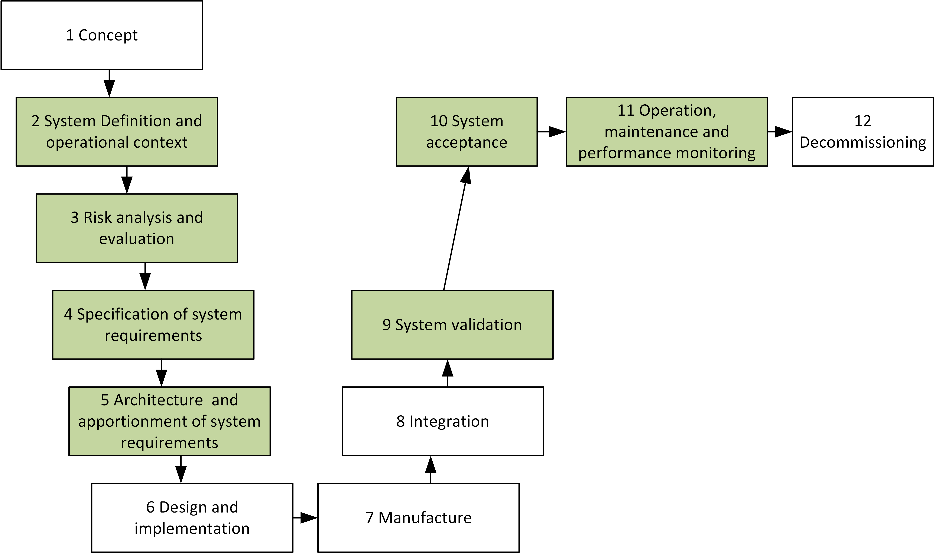
Changes to Standards – September 2022
RIS-0745-CCS Issue1 - Client safety assurance of high integrity software-based systems for railway applications
RUs
Overview –This Rail Industry Standard sets out requirements and guidance for the role of the client in managing the safety assurance of high integrity software-based systems used in railway applications. It identifies the activities to be undertaken in the development, installation, and maintenance phases of the process. It includes and expands upon the main principles within Rail Industry Guidance GEGN8650 Issue 1 – Guidance on high integrity software-based systems for railway applications, which has now been withdrawn.
Benefits – This new standard will help industry to better manage and reduce the number of incidents where the performance of software is one of the causal factors, with the subsequent improvements in safety and reliability. It contributes an estimated industry net benefit of £8.2m over five years.
Audience – The standard is intended for use by organisations when procuring and utilising high integrity software-based systems for railway applications throughout their lifecycle. The standard is also relevant if organisational ownership changes during the lifecycle.
IMs
Projects
Notes:
Headlines ……….

Slide 7
Changes to Standards – September 2022
One Infrastructure standard has been published in the September 2022 standards catalogue.
RIS-7706-INS Issue1 - Processes for Adding, Removing or Updating Differential Permissible Speeds
Click on a standard to find out more
Notes:
Headlines ……….

Slide 8
Changes to Standards – September 2022
RIS-7706-INS Issue1 - Processes for Adding, Removing or Updating Differential Permissible Speeds
RUs
Overview – Lettered Differential Permissible Speeds (LDPSs) are used to permit certain types of rolling stock with the necessary characteristics to operate at increased speeds on particular sections of the network. There are different categories of LDPS which are indicated on the network by different combinations of letters.
This new Rail Industry Standard provides clear processes to be used by projects when adding, removing or modifying LDPSs on the GB mainline network. It also provides guidance on the range of infrastructure parameters and characteristics that must be taken into account in determining whether an LDPS is an appropriate solution in each case, and which LDPS category is most suitable.
The standard includes several case studies to help demonstrate the range of applications and benefits associated with the use of LDPSs.
Benefits – By providing clear processes and guidance will ensure consistency of application and help with the decision making process for projects. This, together with the updated RIS-2711-RST Lettered Differential PermIssueible Speeds Classification, will contribute to an estimated industry net benefit of £12.5m over 10 years.
Audience – This standard is intended for use by individuals and project teams involved in the specification and design of differential speeds on the GB mainline infrastructure.
50
20
50
IMs
55
SP
Projects
Notes:
Headlines ……….

Slide 9
Changes to Standards – September 2022
Three Operations standards have been published in the September 2022 standards catalogue.
RIS-3437-TOM Issue3 - Defective On-Train Equipment
RIS-3786-TOM Issue1 - Trespass Risk Assessment
RIS-3703-TOM Issue5 - Passenger Train Dispatch and Platform Safety Measures
Click on a standard to find out more
More
Notes:
Headlines ……….

Slide 10
Changes to Standards – September 2022
The following Rule Book Modules, Handbooks and Forms have been published in the September 2022 standards catalogue.
Glossary
GERT8000-HB8 Handbook 8
GERT8000-HB9 Handbook 9
GERT8000-HB11 Handbook 11
GERT8000-HB12 Handbook 12
GERT8000-HB12 ERTMS
GERT8000-HB13 Handbook 13
GERT8000-HB15 Handbook 15
GERT8000-P1
GERT8000-P2
GERT8000-SS1
GERT8000-T3
GERT8000-T10
GERT8000- TS1
GERT8000-TW1
GERT8000-TW5
GERT8000- TW7
RS525 ERTMS Handbook
Updates to Rule Book forms
Click on a button to find out more
Back
Notes:
Headlines ……….

Slide 11
Changes to Standards – September 2022
RIS-3437-TOM Issue3 - Defective On-Train Equipment
RUs
Overview – This revised Standard sets out the requirements to be applied when on-train equipment becomes defective. It also provides guidance to assist railway undertakings in the development of contingency plans and alternative controls.
The topic areas that have been updated include -
Doors on passenger vehicles
Driver’s safety device (DSD) and driver’s vigilance equipment
Hot axle box and activations of lineside hot axle box detectors
On-train data recorder (OTDR)
Sanding equipment to assist train braking
Vehicle with locked wheels/wheel flats/shifted tyres/dragging brakes
Fire detection and fire suppression systems.
This standard works alongside the correspondent instructions for operational staff in Rule Book module TW5.
Benefits – The changes provide greater clarity around the operational response to defects. This will allow Railway Undertakings to manage more effectively such occurrences, saving the industry more than £1 million over five years.
Audience – This standard is for railway undertakings, specifically those responsible for developing contingency plans relating to defective or isolated on-train equipment.
IMs
Notes:
Headlines ……….

Slide 12
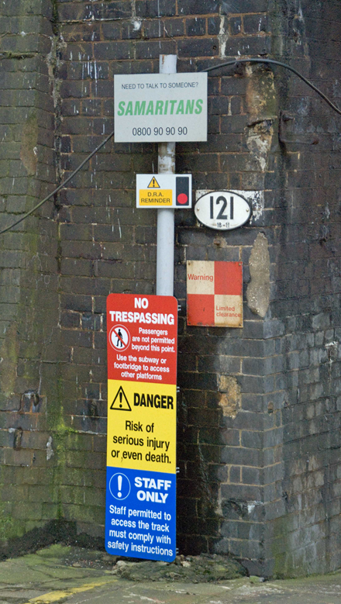
Changes to Standards – September 2022
RIS-3786-TOM Issue1 - Trespass Risk Assessment
RUs
Overview – Trespass incidents cause injury and harm, and delay to the travelling public. They also carry a risk of prosecution for Transport Operators, if not managed correctly.
This new Rail Industry Standard sets out a clear and consistent process
for conducting, implementing and reviewing trespass risk assessments to foster
a common approach throughout the GB mainline railway.
This standard builds upon the legal duties set out in the Railway Safety (Miscellaneous Provisions) Regulations 1997, which require transport operators to take reasonably practicable measures to reduce risk to the public. It also supports the duty of cooperation that transport operators have under the Railways and Other Guided Transport Systems (Safety) Regulations 2006.
Benefits –This standard can help transport operators meet their legal obligations, by helping them to identify, and take the necessary
steps to mitigate trespass risk, also reducing resultant harm, damage and delay.
This is expected to deliver benefits to industry of £2.97 million over 5 years.
Audience – This standard applies to infrastructure managers and railway undertakings, as well as anyone else involved in managing and mitigating trespass risk on the GB mainline railway.
IMs
Notes:
Headlines ……….

Slide 13
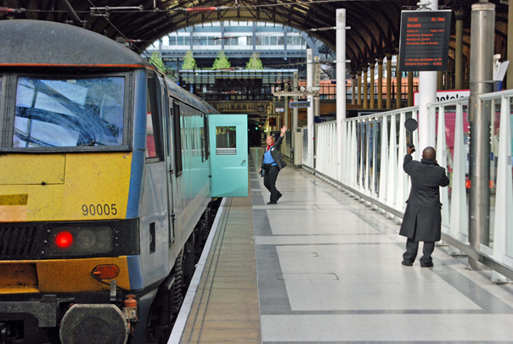
Changes to Standards – September 2022
RIS-3703-TOM Issue5 - Passenger Train Dispatch and Platform Safety Measures
RUs
Overview – This revised standard sets out requirements and guidance for the development, review and implementation of passenger train dispatch processes and measures to manage the safe behaviour of passengers at the platform train interface.
This update covers two main areas - ‘Assessment responsibilities’ and ‘Requirement to review’. They have been amended to make it clearer that trade union health and safety representatives are key stakeholders in a risk assessment and should be informed of their assessment responsibilities ‘with enough time’ to allow them ‘to make the necessary arrangements.’
Involving relevant staff representatives when reviewing, modifying or implementing a method of dispatch helps transport operators take better decisions on a full range of control measures for the risks identified.
Benefits – The changes in RIS-3703-TOM Issue5 will help transport operators take better decisions on the method of dispatch.
Audience – This standard is intended for those responsible for PTI risk management and operational standards, as well as those responsible for leading the review and consultation of risk assessments associated with PTI risk.
Notes:
Headlines ……….

Slide 14
Changes to Standards – September 2022
Glossary of Railway Terminology
RUs
Overview of changes -
The United Kingdom has left the EU. This means that it is no longer necessary for the contents of the glossary to be presented by subject matter and in alphabetical order. However, this format has been kept for ease of use.
The Rule Book has been reviewed to remove cases of gender-specific language which can be taken as an assumption that only males are involved, which could have deterred applications for employment or promotion. There fore the following changes have been made -
Controlled crossing and Manned level crossing – These terms have been reworded to refer to level crossings as 'manually-controlled’ rather than 'manned’.
Level crossing - This item has been reworded to remove the reference to 'manned' level crossings which is not necessary as elsewhere in the Rule Book these crossings are included within the category of 'controlled' level crossings.
Open level crossing - This item has been reworded to remove reference to these level crossings as being 'unmanned’.
Pilotman - The term 'pilotman' is being changed to 'pilot' throughout the Rule Book . In the Glossary the entries concerned have been amended, but as there may be a lapse of time before all corresponding changes can be made, an item has been included to state that the former term 'pilotman' might still be used, but is to be taken as having the same meaning as 'pilot’.
For full details of the changes made please read Rule Book Briefing Leaflet Issue38 December 2022
IMs
Notes:
Headlines ……….

Slide 15
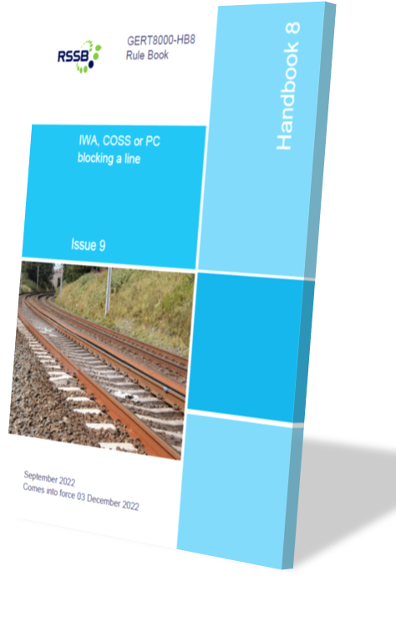
Changes to Standards – September 2022
GERT8000-HB8 - IWA, COSS or PC blocking a line
RUs
Overview of changes -
When a line blockage is taken on an absolute block line, the block indicator is placed to 'train on line' or on a tokenless block line the acceptance switches are placed or kept at 'normal'. The current initiative to provide additional protection for line blockages to the maximum extent possible has identified that on those lines the opportunities for providing additional protection can be limited, particularly when a person is working alone. It has been agreed that the use of the block indicator or acceptance switches can be used as further methods of additional protection, as they involve co-operative action by two signallers to prevent a protecting signal being cleared during the line blockage. This provides a similar level of security to other methods of additional protection such as a disconnection or use of a T-COD.
For full details of the changes made please read Rule Book Briefing Leaflet Issue38 December 2022
IMs
Notes:
Headlines ……….

Slide 16
Changes to Standards – September 2022
GERT8000-HB9 IWA or COSS setting up safe systems of work within possessions
RUs
Overview of changes -
Rule Book module T10 (Duties of a designated person (DP) and people working on rail vehicles) has not previously included any instructions concerning working on vehicles, on-track machines or on-track plant when working within a possession. This included the arrangements for arranging line protection against
train movements. Those instructions have now been included in module T10 and this handbook has been changed to include a new section 3.11. This explains that a DP, or a machine controller in the case of on-track plant, will ask the IWA or COSS for movements to be stopped, and that the IWA or COSS must then ask the ES or SWL to prevent any movements towards the vehicle being worked on.
For full details of the changes made please read Rule Book Briefing Leaflet Issue38 December 2022
IMs
Notes:
Headlines ……….

Slide 17
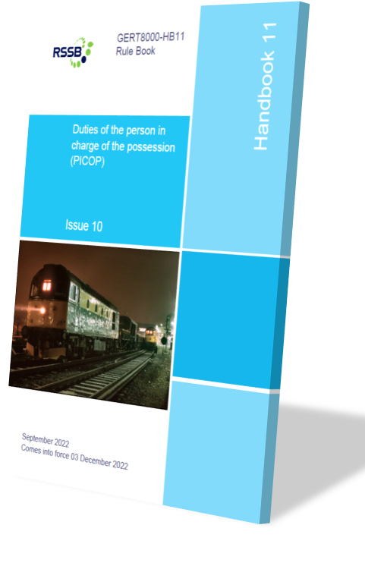
Changes to Standards – September 2022
GERT8000-HB11 Duties of the person in charge of the possession (PICOP)
RUs
Overview of changes -
An alternative procedure has been introduced for an engineering train leaving a possession when the detonator protection is placed at a sub-standard distance from the points it is laid in relation to. Instead of the driver being authorised to proceed from the last signal within the possession for a short distance to the detonator protection, and separately authorised by the signaller to proceed from that location, a single authority for movement can be given from the last signal within the possession, which would be cleared if possible. This avoids a train possibly being detained across a junction awaiting the protection being lifted and the movement being made without the security of the interlocking. The advantages
of this alternative procedure include simplification of the Rule Book process, safety benefit through removal of error potential and train performance benefit. This arrangement can only be used if it has been published in the Weekly Operating Notice or Engineering Notice.
IMs
Continued
Notes:
Headlines ……….

Slide 18
Changes to Standards – September 2022
GERT8000-HB11 Duties of the person in charge of the possession (PICOP)
RUs
Overview of changes (continued) -
Rule Book module T10 (Duties of a designated person (DP) and people working on rail vehicles) has not previously included any instructions concerning working on vehicles, on-track machines or on-track plant when working within a possession. This included the arrangements for arranging line protection against
train movements. Those instructions have now been included in module T10 and this handbook has been changed to include a new section 8.17. This explains that a DP, or a machine controller in the case of on-track plant, will ask the PICOP for movements to be stopped.
The Rule Book has been reviewed to remove cases of gender-specific language which can be taken as an assumption that only males are involved. This may deter applications for employment or promotion. To overcome this, the term 'pilotman’ is being changed to 'pilot' throughout the Rule Book. Changes have been made to remove any references to level crossings as being 'manned' and replace these
with the term 'manually-controlled’
For full details of the changes made please read Rule Book Briefing Leaflet Issue38 December 2022
IMs
Back
Notes:
Headlines ……….

Slide 19
Changes to Standards – September 2022
GERT8000-HB12 Duties of the engineering supervisor (ES) or safe work leader (SWL) in a possession
RUs
Overview of changes -
Handbook states that the ES can allow work to start in connection with AC or DC isolations once the ES or SWL has given permission to set up the work site. There have been cases where that work has been allowed to start even before the possession has been granted, exposing staff to risk, and Network Rail has withdrawn the ability to start that work.
Section 3.3 has been amended to make it clear that when given permission to set up a work site the ES or SWL must not allow any work at all, apart from the placing of work-site marker boards, to start within the work site until the PICOP has confirmed that the work site has been granted.
There have been cases where the instruction had been interpreted as allowing the work in connection with isolations to begin even before the possession had been granted, exposing the staff concerned to risk. As a result, a Network Rail company standard has been amended to prevent this work starting before the WSMBs have been placed, and this authority has
been removed from the ES or SWL in handbook 12.
IMs
Continued
Notes:
Headlines ……….

Slide 20
Changes to Standards – September 2022
GERT8000-HB12 Duties of the engineering supervisor (ES) or safe work leader (SWL) in a possession
RUs
Overview of changes (continued) -
Rule Book module T10 (Duties of a designated person (DP) and people working on rail vehicles) has not previously included any instructions concerning working on vehicles, on-track machines or on-track plant when working within a possession. This included the arrangements for arranging line protection against
train movements. Those instructions have now been included in module T10 and this handbook has been changed to include a new section 6.9. This explains that a COSS, DP, or a machine controller in the case of on-track plant, will ask the ES or SWL for movements to be stopped.
The Rule Book has been reviewed to remove cases of gender-specific language which can be taken as an assumption that only males are involved. This may deter applications for employment or promotion. To overcome this changes have been made to remove any references to level crossings as being 'manned' and replace these with the term 'manually-controlled’.
For full details of the changes made please read Rule Book Briefing Leaflet Issue38 December 2022
IMs
Back
Notes:
Headlines ……….

Slide 21
Changes to Standards – September 2022
GERT8000-HB13 ERTMS Duties of the engineering supervisor (ES) or safe work leader (SWL) in a possession on ERTMS lines where lineside signals are not provided
RUs
Overview of changes -
This Handbook states that the ES can allow work to start in connection with AC or DC isolations once the ES or SWL has given permission to set up the work site. There have been cases where that work has been allowed to start even before the possession has been granted, exposing staff to risk, and Network Rail has withdrawn the ability to start that work.
Section 3.3 has been amended to make it clear that when given permission to set up a work site the ES or SWL must not allow any work at all, apart from the placing of work-site marker boards, to start within the work site until the PICOP has confirmed that the work site has been granted.
Rule Book module T10 (Duties of a designated person (DP) and people working on rail vehicles) has not previously included any instructions concerning working on vehicles, on-track machines or on-track plant when working within a possession. This included the arrangements for arranging line protection against train movements. Those instructions have now been included in module T10 and this handbook has been changed to include a new section 6.9. This explains that a COSS, DP, or a machine controller in the case of on-track plant, will ask the ES or SWL for movements to be stopped
IMs
Continued
Notes:
Headlines ……….

Slide 22
Changes to Standards – September 2022
GERT8000-HB13 ERTMS Duties of the engineering supervisor (ES) or safe work leader (SWL) in a possession on ERTMS lines where lineside signals are not provided
RUs
Overview of changes (continued) -
The Rule Book has been reviewed to remove cases of gender-specific language which can be taken as an assumption that only males are involved. This may deter applications for employment or promotion. To overcome this changes have been made to remove any references to level crossings as being 'manned' and replace these with the term 'manually-controlled’.
For full details of the changes made please read Rule Book Briefing Leaflet Issue38 December 2022
IMs
Back
Notes:
Headlines ……….

Slide 23
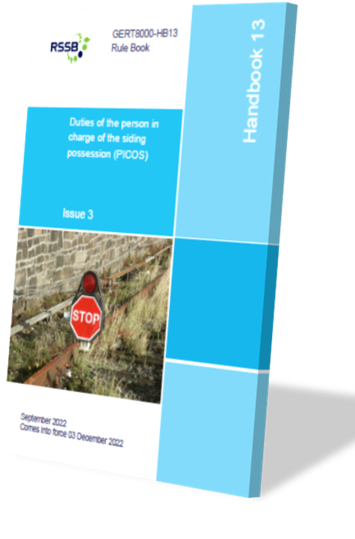
Changes to Standards – September 2022
GERT8000-HB13 Duties of the person in charge of the siding possession (PICOS)
RUs
Overview of changes -
Rule Book module T10 (Duties of a designated person (DP) and people working on rail vehicles) has not previously included any instructions concerning working on vehicles, on-track machines or on-track plant when working within a possession. This included the arrangements for arranging line protection against train movements.
Those instructions have now been included in module T10 and this handbook has been changed to include a new section 5.5. This explains that a DP, or a machine controller in the case of on-track plant, will ask the PICOS for movements to be stopped.
For full details of the changes made please read Rule Book Briefing Leaflet Issue38 December 2022
IMs
Notes:
Headlines ……….

Slide 24
Changes to Standards – September 2022
GERT8000-HB15 Duties of the ‘machine controller (MC) and on-track plant operator
RUs
Overview of changes -
Rule Book module T10 (Duties of a designated person (DP) and people working on rail vehicles) has not previously included any instructions concerning working on vehicles, on-track machines or on-track plant (OTP) when working within a possession. This included the arrangements for arranging line protection against train movements.
Those instructions have now been included in module T10 and this handbook has been changed to include a new section 10.4. This explains that a machine controller in the case of on-track plant will ask the PICOP, COSS, ES, SWL or PICOS for movements to be stopped.
For full details of the changes made please read Rule Book Briefing Leaflet Issue38 December 2022
IMs
Notes:
Headlines ……….

Slide 25
Changes to Standards – September 2022
GERT8000-P1 Single line working
RUs
Overview of changes -
The Rule Book has been reviewed to remove cases of gender-specific language which can be taken as an assumption that only males are involved. This may deter applications for employment or promotion. To overcome this, the term 'pilotman’ is being changed to 'pilot' throughout the Rule Book. All references in this module have been changed. As there may be a lapse of time before all corresponding changes can be made, it should be noted that the former term 'pilotman' might still be used, but is to be taken as having the same meaning as 'pilot'. Changes have been made to remove any references to level crossings as being 'manned' and replace these with the term 'manually-controlled’.
For full details of the changes made please read Rule Book Briefing Leaflet Issue38 December 2022
IMs
Notes:
Headlines ……….

Slide 26
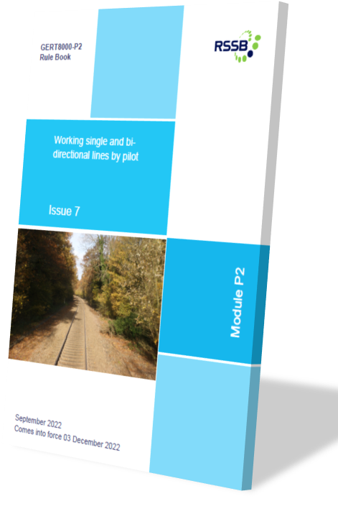
Changes to Standards – September 2022
GERT8000-P2 Working single and bi-directional lines by pilotman
RUs
Overview of changes -
The Rule Book has been reviewed to remove cases of gender-specific language which can be taken as an assumption that only males are involved. This may deter applications for employment or promotion. To overcome this, the term 'pilotman’ is being changed to 'pilot' throughout the Rule Book. All references in this module have been changed. As there may be a lapse of time before all corresponding changes can be made, it should be noted that the former term 'pilotman' might still be used, but is to be taken as having the same meaning as 'pilot’.
The title of the module has been changed to 'Working single and bi-directional lines by pilot’.
When the instructions to the driver concerning non-Issueof a driver's ticket when entering a one-train working line or working to and from the point of obstruction were last changed in section 3.3, the reference to a one-train working line was unnecessarily repeated, and this has now been corrected.
For full details of the changes made please read Rule Book Briefing Leaflet Issue38 December 2022
IMs
Notes:
Headlines ……….

Slide 27
Changes to Standards – September 2022
GERT8000-SS1 Station duties and train dispatch
RUs
Overview of changes -
It has been pointed out that the recessed nature of bodyside doors on some passenger vehicles causes difficulty in carrying out the requirement in section 3.8 of this module to confirm that the doors are properly closed as part of the train safety check when a DO train is being dispatched by the driver from an unstaffed platform. It was realised that the wording of this section of the module is incorrect
in including this within the train safety check. The driver is required, before starting the train safety check, to make sure that the passenger doors have closed, either by seeing that the external orange hazard lights have gone out, or, where appropriate, the traction interlock light is illuminated. The wording has been changed to remove this repetition. By doing so any ambiguity is removed and allows this method of working to be applied as written with any stock with this type of door
For full details of the changes made please read Rule Book Briefing Leaflet Issue38 December 2022
IMs
Notes:
Headlines ……….

Slide 28
Changes to Standards – September 2022
GERT8000-T3 Possession of a running line for engineering work
RUs
Overview of changes -
An alternative procedure has been introduced for an engineering train leaving a possession when the detonator protection is placed at a sub-standard distance from the points it is laid in relation to. Instead of the driver being authorised to proceed from the last signal within the possession for a short distance to the detonator protection, and separately authorised by the signaller to proceed from that location, a single authority for movement can be given from the last signal within the possession, which would be cleared if possible. This avoids a train possibly being detained across a junction awaiting the protection being lifted and the movement made without the security of the interlocking. The advantages of this alternative procedure include simplification of Rule Book processes, safety benefit through removal of error potential and train performance benefit. This arrangement can only be used if it has been published in the Weekly Operating Notice or Engineering Notice.
The Rule Book has been reviewed to remove cases of gender-specific language which can be taken as an assumption that only males are involved. This may deter applications for employment or promotion. To overcome this changes have been made to remove any references to level crossings as being 'manned' and replace these with the term 'manually-controlled’.
For full details of the changes made please read Rule Book Briefing Leaflet Issue38 December 2022
IMs
Notes:
Headlines ……….

Slide 29
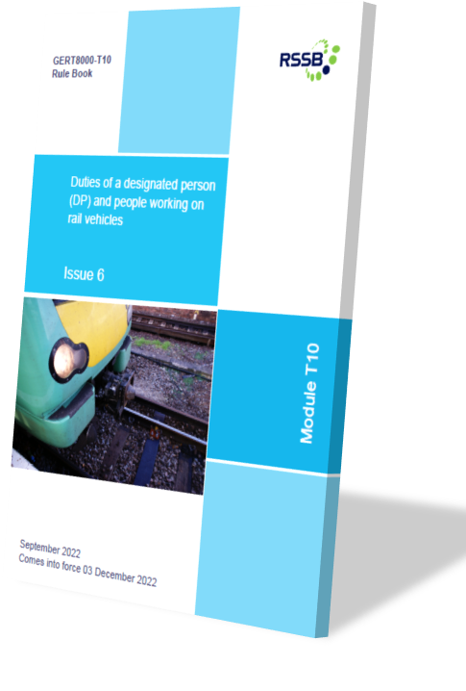
Changes to Standards – September 2022
GERT8000-T10 Duties of a designated person (DP) and people working on rail vehicles
RUs
Overview of changes -
It has been pointed out that in section 3.6 there is a lack of clarity as to the responsibility for removing vehicle protection when the work on a rail vehicle is suspended or has been completed. To make this clearer, the last person working on a rail vehicle to remove personal identification must now ask the DP whether the vehicle protection can now be safely removed. Previously that person was required to remove the vehicle protection which might not have been the correct action.
Section 4.3 has been changed to include a requirement when working on a vehicle to inform station staff if no driver or guard is present. These staff can also influence the movement of a train.
IMs
Continued
Notes:
Headlines ……….

Slide 30
Changes to Standards – September 2022
GERT8000-T10 Duties of a designated person (DP) and people working on rail vehicles
RUs
Overview of changes (continued) -
A proposal was made to include a section on working on a train, on-track machine or on-track plant within a possession, including who is responsible for arranging line protection. A new section 8 has been introduced. Section 8.1 describes who the DP must ask to stop any approaching train movements to be stopped. If work is to take place on an item of on-track plant on a running line or siding, the DP must ask the machine controller to make this request. Section 8.1 sets out in detail who must be asked to arrange line protection in all the various situations of the vehicle being on a running line under possession, on a siding under possession, when line protection is required on an adjacent running line, or on an adjacent siding. Section 8.2 describes the DP's actions when work has been completed and the line protection is no longer required.
The rules set out who must be asked in the various situations of :
a portion of line under the PICOP’s control. • a portion of line under the ES’s control.
a line adjacent to one not under possession. • A siding under possession.
A line or siding adjacent to the sidings possession, under possession or not.
For full details of the changes made please read Rule Book Briefing Leaflet Issue38 December 2022
IMs
Notes:
Headlines ……….

Slide 31
Changes to Standards – September 2022
GERT8000-TS1 General signalling regulations
RUs
Overview of changes -
The Rule Book has been reviewed to remove cases of gender-specific language which can be taken as an assumption that only males are involved. This may deter applications for employment or promotion. To overcome this, the term 'pilotman’ is being changed to 'pilot' throughout the Rule Book. All references in this module have been changed. As there may be a lapse of time before all corresponding changes can be made, it should be noted that the former term 'pilotman' might still be used, but is to be taken as having the same meaning as 'pilot'.
Changes have been made to remove any references to level crossings as being 'manned' and replace these with the term 'manually-controlled'. However in the case of regulation 3.5.3 the requirement to use a reminder appliance when equipment at a manned level crossing must not be operated is incorrect as written, as this would apply to any of the types of level crossing listed as 'controlled' level crossings in module TS9 Level crossings - signallers' regulations, and this has been corrected.
Regulation 13.2 describes, from a signaller's point of view, the requesting and granting of a line blockage. It is described in terms of a blockage of one line only and the signaller only being able to grant a line blockage if the protecting signal or block marker is within that signaller's area of control.
IMs
Continued
Notes:
Headlines ……….

Slide 32
Changes to Standards – September 2022
GERT8000-TS1 General signalling regulations
RUs
Overview of changes (continued) -
Frequently, the request is for a blockage of more than one line, with one protecting signal being controlled by another signaller. It has become an accepted practice for a signaller to treat this as one request and liaise as necessary with the other signaller. This is not compliant with the signalling regulation and the wording has been changed to allow this so that the situation is dealt with in a consistent manner.
There are other situations that are not explicitly addressed in the current rules and regulations and may therefore be dealt with by local interpretation of the correct action. Inclusion of more detailed instructions would assist in such line blockages being arranged in a way that is accepted as an industry standard process. These include the limits of a line blockage over a single or bi-directional line. It is now explained that if two signallers are involved one of them grants the line blockage from a protecting signal or block marker, having spoken to the other signaller and agreed that signaller will keep a signal protecting the line blockage at danger, or keep the route closed at a block marker.
The term 'protecting signal' has caused some confusion with other signals that must be kept at danger to protect a line blockage and a fuller explanation has ben given, that the signal or block marker that controls the entry to the portion of line that is to be blocked is the signal or block marker referred to as the protecting signal or block marker on a NR3180 line blockage form
IMs
Continued
Notes:
Headlines ……….

Slide 33
Changes to Standards – September 2022
GERT8000-TS1 General signalling regulations
RUs
Overview of changes (continued) -
Any other signal that must be kept at danger, or block marker where the route must be closed, is referred to on the form as an 'additional signal’. The use of block signalling equipment to keep a signal at danger is an action that is always taken when a line blockage is to be taken. The requirement to provide additional protection for line blockages to the maximum extent possible has identified that, in an absolute block section, the opportunities for providing that additional protection are limited, particularly should the request be made by a person who is to work alone. The use of the block indicator to maintain the protecting signal at danger can now be regarded as a form of additional protection.
If two signallers co-operate in providing a means of preventing a protecting signal from being cleared it is equivalent to the degree of security provided by other forms of additional protection such as a disconnection or use of a track circuit operating device (T-COD). On a tokenless block line, the block instruments can also be used as a type of additional protection.
An explanation has been included of the purpose served by each of the permitted methods of additional protection.
Regulation 13.2.7 now includes a reference to carrying out absolute block regulation 3.6.14 when a block indicator has been kept at ‘train on line’ in connection with a line blockage.
For full details of the changes made please read Rule Book Briefing Leaflet Issue38 December 2022
IMs
Notes:
Headlines ……….

Slide 34
Changes to Standards – September 2022
GERT8000-TW1 Preparation and movement of trains
RUs
Overview of changes -
To improve the clarity of the intention of the instructions in section 1 concerning abnormal brake applications, this has been changed to say that the same arrangements should be applied when a train protection system has intervened and caused a brake application without the train being brought to a stand.
An incident involving isolating the brake on one vehicle of a four-car electric multiple unit (EMU), led to debate as to the correct instructions to be applied from those contained in modules TW1 and TW5 Preparation and movement of trains Defective or isolated vehicles and on-train equipment and whether the term 'coaching stock' included multiple-unit vehicles. It was suggested that the instructions in section 4.4 be reviewed and reissued in a combined form or repeated completely in both modules. The wording in this module has been changed to explain that coaching stock applies to both locomotive-hauled and multiple-unit stock, that the instructions would also apply during a journey, and to make reference to instructions in module TW5 that must also be taken into account.
IMs
Continued
Notes:
Headlines ……….

Slide 35
Changes to Standards – September 2022
GERT8000-TW1 Preparation and movement of trains
RUs
Overview of changes (continued)-
A freight operator wished to allow a single freight train to operate in a formation which, at a later stage en route, can be uncoupled to form two separate forward services. A dead diesel locomotive is therefore conveyed within the consist at the head of what will constitute the second train. This avoids additional resource requirements such as shunt movements, employee time, pathing time, and fuel usage. Benefits claimed include improved system safety by avoiding shunting operations and that the improved efficiency of the method of working makes rail more attractive leading to societal benefits. As this method of operation could be applied to other air-braked freight trains, section 7.4 has been changed to permit this on a general basis, subject to company instructions allowing it. This would depend on the ability to achieve similar train braking characteristics to those which would be the case if a dead locomotive is not marshalled within the train consist. The rule states a dead locomotive can be formed anywhere in the train except immediately behind the hauling locomotive or at the extreme rear, only if the train operating company instructions allow this and if any other instructions they contain are carried out.
IMs
Continued
Notes:
Headlines ……….

Slide 36
Changes to Standards – September 2022
GERT8000-TW1 Preparation and movement of trains
RUs
Overview of changes (continued)-
The existing instructions concerning use of the driver's reminder appliance (DRA) in section 10 have been changed so that the instructions would be applied on a European Rail Traffic Management System (ERTMS) line in the situations corresponding to those on a conventional line. The DRA is not a standard fitment of ERTMS-fitted traction units, so that the rules only apply if a DRA is provided.
The Rule Book has been reviewed to remove cases of gender-specific language which can be taken as an assumption that only males are involved. This may deter applications for employment or promotion. To overcome this, the term 'pilotman’ is being changed to 'pilot' throughout the Rule Book. All references in section 32 of this module have been changed. As there may be a lapse of time before all corresponding changes can be made, it should be noted that the former term 'pilotman' might still be used, but is to be taken as having the same meaning as 'pilot’.
For full details of the changes made please read Rule Book Briefing Leaflet Issue38 December 2022
IMs
Notes:
Headlines ……….

Slide 37
Changes to Standards – September 2022
GERT8000-TW5 Preparation and movement of trains: Defective or isolated vehicles and on-train equipment
RUs
Overview of changes -
A number of sections of the module have been changed to provide further clarity in areas known to be causing confusion, improve consistency in the application of rules or to clarify terminology.
For full details of the changes made please read Rule Book Briefing Leaflet Issue38 December 2022
IMs
Notes:
Headlines ……….

Slide 38
Changes to Standards – September 2022
GERT8000-TW7 Wrong-direction movements
RUs
Overview of changes -
This module has been changed following an incident in which a train was authorised to make a wrong-direction movement of some 20 minutes duration in darkness and to stop opposite a signal on an adjacent opposite line. The driver misunderstood the intended limit of the movement and ran through points onto a portion of line open to traffic. The Rule Book now states that if the wrong direction movement is to a location that might be difficult to identify it should be authorised as far as a clearly identifiable location, similar to the rules for Emergency Special Working. On reaching that location, the driver will ask the signaller for further instructions. This should mitigate against miscommunication or misunderstanding and also help in the event of darkness or poor visibility.
The Rule Book has been reviewed to remove cases of gender-specific language which can be taken as an assumption that only males are involved. This may deter applications for employment or promotion. To overcome this, the term 'pilotman’ is being changed to 'pilot' throughout the Rule Book. All references in this module have been changed. As there may be a lapse of time before all corresponding changes can be made, it should be noted that the former term 'pilotman' might still be used, but is to be taken as having the same meaning as 'pilot'. Changes have been made to remove any references to level crossings as being 'manned' and replace these with the term 'manually-controlled.
For full details of the changes made please read Rule Book Briefing Leaflet Issue38 December 2022
IMs
Notes:
Headlines ……….

Slide 39
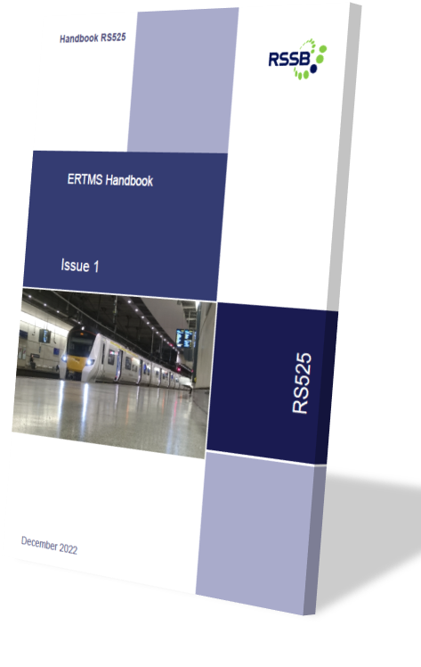
Changes to Standards – September 2022
RS525 ERTMS Handbook
RUs
Overview -
This is a new information handbook intended for use by anyone who needs to understand how the European Rail Traffic Management System (ERTMS) operates on the GB network.
It explains the basic concepts and operating principles of ERTMS to front line staff.
It provides specific reference material and guidance relating to ERTMS principles and operation. It is designed to complement formal training by providing additional guidance and information beyond the rules contained within the Rule Book.
By giving frontline staff the underpinning knowledge needed to understand ERTMS operation, the handbook will enable them to make safe decisions in degraded working, and help them to operate the system correctly and effectively.
This will improve safety and reliability and operational performance, as decisions will be made quickly, safely and efficiently under ERTMS.
For full details of the changes made please read Rule Book Briefing Leaflet Issue38 December 2022
IMs
Notes:
Headlines ……….

Slide 40
Changes to Standards – September 2022
Rule Book forms
RUs
The following forms have been published –
Form RTWO04 Issue 12-22 Written Order 04 Permission to Make a Wrong-Direction Movement Form
Form RTWO05 Issue 12-22 Written Order 05 Permission to Proceed Under Modified Working Arrangements on Single and Bi-Directional Lines
Form RT3154 Issue 12-22 Pilot’s form for Working Single and Bi-Directional ERTMS Lines by Pilot Form RT3154 ERTMS Issue 12-22 Pilot's form for working of single and bi-directional ERTMS lines by Pilot
Form RT3155 Issue 12-22 Signaller’s form for Working Single and Bi-Directional Lines by Pilot
Form RT3155 ERTMS Issue 12-22 Signaller’s form for Working Single and Bi-Directional ERTMS Lines by Pilot
Form RT3156 Issue 12-22 Driver’s Ticket for Working Single and Bi-Directional Lines by Pilot
Form RT3156 ERTMS Issue 12-22 Driver’s Ticket for Working Single and Bi-Directional Lines by Pilot
Form RT3191 Issue 12-22 Pilot's Single Line Working Form
Form RT3192 Issue 12-22 Signaller's Single Line Working Form
Form RT3193 Issue 12-22 Driver’s Single Line Working Ticket Movement in the Right Direction
Click on the form to access it on the RSSB website
IMs
Notes:
Headlines ……….

Slide 41
Changes to Standards – September 2022
Changes to Railway Related Legislation since June 2022
IMs
Interoperability - Minor corrections to the Infrastructure and Safety in Railway Tunnels NTSNs
The Department for Transport (DfT) has made minor corrections to the Infrastructure (INF) and Safety in Railway Tunnels (SRT) National Technical Specification Notices (NTSNs) to address errors in the NTSNs published on 1 January 2021. The changes ensure the NTSNs reflect the versions of the Technical Specifications for Interoperability that were in force on 31 December 2020.
The INF NTSN was updated to include mIssing text in clause 5.3.2 about rail fastening systems and remove redundant text in clause 4.2.4.4 relating to abrupt change of cant deficiency. Appendix C2 was also amended to include the list of defined characteristics relating to bearers.
The SRT NTSN was updated to include clauses 7.2.3 and 7.2.4 relating to the operation subsystem and operation of new rolling stock in existing tunnels. A minor change was also made to correct the numbering in clause 1.1.1 relating to the scope of the NTSN.
The correct versions of all NTSNs are currently listed on the DfT webpages.
Projects
More
Notes:
Headlines ……….

Slide 42
Changes to Standards – September 2022
Changes to Railway Related Legislation since June 2022
RUs
Interoperability - Ending recognition of EU certificates for interoperable rail products
The Department for Transport (DfT) is planning legislative changes to end recognition of EU certificates for interoperable rail products in Great Britain. These changes will be effective from 1 January 2023.
After the end of the EU Exit Transition Period in January 2021, it remained possible to place certain manufactured goods on the GB market. These goods required marking or documentation signifying conformity to EU rules without the need for reassessment against identical UK rules. This extended recognition period included rail products regulated under the Railways (Interoperability) Regulations 2011, which are named in National Technical Specification Notices (NTSNs). This was always intended as a temporary measure to ease the transition to the new UK regulatory framework.
For more information visit the Railway Legislation News page on the RSSB website
IMs
Projects
Suppliers
Back
More
Notes:
Headlines ……….

Slide 43
Changes to Standards – September 2022
Changes to Railway Related Legislation since June 2022
RUs
Safety - Ending recognition of EU ECM certification
DfT is planning legislative changes to end the recognition of EU certificates for entities in charge of rail vehicle maintenance (ECMs) responsible for vehicles in domestic-only operations in Great Britain. These changes will be effective from 1 January 2023.
Once the recognition of EU ECM certification for domestic-only operations ends, ECMs will need to obtain UK ECM certification for vehicles involved in domestic-only operations. This will support ORR to monitor the adequacy of surveillance arrangements by the ECM certification bodies and ECMs. UK ECM certification can be obtained from a UK certification body accredited by the United Kingdom Accreditation Service (UKAS).
The planned legislative changes will allow the UK to recognise ECM certificates issued in accordance with the legal framework of the Convention concerning International Carriage by Rail (COTIF) for international traffic.
DfT strongly advises obtaining ECM certification from a UK certification body if vehicles that you are responsible for maintaining have ECM certification issued by an EU certification body. This will ensure that your maintenance activities can continue to be valid from 1 January 2023.
For more information visit the Railway Legislation News page on the RSSB website
IMs
Projects
Suppliers
Back
Notes:
Headlines ……….

Slide 44
Changes to Standards – September 2022
Non RSSB
4 Non RSSB standards and 2 posters have been published on the RSSB website
COP0002 Issue 12 - Code of Practice for Planning for the Use of Mobile Operated Plant
COP0024 Issue 7 - Code of Practice for Use and Loading of MEWPs
COP0047 Issue 1 - Code of Practice for Protection of non PTS holders at OTM stabling points
Poster P11 Issue 1 - Injection Injury
Poster P6 Issue 6 - Points run throughs
Click on the title to access the standard on the RSSB website
Notes:
Headlines ……….

Slide 45
Changes to Standards – September 2022
26 Deviations Issued
There has been 17 deviations issued against GLRT1210 Issue 2 - AC Energy Subsystem and Interfaces to Rolling Stock Subsystem. All of them are for different overbridges where the cost of compliance with the requirement is not justified, based on the safety benefits achieved by compliance. They are -
22-046-DEV; Overbridge OB090/123
22-044-DEV; Overbridge OB113/014
22-035-DEV; Overbridge OB223/022A
22-037-DEV; Overbridge OB223/015A1
22-048-DEV; Overbridge MVL3/105
22-040-DEV; Overbridge OB223/036
22-045-DEV; Overbridge OB090/093A
22-042-DEV; Overbridge OB090/016
22-043-DEV; Overbridge OB090/012
22-041-DEV; Overbridge OB090/026A
22-047-DEV; Overbridge MVL3/90
22-049-DEV; Overbridge MVN2/201
Link to all deviations on RSSB website
More
Click on the title to access the deviation on the RSSB website
Notes:
Headlines ……….

Slide 46
Changes to Standards – September 2022
26 Deviations Issued
22-038-DEV; Overbridge OB223/018
22-039-DEV; Overbridge OB223/018A1
22-036-DEV; Overbridge OB223/023A1
22-033-DEV; Overbridge OB090/009-1
22-020-DEV; GERT8000-TW1 Issue 17 - Preparation and movement of trains SLC Operations intend to operate Class 43 in pairs on either end of a train formation to remove the need to run the locomotives around when changing the direction of travel and to add additional brakeforce if required. SLC Operations wish to operate with a pair of locomotives marshalled at the rear of a train.
21-006-DEV; GIRT7020 Issue 1.1 - GB Requirements for Platform Height, Platform Offset and Platform Width Existing high platforms at Rectory Road present challenges in providing satisfactory clearance to the new class 720 rolling stock. temporary variation. This is whilst we seek a permanent solution."
Back
More
Link to all deviations on RSSB website
Click on the title to access the deviation on the RSSB website
Notes:
Headlines ……….

Slide 47
Changes to Standards – September 2022
26 Deviations Issued
21-014-DEV; GIRT7073 Issue 2 - Requirements for the Position of Infrastructure and for Defining and Maintaining Clearances. This application concerns an increase to the gap filler dimensions to address a change in rolling stock on Heathrow Express services .
22-031-DEV; GLRT1210 Issue 2 - AC Energy Subsystem and Interfaces to Rolling Stock Subsystem The introduction of electrification onto the Midland Mainline route means lineside assets found to be within the Overhead Contact Line Zone (OCLZ) require earthing and bonding or separation.
22-023-DEV; GERT8075 Issue 2 - AWS and TPWS Interface Requirements The scope of the deviation applies only to Auto-Reverse moves on the core operating section of the Elizabeth Line.
Back
More
Link to all deviations on RSSB website
Click on the title to access the deviation on the RSSB website
Notes:
Headlines ……….

Slide 48
Changes to Standards – September 2022
26 Deviations Issued
22-050-DEV; GIRT7020 Issue 1.1 - GB Requirements for Platform Height, Platform Offset & Platform Width Covering the hoarding installed on Platforms 1 and 4 at Broxbourne Station, during construction work to extended them to accommodate the new, longer Class 720 trains.
21-049-DEV; GIRT7020 Issue 1.1 - GB Requirements for Platform Height, Platform Offset & Platform Width Platforms 3 and 4 at Surbiton Station, during construction of a new staircase and overbridge.
22-052-DEV; GIRT7020 Issue 1.1 - GB Requirements for Platform Height, Platform Offset & Platform Width Platform 1 at Broxbourne is being extended, during construction there will be a temporary step between platform 1 and 2
22-051-DEV; GIRT7020 Issue 1.1 - GB Requirements for Platform Height, Platform Offset & Platform Width Platform 1 at Broxbourne is being extended, during construction the coper to coper width of the island at the last passenger door will be reduced to 3.5m
Back
Link to all deviations on RSSB website
Click on the title to access the deviation on the RSSB website
Notes:
Headlines ……….

Slide 49
Standards planned for publishing in 2022
December 2022
RIS-1853-ENE Issue 1 - AC energy Subsystem and Interfaces to Rolling Stock Subsystem
GLRT1210 Issue 3 - AC energy Subsystem and Interfaces to Rolling Stock Subsystem
GLGN1610 Issue 1 (Withdrawal) – Guidance on AC energy Subsystem and Interfaces to Rolling Stock Subsystem
RIS-2715-RST Issue 1 - Rolling Stock Subsystem and Interfaces to AC Energy Subsystem
GMRT2111 Issue 3 - Rolling Stock Subsystem and Interfaces to AC Energy Subsystem
GMGN2611 Issue 1 (Withdrawal) - Guidance on Rolling Stock Subsystem and Interfaces to AC Energy Subsystem
Back
More

Slide 50
Standards planned for publishing in 2022
December 2022 (Continued)
GERT8073 Issue 4.1 – Application of Standard Vehicle Gauges
RIS-8072-CCS Issue 2 – ERTMS National Identities Management
Back

Slide 51
Standards currently being drafted and due for consultation
September 2022
RIS-1853-ENE Issue 1 - AC energy Subsystem and Interfaces to Rolling Stock Subsystem
GLRT1210 Issue 3 - AC energy Subsystem and Interfaces to Rolling Stock Subsystem
GLGN1610 Issue 1 (Withdrawal) – Guidance on AC energy Subsystem and Interfaces to Rolling Stock Subsystem
RIS-2715-RST Issue 1 - Rolling Stock Subsystem and Interfaces to AC Energy Subsystem
GMRT2111 Issue 3 - Rolling Stock Subsystem and Interfaces to AC Energy Subsystem
GMGN2611 Issue 1 (Withdrawal) - Guidance on Rolling Stock Subsystem and Interfaces to AC Energy Subsystem
More Standards
Link to the standards consultation page on the RSSB website

Slide 52
Standards currently being drafted and due for consultation
September 2022
GMRT2466- Issue 5 - Railway Wheelsets
RIS-2766-RST Issue 2 - Rail Industry Standard for Wheelsets
GIRT7073 Issue3 - Requirements for the Position of Infrastructure and for Defining and Maintaining Clearances
GEGN8573 Issue 4 - (withdrawal); Guidance on Gauging and Platform Stepping Distances
Back
More
Link to the standards consultation page on the RSSB website

Slide 53
Standards currently being drafted and due for consultation
November 2022
RIS‐1530‐PLT Issue7 - Technical requirements for On‐track Plant and their associated equipment & trolleys
RIS-2714-RST Issue 1 -Axlebox Bearing Condition Monitoring
GEGN8614 Issue 1 (Withdrawal) - Guidance on Axlebox Condition Monitoring
GERT8014 Issue 2 (Withdrawal) - Axlebox Condition Monitoring
GMGN2696 Issue 1 – Assessment of Passenger Seat Comfort
Back
More
Link to the standards consultation page on the RSSB website

Slide 54
Standards currently being drafted and due for consultation
November 2022
RIS 0798 CCS Issue 1 (withdraw) - ERTMS/ETCS Baseline 3 Onboard Subsystem Requirements
RIS-0799-CCS Issue 1 - ERTMS/ETCS Baseline 3 Onboard Subsystem Requirements
RIS-0797-CCS Issue 1 (withdraw) - ERTMS/ETCS Baseline 3 Onboard Subsystem Requirements: Retrofit
December 2022
GCRT5021 Issue 6 - Track System Requirements
RIS-7707-INS Issue1 - Infrastructure requirements for Switches and Crossings
Back
More
Link to the standards consultation page on the RSSB website

Slide 55
Standards currently being drafted and due for consultation
December 2022 (continued)
RIS‐8034‐CCS Issue2 ‐ Maintenance of Signal and Operational Sign Visibility
RIS-0746-CCS Issue 1 - Block System Interface Requirements
GKGN0655 Issue 1(withdrawal) - Guidance on Block System Interface Requirements
GKRT0055 Issue 1 (withdrawal) - Block System Interface Requirements
BR1654 issue 2 (withdrawal) - Radio Electronic Token Block System
Back
More
Link to the standards consultation page on the RSSB website

Slide 56
Standards currently being drafted and due for consultation
December 2022 (continued)
RIS-8250-RST Issue 2 - Reporting High Risk Defects
Form 8250 Issue 4 - Reporting High Risk Defects
Back
Link to the standards consultation page on the RSSB website

