Slide 1
Changes to standards December 2024 Interactive briefing
Navigate using the arrows buttons
Return to main menu by clicking the home icon
This icon links to online content
Click this icon to exit the presentation
This icon will be displayed when slide have audio
View in slideshow mode for live links

Slide 2
Changes in the December 2024 standards update
Draft standards scheduled to be published in March 2025
Draft standards scheduled for consultation
Click a button to proceed

Slide 3
Changes in the December 2024 standards update
Plant
Rolling stock
Data, Systems, and Telematics
No standard updates
2 standards updated
1 technical note
1 standard updated
Control, Command, and Signalling
Non-RSSB standards
Infrastructure
1 new standard
1 standard updated
1 technical note
No standard updates
2 standards updated
Energy
Rail-related legislation
Operations
1 standard updated
5 point releases
No standard updates
2 Safety and 1 EU Exit news items
Click the icons with red rings for detail on those changes

Slide 4
Changes to standards – December 2024
Two Rolling Stock standards and one Technical Note have been updated in the December 2024 Standards Catalogue.
RIS‐2704‐RST – Issue 2 – Rail Industry Standard for Wheelsets Handling and Storage
RIS‐2709‐RST – Issue 2 – Rail Industry Standard for the Identification of Roller Bearings
TN2323 – Issue 1 – Guidance on wagon maintenance related to recommendations from RAIB reports
Click on a play button to find out more about the change.

Slide 5
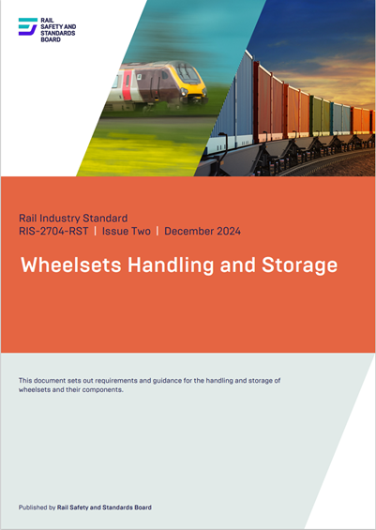
Changes to standards – December 2024
RIS‐2704‐RST – Issue 2 – Rail Industry Standard for Wheelsets Handling and Storage
Overview – RIS-2704-RST Issue 2 sets out the requirements and guidance for wheelset manufacturers, overhaulers and maintainers on the handling and storage of railway wheelsets. The standard includes guidance on serviceable and unserviceable wheelsets. The standard reflects on current industry good practice in preserving the condition of wheelsets.
Benefits – Wheelsets and axle bearings are high-value components that could fail prematurely in service or be scrapped if handled incorrectly. The additional guidance will help to avoid the unscheduled removal of vehicles from service or the premature scrapping of expensive parts.
Audience – This standard update is of particular interest to personnel involved in the storage and management of wheelsets at:
Rolling stock owning companies (RoSCos)
Train operating companies (TOCs)
Freight operating companies (FOCs)
Entities in charge of maintenance (ECM)
Wheelset and bearing manufacturers and overhaulers
ROSCOs
RU
Suppliers
overhaulers
ECMs
Click on the link icon to go to the standard

Slide 6
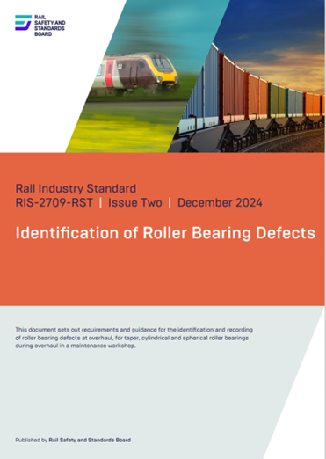
Changes to standards – December 2024
RIS‐2709‐RST – Issue 2 – Rail Industry Standard for the Identification of Roller Bearings
Overview – RIS‐2709‐RST – Issue 2 sets out requirements for the inspection and recording of axle bearing component defects during overhaul. It also provides a common definition and reporting code for each defect type with photographic examples of each defect.
Benefits – The improved clarity of the photographic examples will assist inspectors in making and recording judgements, resulting in improved defect control and bearing failure trends in service.
Audience – This standard update is of particular interest to personnel involved in the inspection and recording of axle bearing defects at:
Bearing overhaulers
Train operating companies (TOCs)
Freight operating companies (FOCs)
Entities in charge of maintenance (ECM)
RU
Suppliers
overhaulers
ECMs
Click on the link icon to go to the standard

Slide 7
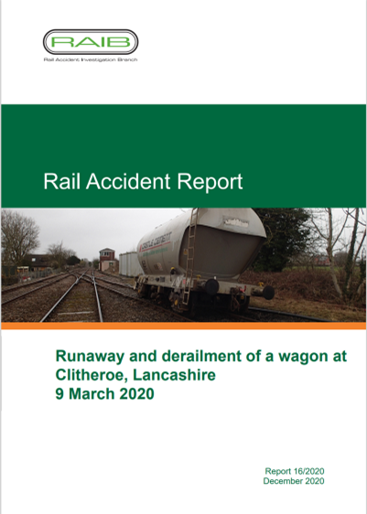
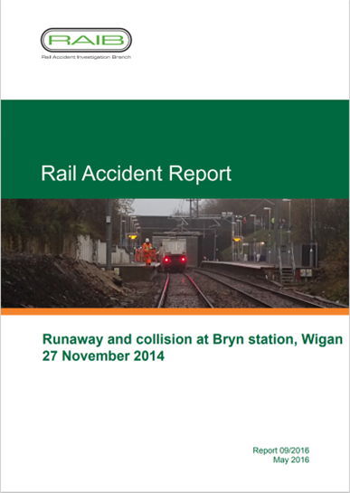
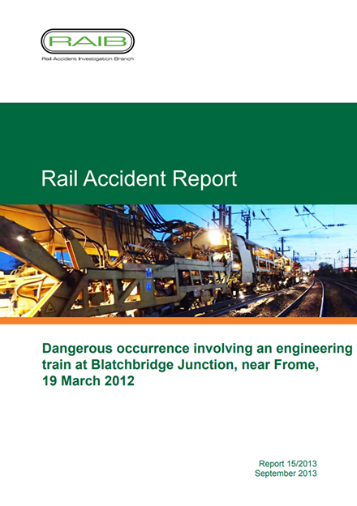
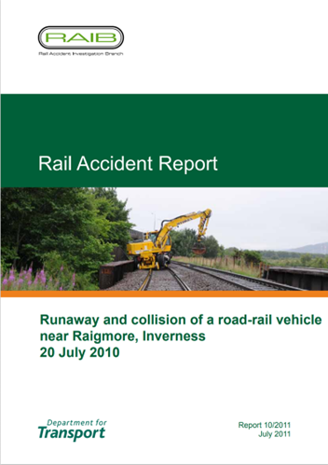
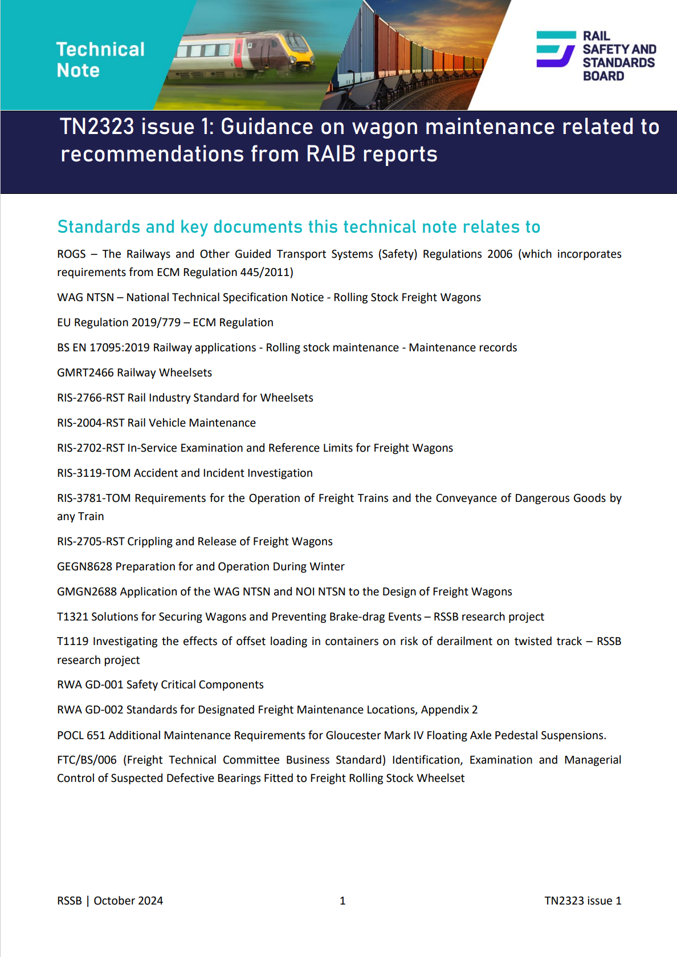
Changes to standards – December 2024
TN2323 Issue 1 – Guidance on wagon maintenance related to recommendations from RAIB reports
Overview – This is a new document. It has been prepared as an initial response to Recommendation 8 of RAIB report 01/2022 into the derailment at Llangennech. It is aimed at all entities that have a responsibility for designing, building, owning, operating, and maintaining freight wagons. It draws together the learning from all RAIB reports, bulletins, and safety digests relating to freight wagon maintenance, in the form of guidance.
RU
ROSCOs
ECMs
Builders
Click on the link icon to go to the standard

Slide 8
Changes to standards – December 2024
One Data, Systems, and Telematics standard has been published in the December 2024 Standards Catalogue.
RIS‐6702‐DST Issue 1 – Time and Date in Railway Systems
Click on a play button to find out more about the change.

Slide 9
Changes to standards – December 2024
RIS‐6702‐DST Issue 1 – Time and date in railway systems
Overview – Systems on the railway use different sources of time and date information, however the information obtained from these sources is not necessarily aligned. For example, at time of writing, Coordinated Universal Time (UTC) lags 37 seconds behind atomic clock time, and 18 seconds behind GPS time. Without knowledge of this, or if it is not apparent which time source a system is using, there is a risk that when timestamps from two disparate systems are compared or aggregated, the sequence of events are masked, confused, or appear falsely aligned. This could lead to both poor quality or delayed incident or failure investigations.
Benefits – By providing guidance on time, particularly the time sources available and how to translate between them, accident, incident, and failure investigations can progress more quickly. This is particularly relevant where two or more sources of timestamped data need to be compared and harmonised to establish the sequence of actions that led to the event. In many cases, this is not a trivial activity, and this standard can save investigators’ time. Where investigations can progress more quickly, underlying causes and defects are identified sooner and therefore actions and risk mitigations can be put in place earlier. This will potentially prevent an unwanted event occurring in future.
Audience – Railway undertakings, infrastructure managers, the supply chain, rolling stock owners, and maintainers, procurement teams.
RU
IM
Suppliers
Procurement
ROSCOs
Maintainers
Click on the link icon to go to the standard

Slide 10
Changes to Standards – December 2024
Two Control, Command and Signalling standards have been updated in the December 2024 Standards Catalogue.
RIS‐0793‐CCS Issue 1 – Level Crossing System Integration
RIS-0733-CCS Issue 1.2 – Lineside Operational Signs
One new Control, Command and Signalling technical note has been added in the December 2024 Standards Catalogue.
TN0301 – TPWS Receiver Aerial Location
Click play to find out more about the change

Slide 11
Changes to Standards – December 2024
RIS‐0793‐CCS Issue 1 – Level Crossing System Integration
Overview – The principal unwanted event at a level crossing (LC) is a collision of a train and a level crossing user, which occurs when both occupy the level crossing conflict area at the same time. The RSSB safety risk model provides evidence that collision risk at LC is significantly higher than at bridges or subways.
Benefits – The Level Crossing Regulations 1997, made under the Level Crossing Act 1983, place obligations on the operator of the level crossing (infrastructure manager) and the local traffic authority to implement safety and protection arrangements. The content of RIS-0793-CCS provides requirements and guidance that an operator of the level crossing can use to inform the design of level crossing safety and protection arrangements that are capable of mitigating risk. The application of RIS-0793-CCS is estimated to provide a benefit of £1.44M over ten-years, through a reduction in level crossing risk and efficiencies in the design and operation of level crossing systems (LC Systems). The requirements and guidance in RIS-0793-CCS are agnostic of existing level crossing system designs, which is intended to facilitate innovation in the application of technology to LC systems.
Audience – Infrastructure managers, Railway undertakings, System integrators, Suppliers, Conformity assessment bodies, Safety assessment bodies
RU
IM
System Integrators
Assessment Bodies
Click the link icon to go to the standard

Slide 12
Changes to Standards – December 2024
RIS-0733-CCS Issue 1.2 – Lineside Operational Signs
Overview – There has been a minor update to this standard.
References to level crossing signs CC01 to CC17 have been removed from Appendix F. They have been replaced by those specified in The Private Crossings (Signs and Barriers) Regulations 2023.
Click the link icon to go to the standard

Slide 13
Changes to Standards – December 2024
TN0301 – TPWS Receiver Aerial Location
Overview – This technical note is a new document and has been produced to highlight technical compatibility issues that can occur when TPWS is fitted in areas that use TI.21 (EBI Track 200) track circuits. The guidance provided in this technical note is intended to complement existing information provided in RIS-0775-CCS. It aims to provide guidance to assist in the safe integration of TPWS subsystems with train operations.
Audience – Infrastructure managers, railway undertakings, system integrators, suppliers, conformity assessment bodies, safety assessment bodies, project entities, and rail vehicle owners
RU
IM
System Integrators
Assessment Bodies
Click the link icon to go to the standard

Slide 14
Changes to Standards – December 2024
One Traffic Operation and Management standard has been updated in the December 2024 Standards Catalogue.
RIS‐3751‐TOM – Issue 4 – Psychometric Assessment in Train Driver Selection and associated forms
Click play to find out more about the change
Point Releases

Slide 15
Changes to Standards – December 2024
Five Traffic Operation and Management point releases have been made in the December 2024 Standards Catalogue.
GOGN3616 Issue 1.1 – Guidance on Operational Railway Safety Awareness
Handbook 9 Issue 8.1 – IWA or COSS setting up safe systems of work within possessions
Module TS1 Issue 18.1 – General signalling regulations
RS524 Issue 1.2 – List of dangerous goods and their United Nations numbers
GEGN8646 Issue 1.1 – Guidance on the Common Safety Method for Risk Evaluation and Assessment
Click on the links to go to the standard.
Back

Slide 16
Changes to Standards – December 2024
RIS‐3751‐TOM Issue 4 – Psychometric Assessment in Train Driver Selection and associated forms
Overview – The principles and requirements for occupational psychological assessments are contained in:
Operation and Traffic Management National Technical Specification Notice (OPE NTSN)
Train Driving Licences and Certificates Regulations 2010 (TDLCR)
ORR’s A guide to the occupational psychological fitness and medical requirements.
Together with outputs from research to validate selection criteria and the psychometric assessment process for GB mainline train driving, they are the basis from which RIS-3751-TOM has been developed.
Benefits – The updated standard provides clarity around the psychometric train driver assessment, ensuring the integrity of a well-established process is maintained. It enables the industry to use a more efficient and effective psychometric assessment process that is easier to follow, while also helping to reduce the time required to undertake certain parts. A robust process ensures employers can recruit drivers who are occupationally psychologically fit for the role. Not doing so carries a risk of injury and can contribute to performance delays due to error. The changes to this standard have the potential of saving the industry just under £4 million over five years.
Audience – This standard is intended for those responsible for the psychometric assessment process in the recruitment of GB mainline train drivers
RU
IM
Click the link icon to go to the standard

Slide 17
Changes to Standards – December 2024
Two safety news items and one EU exit news item have been published since September.
Safety – ORR publishes updated staff fatigue guidance
EU Exit – Change of references to ‘retained EU law’
Safety – ORR updates the list of ROGS mainline railway exclusions
Click play to find out more about the change
Point Releases

Slide 18
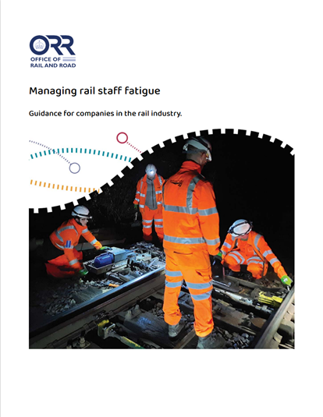
Changes to standards – December 2024
Safety – ORR publishes updated staff fatigue guidance
The Office of Rail and Road (ORR) has published updated guidance on managing rail staff fatigue. This follows a consultation earlier in 2024 on updating the guidance published in 2012. The updated guidance helps duty holders comply with their legal obligations. It provides an approach for companies in the rail industry to assess and control fatigue risk. It also provides advice on good practice

Slide 19
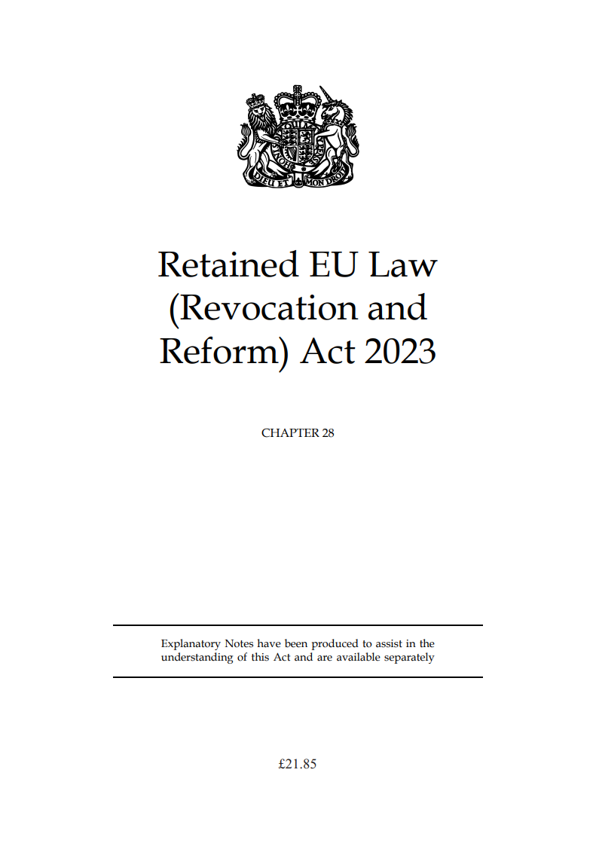
Changes to standards – December 2024
EU Exit – Change of references to ‘retained EU law’
On 31 December 2020, the European Union (Withdrawal) Act 2018 incorporated EU law applying to the UK onto the UK statute book. This created a new category of UK law called ‘retained EU law’. ‘Retained EU law’ includes EU regulations. It also includes UK legislation that implements EU directives. Commission Implementing Regulation (EU) 402/2013 is an example of an EU regulation. ROGS is an example of UK legislation that implements an EU directive. Therefore, these are both retained EU law.
Since 1 January 2024, the term ‘retained EU law’ has become ‘assimilated law’. Section 5 of the Retained EU Law (Revocation and Reform) Act 2023 made this change. The change is to reflect that EU law no longer influences interpretation of legislation on the UK statute book. This means that ‘retained EU law’ and related terms are now known as ‘assimilated law’ and related terms. For example, ‘retained direct EU legislation’ has become ‘assimilated direct legislation’. ‘Retained case law’ has become ‘assimilated case law’.

Slide 20
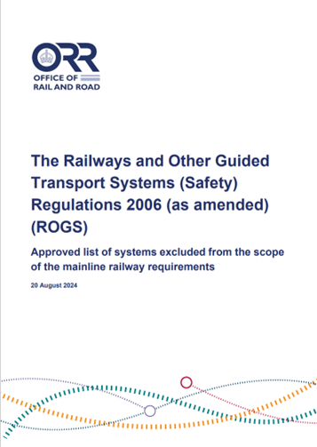
Changes to standards – December 2024
Safety – ORR updates the list of ROGS mainline railway exclusions
In August 2024, the Office of Rail and Road (ORR) updated its list of rail systems that are not part of the mainline railway. The ORR keeps the list in accordance with regulation 2A of the Railways and Other Guided Transport Systems (Safety) Regulations 2006 (as amended) (ROGS). It contains rail systems that ORR determines are not part of the mainline railway. Therefore, the mainline railway requirements in ROGS excludes those systems on the list. The updated list is published on ORR’s website.
Click on the link icon to go to the standard

Slide 21
Changes to Standards – December 2024
Two non-RSSB standards have been published on the RSSB website.
COP0012 Issue 8 – Code of Practice for Defect Reporting for OTP, Plant, and Equipment
COP0038 Issue 4 – Code of Practice for Defective OTP Safety Critical Equipment

Slide 22
Draft standards scheduled for publishing in March 2025.
Medical Fitness Requirements
RIS-3789-TOM Issue 1 – Medical Fitness Requirements
GOGN3655 (Withdrawal) – Guidance on Medical Fitness for Railway Safety Critical Workers
RIS-3451-TOM (Withdrawal) – Train Drivers – Suitability and Medical Fitness Requirements
RIS-3452-TOM (Withdrawal) – Train Movement – Medical Fitness Requirements
Continued

Slide 23
Draft standards scheduled for publishing in March 2025 (continued).
Implementation of Maintaining the Visibility of Signals and Operational Signs
RIS-7708-INS Issue 1 – Maintenance of Signal and Operational Sign Visibility
RIS-8034-CCS Issue 1 (Withdrawal) – Maintenance of Signal and Operational Sign Visibility
Rolling stock Code of Practice and standard
GMRC2542 Issue 2 – Recommendations for Determination of Aerodynamic Rolling Moment Coefficient
RIS-2702-RST Issue 3 – In-service Examination and Reference Limits for Freight Wagons
Continued

Slide 24
Draft standards scheduled for publishing in March 2025.
GERT8073 Issue 5 – Application of Standard Vehicle Gauges
GMRT2173 Issue 5 – Size of Vehicles and Position of Equipment
RIS-2700-RST Issue 3 – Rail Industry Standard for Verification of Conformity of Engineering Change to Rail Vehicles
RIS-0386-CCS Issue 2 – Rail Industry Standard on Signal Overrun Risk Evaluation and Assessment
RIS-3781-TOM Issue 2 – Requirements for the Operation of Freight Trains and the Conveyance of Dangerous Goods by Any Train
Continued

Slide 25
Draft standards scheduled for publishing in March 2025 (continued).
Introducing Special Working to the Rule Book
TN3301 Issue 1 – Extended Block Working
GERT8000-HB5 Issue 3 – Handsignalling duties
GERT8000-M1 Issue 8 – Dealing with a train accident or train evacuation
GERT8000-M2 Issue 8 – Train stopped by train failure
GERT8000-S5 issue 13 – Passing a signal at danger or an end of authority (EoA) without a movement authority (MA)
Continued

Slide 26
Draft standards scheduled for publishing in March 2025 (continued).
Introducing Special Working to the Rule Book (continued).
GERT8000-TS2 Issue 7 – Track circuit block regulations
GERT8000-TW1 Issue 21 – Preparation and movement of trains
RS521 Issue 8 – Signals, handsignals, indicators and signs Handbook
Form NR3190 Issue 2 – Emergency Special Working Ticket
Back

Slide 27
Draft standards scheduled for consultation in January 2025.
GMGN2697 Issue 1 – Guidance on Entity in Charge of Maintenance (ECM) Regulations
RIS-2717-RST Issue 1 – Audibility of Rail Vehicles
RIS-2718-RST Issue 1 – Visibility of Rail Vehicles
GMRT2131 Issue 2 – Audibility and Visibility of Trains

Slide 28
Draft standards scheduled for consultation in March 2025.
RIS-6701-DST Issue 1 – Unique Train Service Identifiers
GIGN7608 Issue 3 – Guidance on the Infrastructure Technical Specification for Interoperability
RS523 Issue 2 – GSM-R Handbook
RIS-3772-TOM Issue 1 – Rail Industry Standard for Speed Restriction Management
Continued

Slide 29
Draft standards scheduled for consultation in April 2025.
Reducing the use of detonators
GERT8000-AC Issue 8 – AC Electrified Lines
GERT8000-DC Issue 6 – DC Electrified Lines
GERT8000-HB5 Issue 3 – Handsignalling duties
GERT8000-P1 Issue 9 – Single Line Working
GERT8000-P2 Issue 8 – Working Single and Bi-directional Lines by Pilot
Continued

Slide 30
Draft standards scheduled for consultation in April 2025 (continued).
Reducing the use of detonators (continued).
GERT8000-TS2 Issue 6 – Track Circuit Block Regulations
GERT8000-TS3 Issue 8 – Absolute Block Regulations
Reviewing of emergency protection arrangements
GERT8000-M1 Issue 8 – Dealing With a Train Accident or Train Evacuation
GERT8000-M2 Issue 8 – Train Stopped by Train Failure
Continued

Slide 31
Draft standards scheduled for consultation in April 2025 (continued).
Reviewing safety competence and training requirements for guards
GOGN3678 Issue 1 – Guidance on training requirements for guards
Defective on-train equipment
GERT8000-TW5 Issue 13 – Preparation and movement of trains: Defective or isolated vehicles and on-train equipment
RIS-3437-TOM Issue 4 – Defective On-Train Equipment
Operation of trams and light rail or metro vehicles on mainline infrastructure
GEGN8502 Issue 2 – Operation of Trams and Light Rail or Metro Vehicles Over GB Mainline Controlled Infrastructure

Slide 32
Draft standards scheduled for consultation in April 2025 (continued).
Review of AC and DC Rule Book modules and Electrical Risk
GERT8000-AC Issue 8 – AC Electrified Lines
GERT8000-DC Issue 6 – DC Electrified Lines
GERT8000-HB16 Issue 6 – AC Electrified Lines
GERT8000-HB17 Issue 5 – DC Electrified Lines
GEGN8675 Issue 2 – Guidance Note on the Management of Electrical Risk Related to Operational Tasks on Electrified Lines
Continued

Slide 33
Draft standards scheduled for consultation in May 2025.
GEGN8615 Issue 2 – Guidance on the Application of the Person with Reduced Mobility National Technical Specification for Interoperability
Draft standards scheduled for consultation in June 2025.
Revision to DC Energy Collection Standards
RIS-1852-ENE Issue 1 – Rail Industry Standard for DC Conductor Rail Energy Subsystem and Interfaces to Rolling Stock Subsystem
GLGN1612 Issue 1 (withdrawal) – Guidance on DC Conductor Rail Energy Subsystem and Interfaces to Rolling Stock Subsystem
GMGN2613 – Issue 1 (withdrawal) – Guidance on Rolling Stock Subsystem and Interfaces to DC Conductor Rail Energy Subsystem
Continued

Slide 34
Draft standards scheduled for consultation in June 2025 (continued).
Revision to DC Energy Collection Standards (continued).
RIS-2716-RST Issue 1 – Rail Industry Standard for Rolling Stock Subsystem and Interfaces to DC Conductor Rail Energy Subsystem
GLRT1212 Issue 2 – DC Conductor Rail Energy Subsystem and Interfaces to Rolling Stock Subsystem
GMRT2113 Issue 2 – Rolling Stock Subsystem and Interfaces to DC Conductor Rail Energy Subsystem
New probabilistic gauging standard
RIS-3773-RST Issue 1 – Probabilistic Gauging
Back

