Slide 1
Trains unable to make normal progress

Slide 2
About these
Use this style of slide when your content is just plain text.
Changing the text in the footer:
In the Ribbon, select View > Slide Master.
In the Slide Master tab scroll up to the Number 1 master slide.
You can change the footer text in here.
When you have finished change your Presentation View to Normal.
Changes will be published in the September Periodical Operating Notice and will come into force on 5 September 2020
Notes:
We have updated the requirements for managing defective on-train equipment so that they permit a more proportionate approach to improve the performance when trains are defective. By consideringed whole system risk certain requirements concerning when passengers are detrained , introduces additional controls for duration and speed for defective passenger trains to continue to manage risk, but these are more proportionate and should improve the performance of defective trains have been relaxed, but additional controls on speed and duration have been introduced as a more effective means of managing risk. Read the update.

Slide 3
Trains unable to make normal progress - background
RAIB investigated an incident at Lewisham which led to a number of trains being delayed for long periods in severe winter weather conditions.
Because of the general disruption, the fact that the first train involved was struggling to make progress due to conductor rail icing was not fully appreciated.
A following train was held not far short of a station platform, and in turn a junction was blocked and seven trains were delayed.
Passengers self-evacuated from three trains, and the traction current had to be discharged, meaning that delays of over four hours occurred, with very unpleasant conditions for passengers.
RAIB concluded that in the absence of timely advice, any opportunity to minimise the effects through diverting the next train to an alternative platform or introducing emergency permissive working had been lost.

Slide 4
RAIB recommendation
The intent of this recommendation is to ensure that signallers and drivers respond in a timely manner to events that have the potential to result in a train being stranded or held at a signal for an extended period of time.
Network Rail (South East route) and Southeastern should work in conjunction with RSSB to provide suitable instructions and guidance to operations staff to help them determine when a train should be considered as stranded (as a result of it being unable to move, or make adequate progress), the timeframe within which this needs to be declared and the actions that then need to be taken. They should develop and publish suitable instructions, and where appropriate update the Rule Book (paragraphs 175a.ii and 176c).
This recommendation may also be applicable to other train operating companies and Network Rail routes.

Slide 5
Response to the recommendation
Arrangements were made locally that the driver of a train in difficulty from conductor rail icing would call the signaller using the words ‘ICE CALL’ which would be passed on to control and other signallers.
There are other situations such as rail adhesion and loss of traction power where if a signaller is aware quickly of a train in difficulty, it is possible to take actions to minimise the impact such as:
  Rerouting trains around the location where the train is standing.
  Holding trains in stations rather than on the open line.
  Introducing emergency permissive working to allow trains to be platformed.
  Mobilising any emergency response to the train in difficulty.

Slide 6
Trains unable to make normal progress – drivers’ instructions
Following an incident in which trains became stranded for long periods in poor conditions, the rules in section 41 of module TW1 have been changed.
There is a new requirement for the driver to tell the signaller, if possible, that the train is only making slow progress and may come to a standstill, because of reasons such as conductor rail icing, rail adhesion conditions or insufficient traction power.
The driver must carry out any instructions given by the signaller.

Slide 7
Trains unable to make normal progress – signallers’ instructions
These instructions apply when a signaller is told by a driver that a train has stopped out of course for any reason, or Is only making slow progress and may be brought to a standstill.
The purpose is to reduce the possibility of the train being overlooked and other trains becoming stranded or trapped.
The signaller must
    Take any actions that may prevent other trains being stopped as a result.
    Tell any other signaller who may be able to take this type of action
    Tell operations Control

Slide 8
Publication of the new rules
These rules have been included in the reissue of module TW1 published in September which comes into force on 5th December 2020.
As the situation may well arise more often during the autumn and winter period, the revised rules have been included in the September PON so that they can be applied as soon as possible.
The new rules would help to reduce the impact of a delay like that which occurred at Lewisham, and so avoid the effects on passengers on trains that become stranded in the course of a journey, as well as those waiting to begin their journeys.

Slide 9
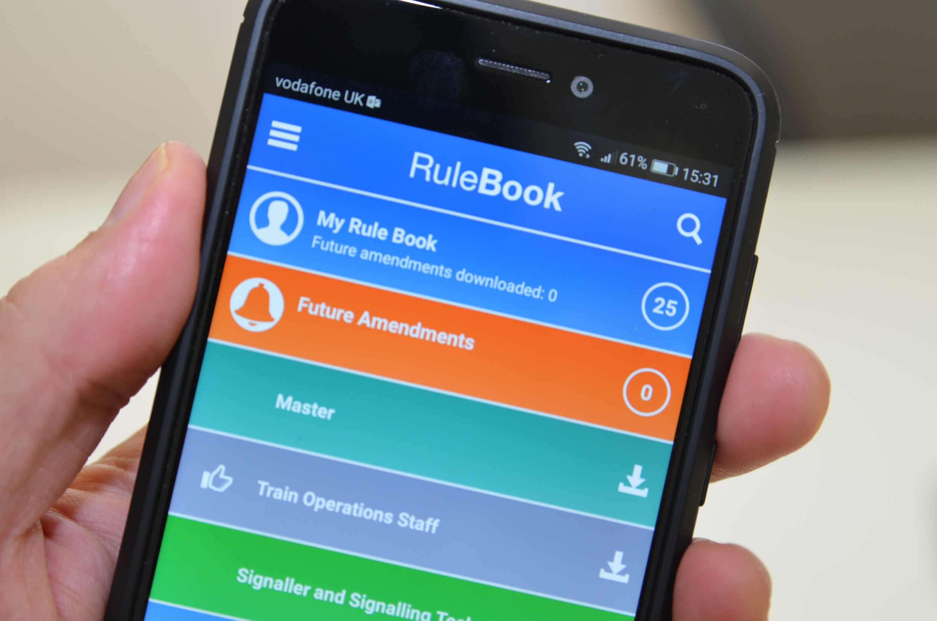
Reminders
Amendments
App
Talk to your manager

Slide 10
More information
Go to the RSSB website at www.rssb.co.uk for
The updated Rule Book module (issue 14.1)
Briefing Leaflet issue 33.1
This amendment has been published in the Rule Book App
It also appears in the September PON
It is included in issue 15 of Module TW1 from December.

